Slide 1
Tuesday and Wednesday
Here is a chance to show off your fabulous writing skills, using all those English skills you have learnt this term.
Remember to use interesting, adventurous language and practise editing and improving your work after your first draft.
If you want to email your work to me, or take a picture of your work I’d love to see it!

Slide 2
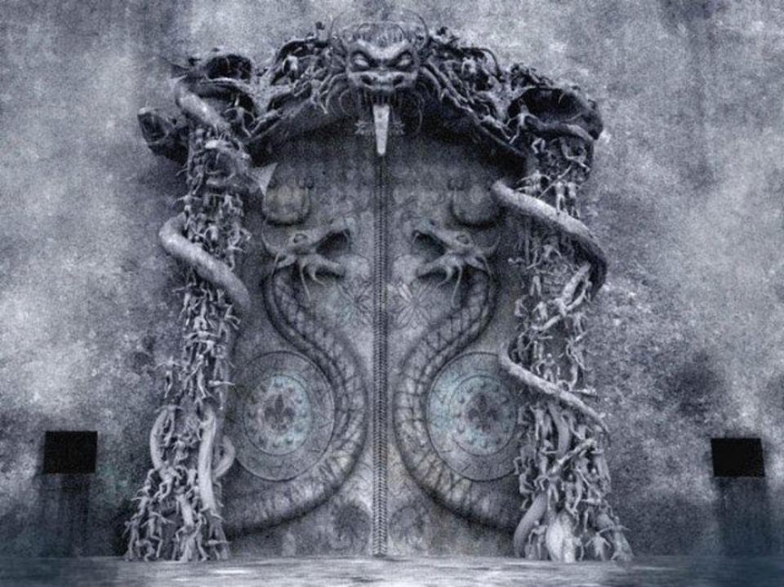
Task 1: The Door to …
Two friends, Sima and Mitul, are on holiday with their families. It is a hot, sunny day and they are on a crowded beach. Bored of swimming, they wander off to explore the quieter section of the beach where they discover a cave. They decide to venture into it and follow a narrow tunnel which ends in a large, decorated door. What is on the other side?
Write the rest of the story from the point where they open the door.

Slide 3
Task 1: The Door to …
Characters
Sima: confident, sporty and loves adventure.
Mitul: a great friend to Sima, a quieter character who loves solving puzzles.
A character who helps them (you decide).
Settings
A cave: dark with a long tunnel leading to a door.
Another world: a setting of your choice which the children enter via the door.
Other setting: within your imaginary world (you decide).
Events
Find the door and go through it to another world.
Meet a character who explains the dilemma – they can’t go back without the key.
The character gives them a map to direct them to the key.
Journey to get the key.
Get the key after solving a puzzle.
Do they return or not? Do they want to return?

Slide 4
Task 1: The Door to …
Mission: to write the story from the point where the children find the door. Use the ‘ingredients’ to plan and write a short, third person, past tense narrative that demonstrates your ability to be imaginative and grab the reader’s interest.
Before you write:
Map out the events of your story in more detail. Consider the ending – will you create a wonderful place where they want to stay or is it a place full of danger which they want to escape from?
What techniques will you use to engage your reader? How will you show different moods and atmospheres within the story? How will you create suspense?
Think about the character and setting profiles; add further detail to make them your own. How will the traits of the main characters affect the events?

Slide 5
Task 1: The Door to …
After you have written:
Read your short story aloud. Is it entertaining? How have you created suspense to engage the reader?
Look carefully at the different types of punctuation in your writing. Is it placed and used accurately?
Notice the way you have balanced dialogue with description and action. Is it varied enough to hold the reader’s interest and tell the story?
Identify key language in your writing. Have you experimented with adventurous vocabulary and the structure of your sentences?
Have you created an interesting ending?

