Slide 1
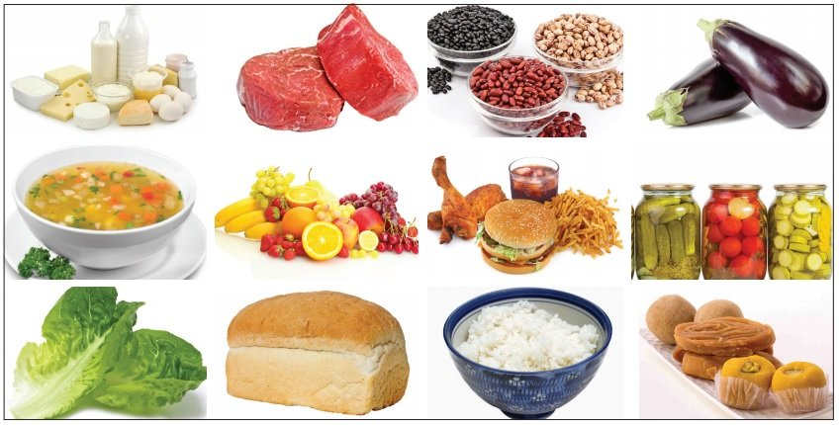
Wednesday 13th January 2021
Design and technology

Slide 2
Over the next couple of weeks, we will be looking healthy eating and a varied diet, we will be discussing where food comes from and hopefully preparing and comparing meals towards the end of this unit of work.
At the beginning of the year we learnt all about healthy eating and food groups, we looked at the 5 food groups, and sorted different foods into the correct groups. We talked about what each group provided for our bodies to keep us strong and healthy.

Slide 3
Please watch the clip underneath
https://www.youtube.com/watch?v=Z51bWG17m-Q

Slide 4
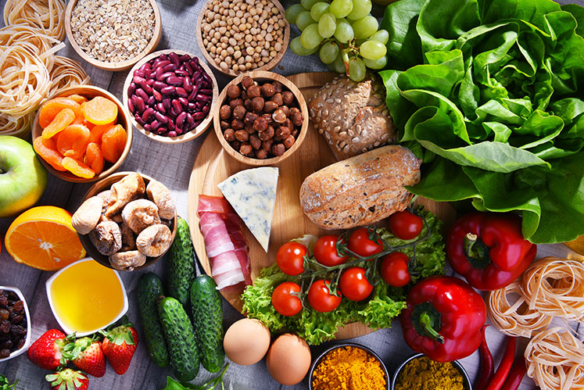
Can you discuss these questions with an adult?
Can you name all the five food groups?
Why is it important to eat fruit and vegetables?
What does protein do for our bodies?

Slide 5
Task 1 Could you draw a table of the five food groups and add two different types of foods to each group.
Protein | carbohydrates | Dairy | Fruits and vegetables | Fats
Tuna | pasta | cheese | Blueberries | Chocolate

Slide 6
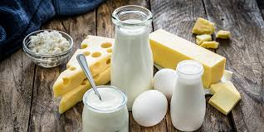
Task 2
Could you write one sentence about each of the five food groups, describing what the groups provide our bodies.
Example.
Eating dairy is good for our bones & teeth it has calcium which keeps us strong.

Slide 7
Extension activities once you have finished.
Could you draw a picture of each of the foods you have written in your food groups.
Can you send a picture of your writing to us?
lara.crawford@worthvalleyprimary.co.uk
steph.milner@worthvalleyprimary.co.uk

