Slide 1
English
Wednesday
20.01.21

Slide 2
Handwriting
Practice harder words – LETTERJOIN – Students – Password lj8943 (finger swipe is in the shape of a letter L) https://www.letterjoin.co.uk/tablet_login/

Slide 3
Reading
Today’s reading is a short comprehension – read the text and answer the questions. To open the document go to Purplemash the document is called ‘Reading-Wednesday’. There is one for group 1 and 2 and a different one for group 3.
The work is on a word document so please type your answers on to it and send it back via Purple mash.
https://www.purplemash.com/login/
Any problems please email me,
r.metcalf@worthvalleyprimary.co.uk

Slide 4
Spellings
Silent letters.
Silent letters are letters that can’t be heard when the word is spoken.
For example in the word ‘sword’, you don’t pronounce the letter ‘w’. And the letter ‘h’ is silent in the word 'ghost'.

Slide 5
Group 1
On Purplemash you will find a spelling activity names ‘Spelling group 1 Wednesday’. The work is on a word document you should be able to type straight on to the document if you enable editing.
Please type into the text boxes, save the work and upload it back to Purplemash for feedback.

Slide 6
Spellings – group 2
This week you are going to focus on these words: door, floor, poor, because and find.
You need to open the document called ‘spellings group 2 Wednesday’ from Purplemash and complete the tasks on the word document. You should be able to type straight onto the document if you enable editing.
Once you’ve finished upload your work back onto Purplemash for feedback.

Slide 7
Writing task:
Today we are looking at the diary extracts from Monday. You are going to compare the two diaries. On the next few slides I have included the diary extracts again so you can read them and identify the similarities and differences. For example they both have a date, they are both written in the first person (I) etc.
I have uploaded your task on to Purplemash, if you are unsure which group you are in please email me.
r.metcalf@worthvalleyprimary.co.uk

Slide 8
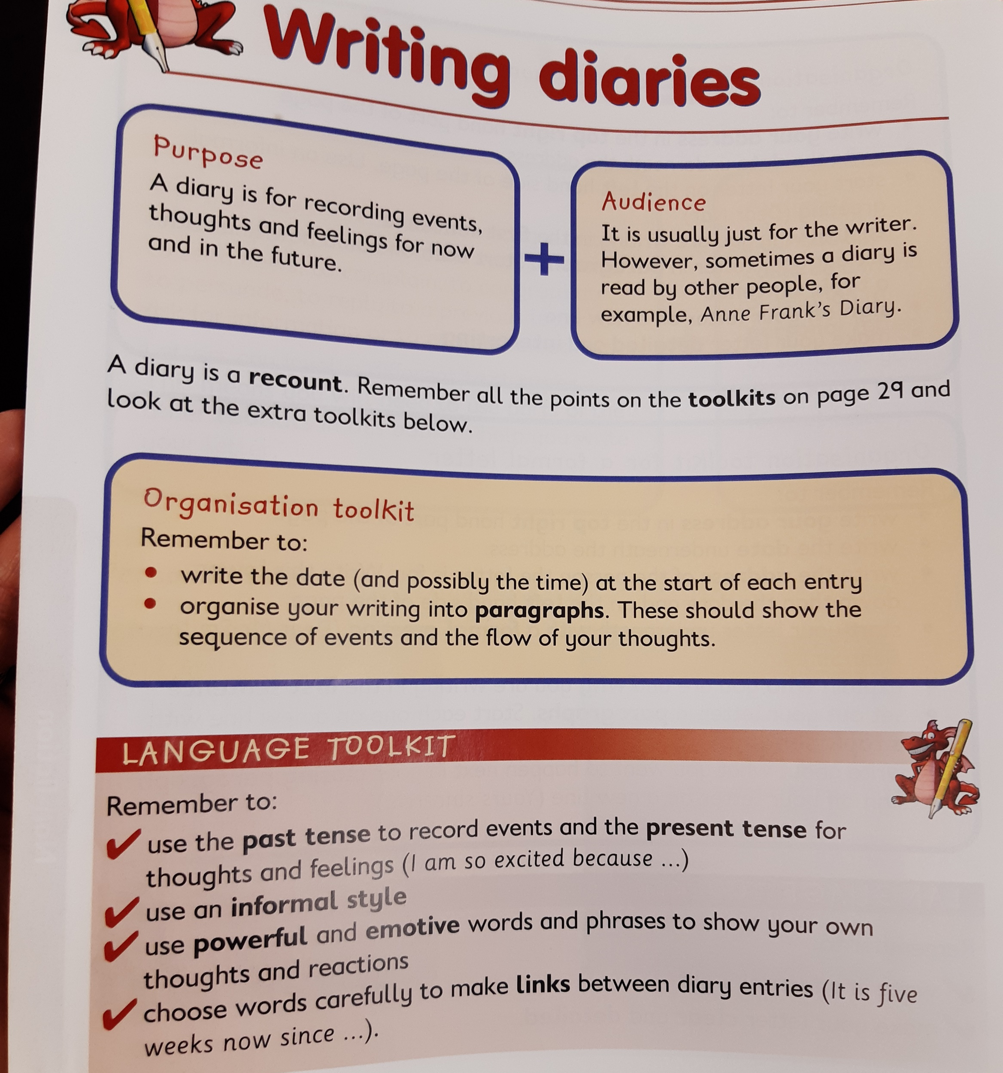
Features of a diary

Slide 9
Diary of a Whimpey kid extract.
Read or listen to the following extract

Slide 10
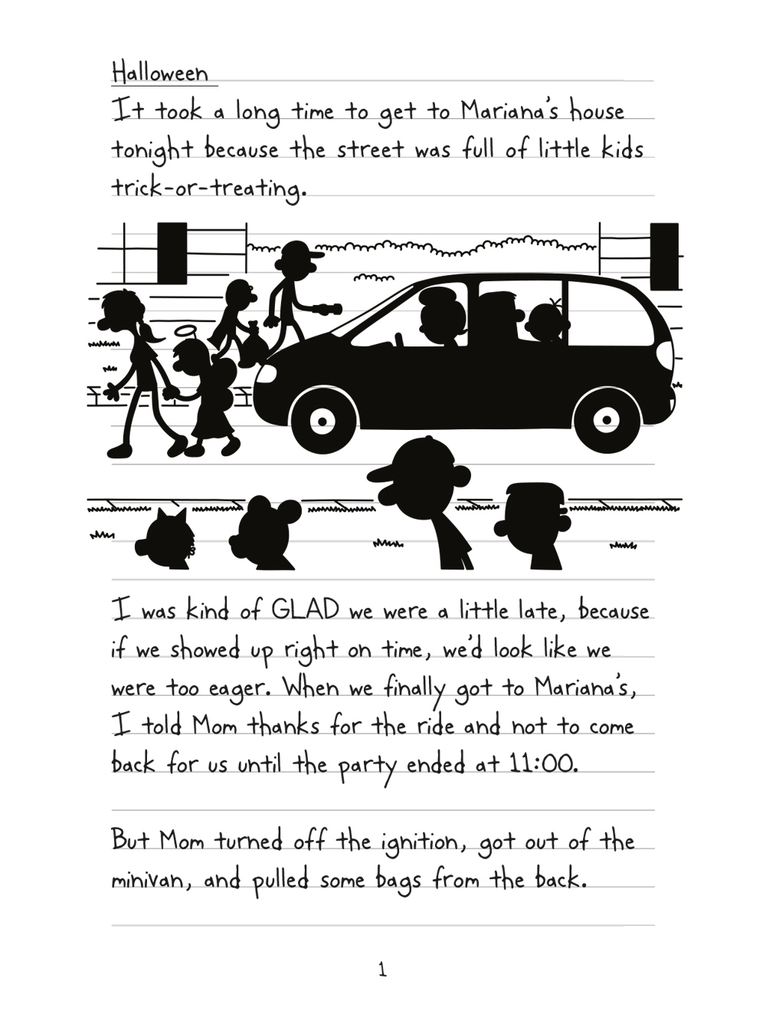
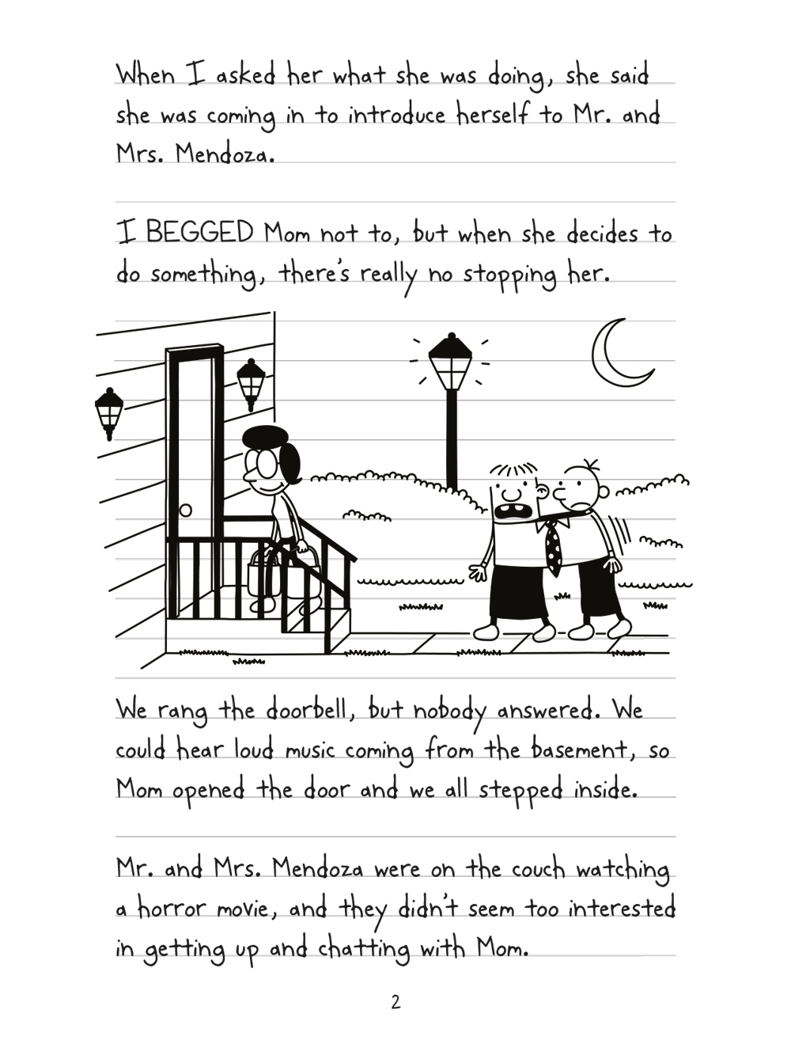


Slide 11
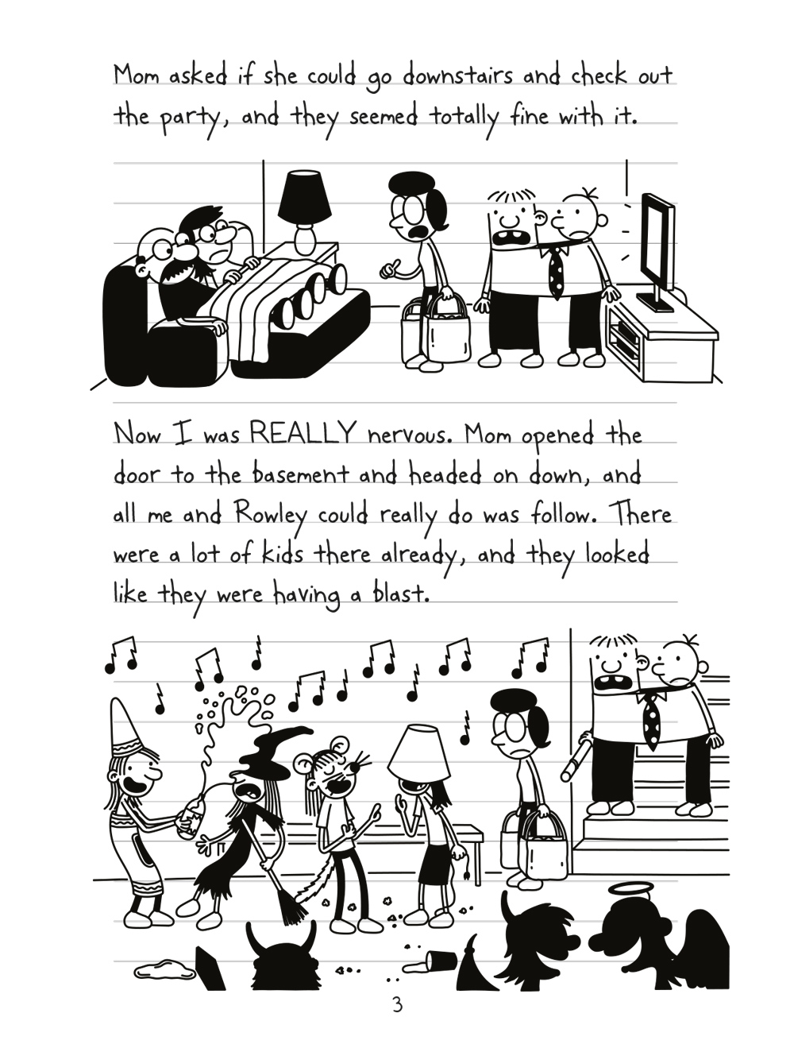
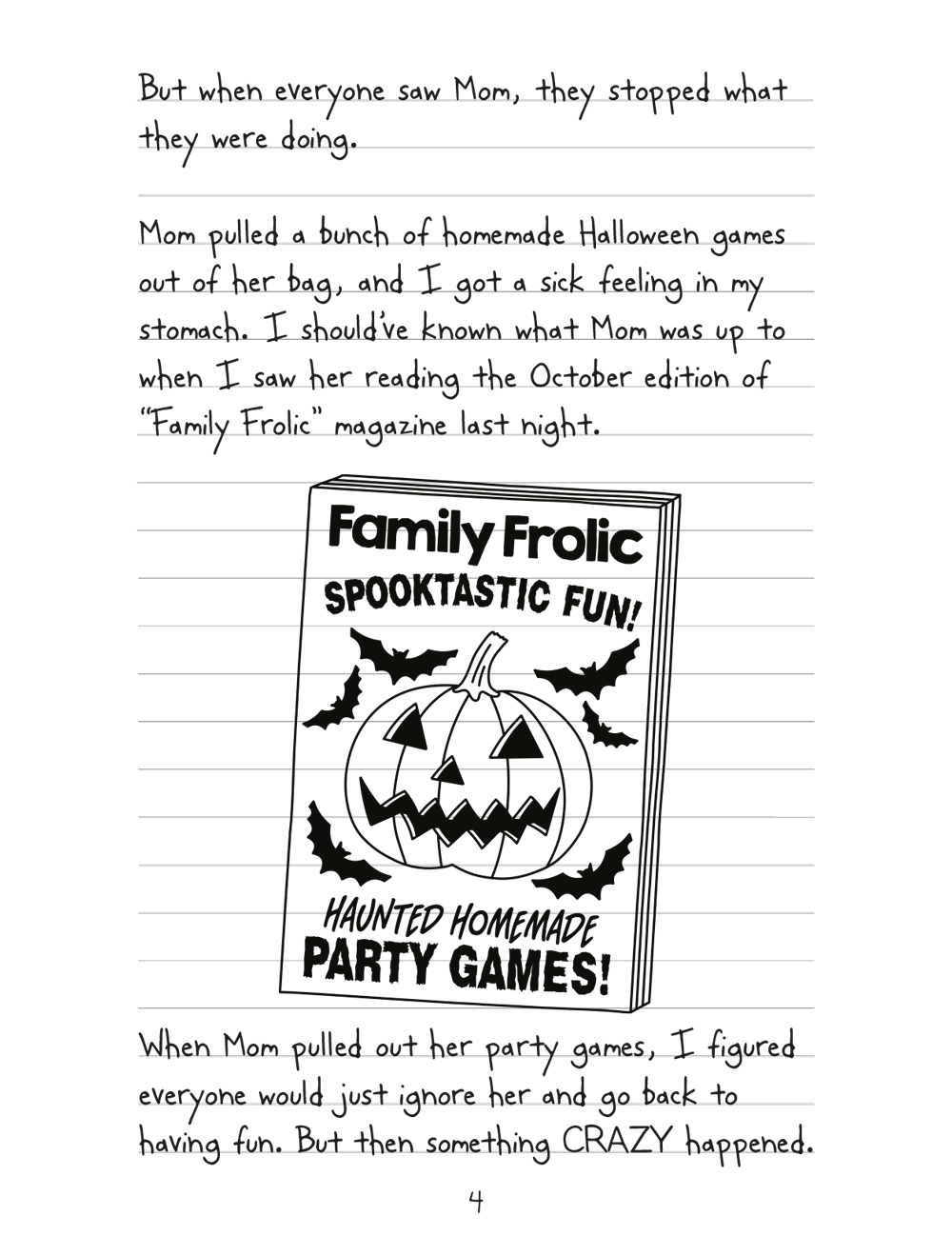

Slide 12
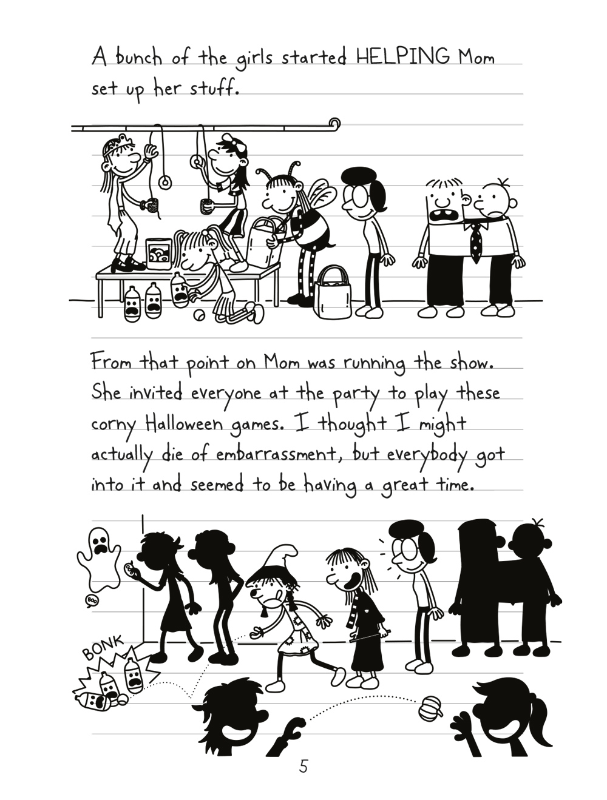
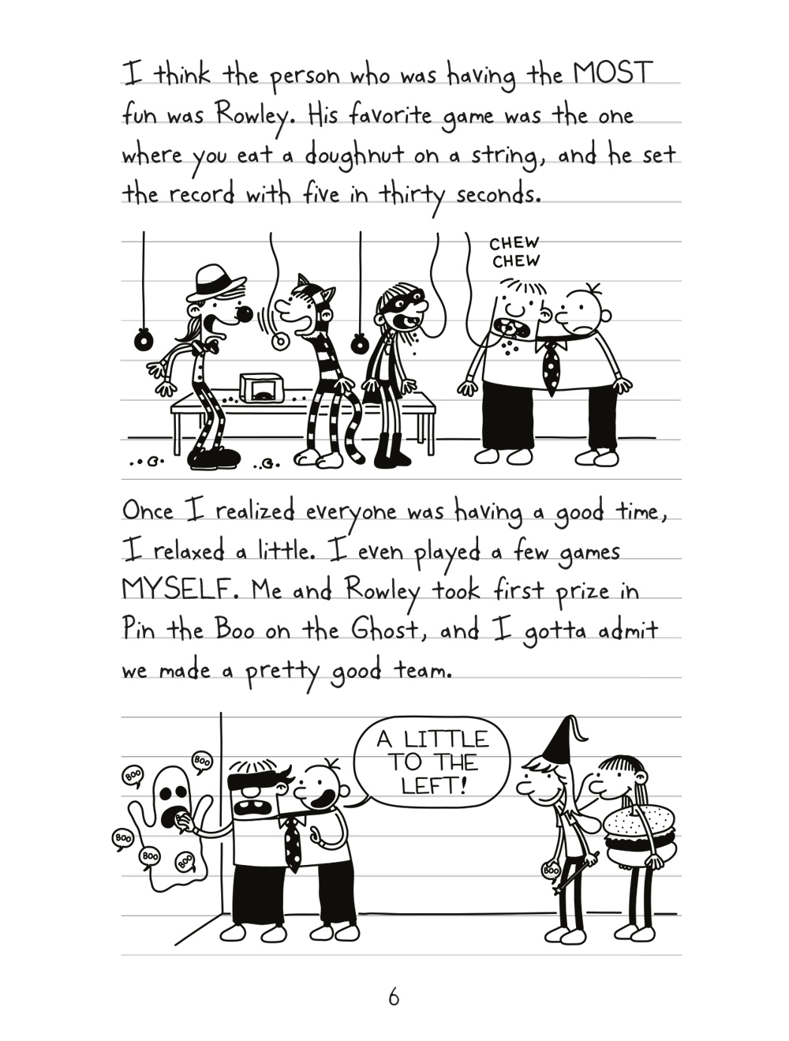

Slide 13
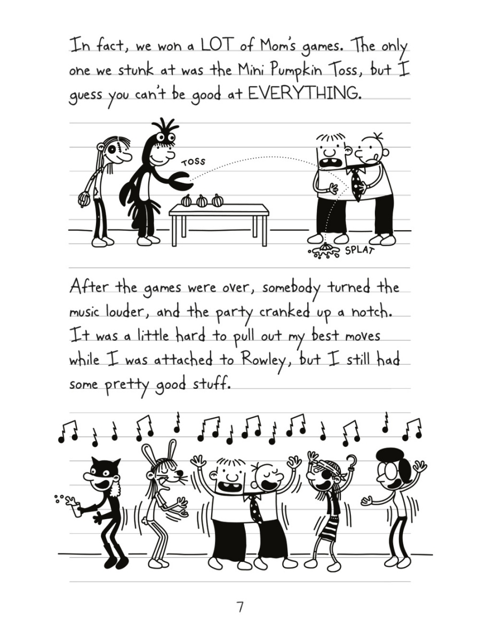
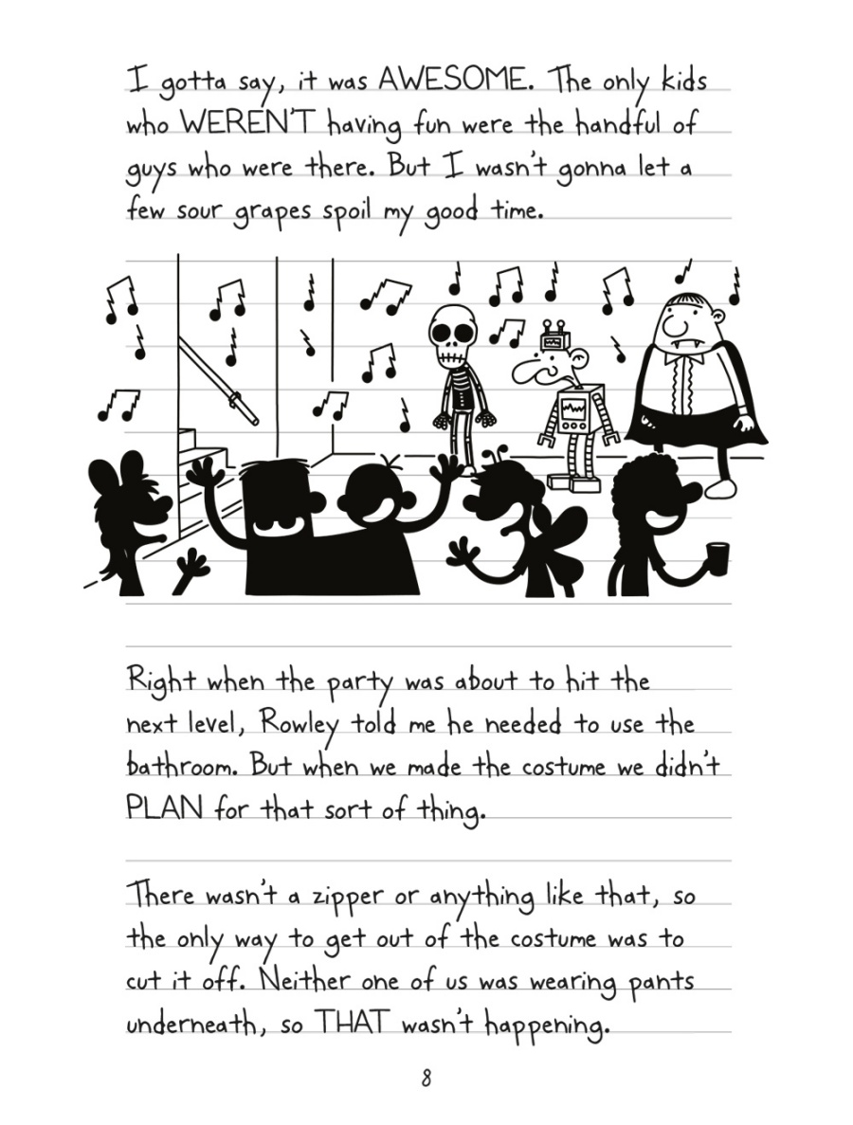

Slide 14
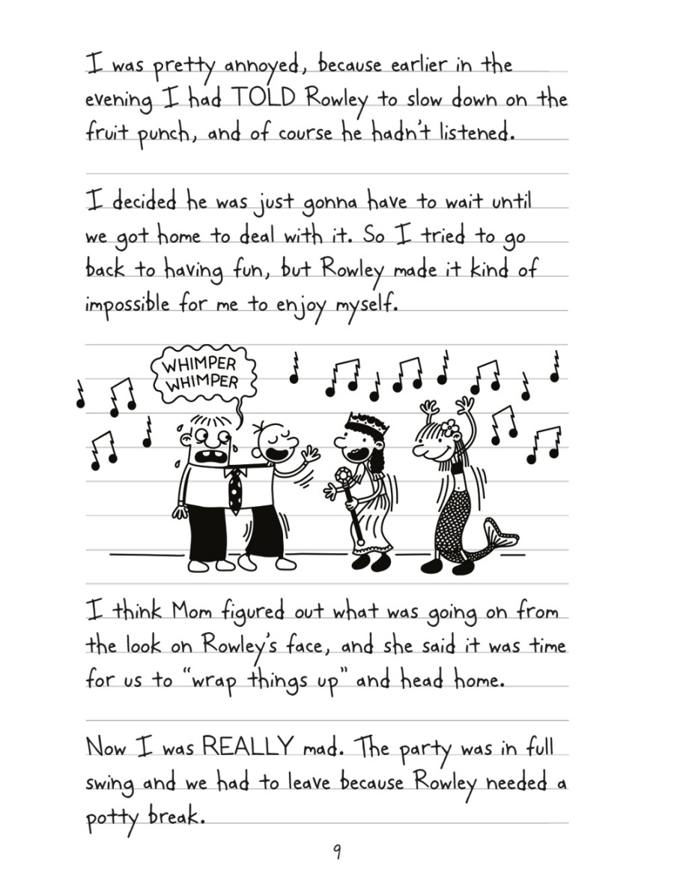
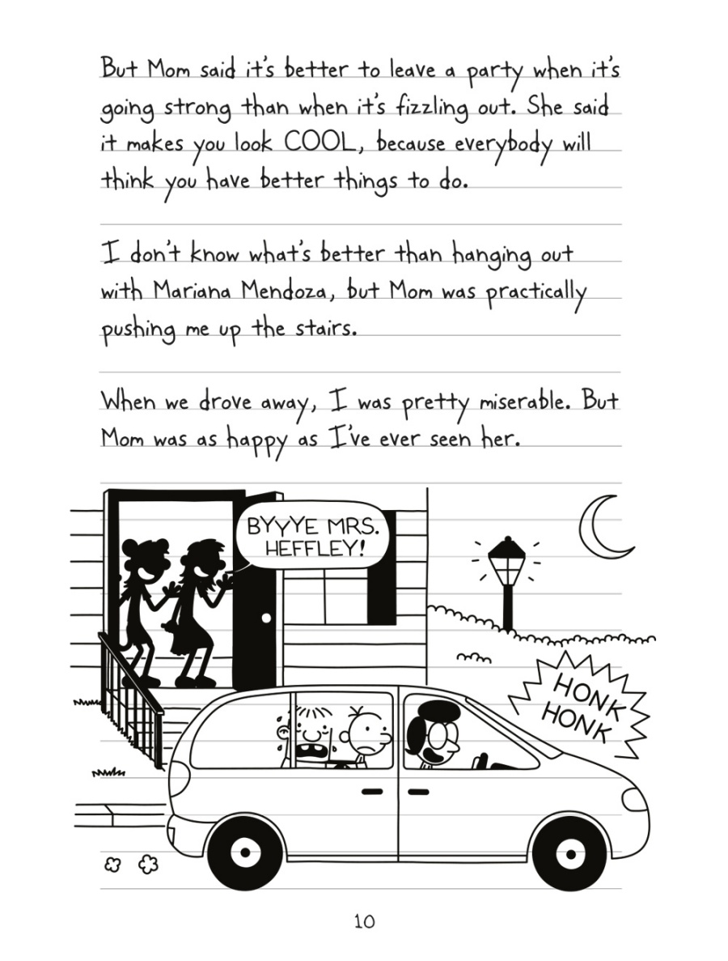

Slide 15
Anne Frank’s diary entry
Read or listen to the following extract

Slide 16
Thursday 14th June 1942
Dear diary,
Well this has been the most scariest day of my life! Luckily, I'm still here to tell the tale and hopefully shall be from now on.
At about half past eight this morning life was going as normal: well as in we were all creeping around in our stocking feet so the workers below couldn't hear us. Then it happened. The clank of footsteps could be heard coming up the stairs. I knew they'd reached the third step from the top - it creaked like grandmother's knees. Immediately we all stopped, stood still and held our breath. Mother went white as a sheet and made that face at me- like don't you dare make a sound! As if I would be so silly. This was our hiding place, our only chance of not being caught, our one secret that must never be told.
It was as if time stood still (though after I'm sure it was no more than five minutes) like the air had been sucked out from all around me! Nothing, no movement, no sound. Just waiting to hear if the steps would descend back down the stairs. My heart was beating like a drum; my ears were pounding as they listened for any sound that would indicate we'd been found. I stood like a statue staring at my mother, who was doing the same, making no movement no sound. One minute, two minutes, three minutes, how many had passed? Still we stood, frozen to the spot.

Slide 17
After what seemed an eternity the footsteps turned, making that gritty sliding on floorboards sound. Voices could be heard getting fainter and fainter. Whoever it had been had finished their chore and had moved on. My mind filled with the most dreaded thought. Who could it have been? Workers collecting something? I stared wide-eyed at my mother. The all-clear signal to move was given to me by my mother. I crept into my small, cramped bedroom at the back of the secret annexe and quietly pushed the door to.
Collapsing heavily, the biggest sigh ever left my chest! I was sure that was the closest we'd ever come to being found. I can't even imagine what would happen to us if we did. How long do we have to live like this? There are so many things I miss: my school friends; visits to the park; theatre trips and just being outside!
It fills me with dread, what will tomorrow bring?

