Slide 1
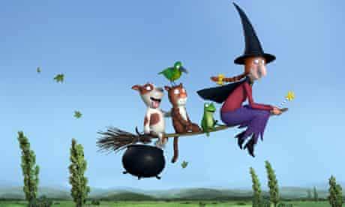
Tuesday 19th January 2021
English tasks.

Slide 2
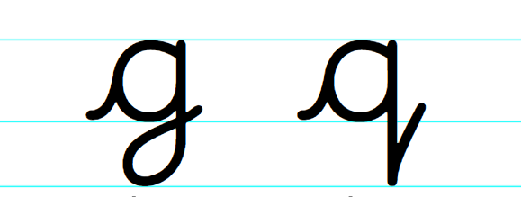
Handwriting
Please practise the letters:
Look on the letterjoin website to see how to form them correctly.
https://letterjoin.co.uk
Username: lj8943
If you are using a laptop the password is: home
If using an ipad or tablet the password is: capital L (Make the shape of a capital L)

Slide 3
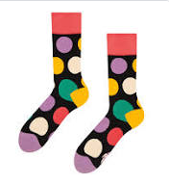
Can you knock my socks off with your neat writing?
Now that you have practised your letters on letterjoin can you practise on a piece of paper?
Can you send a picture of your writing to me?
s.hiley@worthvalleyprimary.co.uk

Slide 4
Reading Task Can you think about what the characters might be saying here?
Remember that good readers need to be able to use inference skills to say what a character might be thinking, feeling or saying. This shows how well you understand the story.

Slide 5
What might the witch and the cat be thinking and saying to each other here? Can you remember what part of the story it is from?

Slide 6
Writing
This week we are reading
Room on the Broom
by Julia Donaldson.
Here is the link to the story again if you would like to watch it again to help with your work for today.
https://www.bbc.co.uk/iplayer/episode/p0102qfj/room-on-the-broom

Slide 7
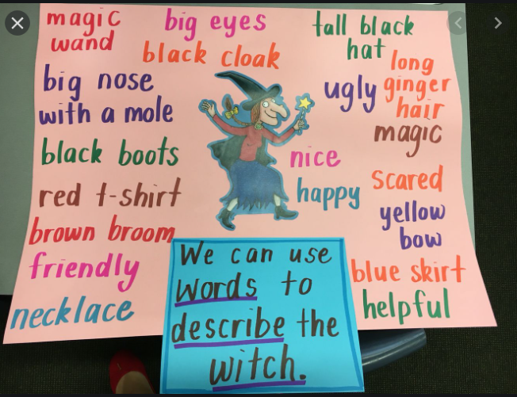
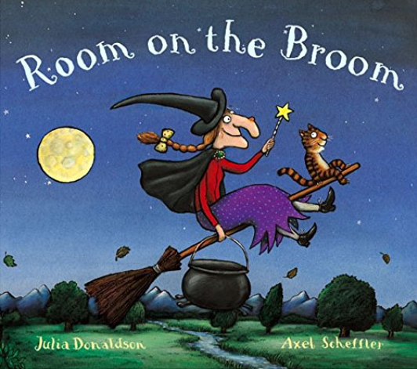
Writing Task
Can you describe the witch?
Here are some ideas of adjectives you can add to your sentences. Can you add any more?

Slide 8
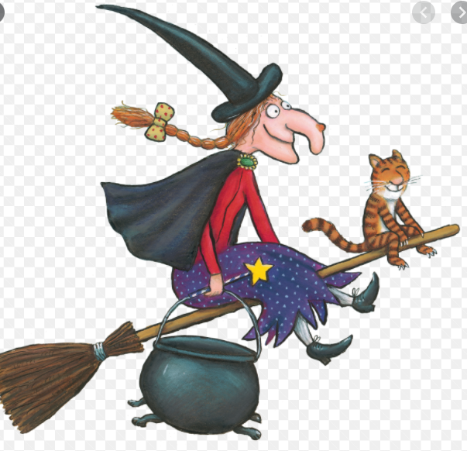
Can you write super sentences to describe the witch? Here is an example: The friendly witch has a very tall hat and long ginger hair, which she wears in a plait. Her favourite things are flying over moors and mountains, creating spells and potions. She is very kind because she never likes to leave anyone behind.
Don’t forget your neatest handwriting, finger spaces, capital letters and full stops.

Slide 9
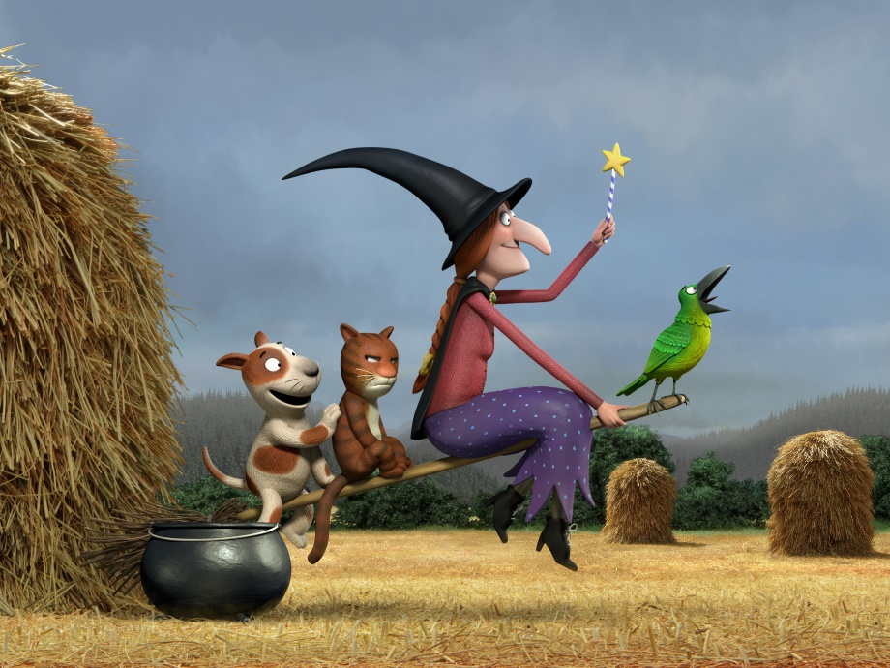
Remember I love to see your work so please email pictures to me at:
s.hiley@worthvalleyprimary.co.uk

