Slide 1
English
Monday 18th January 2021

Slide 2
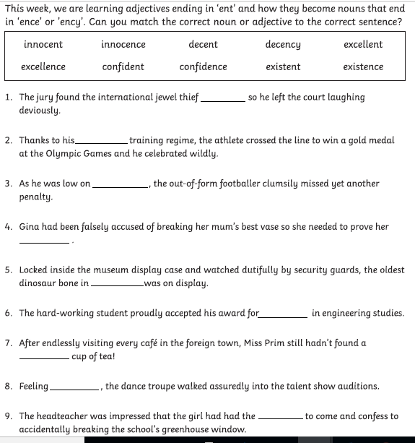
Can I use the –ent, -ency, -ence suffix?
Adjectives can become nouns with the addition of a range of suffixes
Adjectives ending -ent become nouns ending –ency and -ence
Log into Purple Mash to find the worksheet.
https://www.purplemash.com/

Slide 4
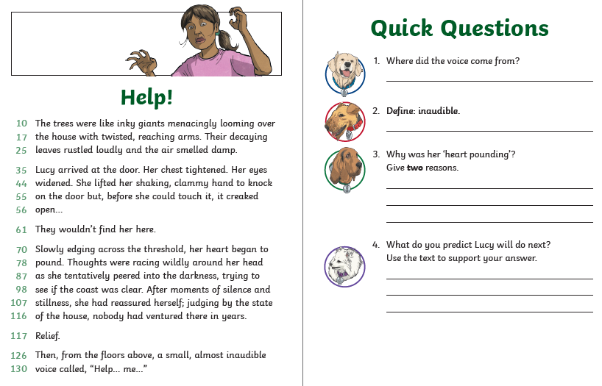
Log into Purple Mash to find the worksheet.
https://www.purplemash.com/

Slide 5
You should now have edited the first draft of your setting description. Watch the BBC bitesize clips on editing and improving your work and work through the activities to practise your editing and proof reading skills. .
https://www.bbc.co.uk/bitesize/articles/zmbr47h
You can find the worksheets on purple mash
.

Slide 6
Reading Together for Pleasure
Miss Lodge, kindly bought us this lovely book ‘The Book of Hope’ just before the Christmas holiday. We thought it would be nice to share everyday ,some of the words and pictures to provide you with a little bit of comfort, inspiration and entertainment!
Hope you enjoy hearing our voices.

Slide 7
