Slide 1
English 19/01/2021

Slide 2
Reading Activity Please see the next slides for your group`s activity
Let me know if you can`t remember which Reading group you are in
You will need a pencil or pen, and paper

Slide 3
Groups 1 and 2
2Do Purple Mash task
It is called RIC Hagar
Watch the clip and then answer the questions (using a pen and paper)

Slide 4
Groups 3 and 4
2Do Purple Mash tasks
Recap the Powerpoint R4e Therapy from yesterday and then have a go at Tests 2 and 3

Slide 5
Handwriting + Spellings Group 3

Slide 6
Handwriting + Spellings Group 2

Slide 7
Handwriting + Spellings Group 1 first 5 words

Slide 8
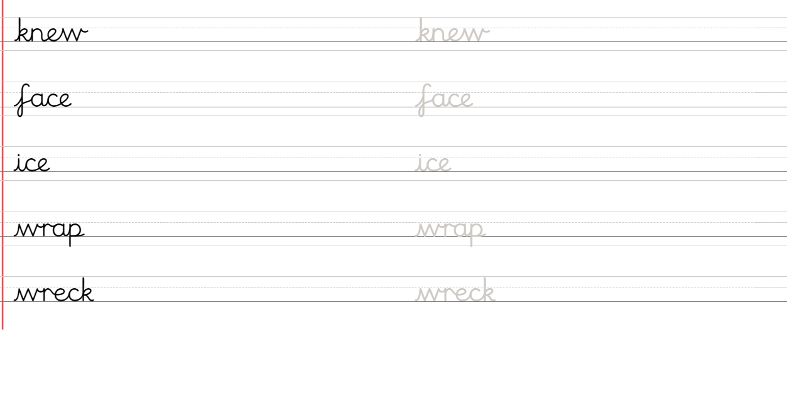
Handwriting + Spellings Group 1 second 5 words

Slide 9
Handwriting
Use the spelling sheets to practise your handwriting, just as we do in class
Practise 3 words per day on lined paper and then have a go at writing sentences with those words in
Remember, it is quality joined writing that we are looking for, with your proper tripod grip

Slide 10
Group 1 Spellings
Have a go at Phonics Play

Slide 11
Group 2 and 3 Spellings
Use the Spelling Frame website to practise your spellings https://spellingframe.co.uk/spelling-rule/8/1-Adding-suffixes-beginning-with-vowel-letters-to-words-of-more-than-one-syllable

Slide 12
Groups 2 and 3 – on the Spelling Frame website, have a go at each of these methods of practising your words

Slide 13
Grammar
Other words for `said’
Today we are again looking at using other words than ‘said’ in order to keep our writing interesting
Try the `Using Said Synonyms in Direct Speech` 2Do task on Purple Mash
Use the Word Mat below to help you

Slide 14
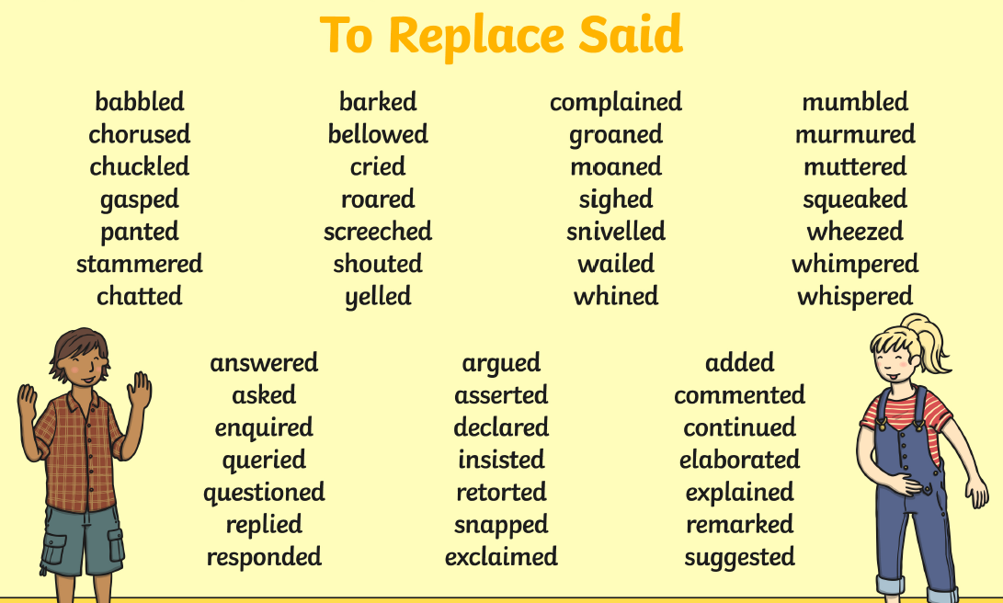
Synonyms for said Word Mat

Slide 15
Grammar games
Have you tried the Karate Cats game on BBC Bitesize? https://www.bbc.co.uk/bitesize/topics/zd63xyc/articles/zdp4pg8

Slide 16
Writing activity
Read Street Child Chapter 15: 2Do Purple Mash
Can you find any speech that uses “said”? If you can, then replace this speech with words of your choice.
For example: “Come `ere Jim and shovel this coal, “ said Grimy Nick.
You could replace this with, “Come `ere and shovel this coal!” ordered Grimy Nick.

