Slide 1
Friday 15th January 2021
English tasks.

Slide 2
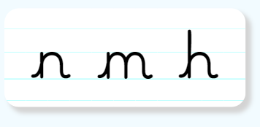
Handwriting
Please practice the first group of easy letters ‘, n, m and h’ (lowercase).
https://letterjoin.co.uk
Username: lj8943
If you are using a laptop the password is: home
If using an ipad or tablet the password is: capital L (Make the shape of a capital L)

Slide 3
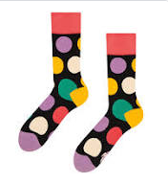
Can you knock my socks off with your neat writing?
Now that you have practised your letters on letterjoin can you practise on a piece of paper?
Can you send a picture of your writing to me?
s.hiley@worthvalleyprimary.co.uk

Slide 4
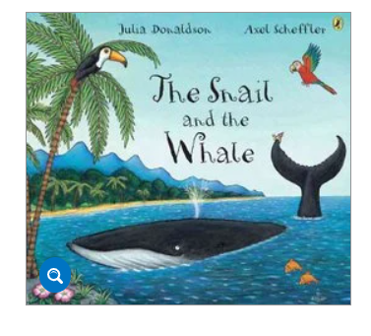
Reading and Writing Task
This week we are reading the Snail and the Whale by Julia Donaldson.
The link to the film is here if you would like watch it again.
Can you watch the film using the link below?
https://www.bbc.co.uk/iplayer/episode/m000cslw/the-snail-and-the-whale

Slide 5
Writing task
Can you write a fact file about me to teach the flock of snails all about whales?

Slide 6
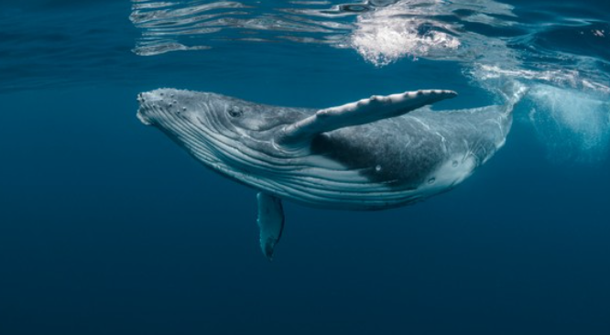
Here are some links for you to use to research humpback whales. What can you find out?
https://www.natgeokids.com/uk/discover/animals/sea-life/humpback-song/
https://www.dkfindout.com/uk/animals-and-nature/whales-dolphins-and-porpoises/humpback-whale/
https://www.youtube.com/watch?v=fBGq85Q2198&safe=active

Slide 7
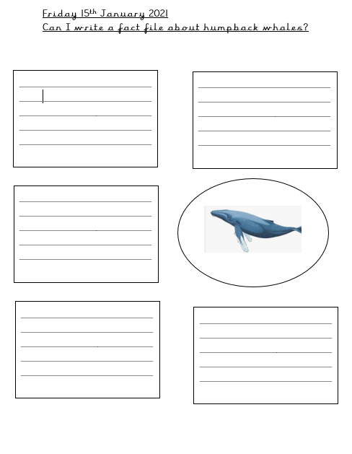
Can you write the facts you have found out? Here are some examples of how you might want your fact file to look.

Slide 8
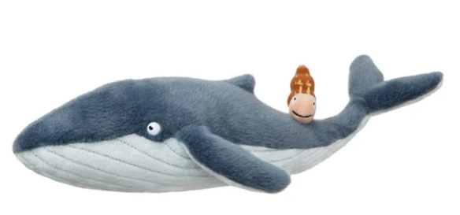
Remember I love to see your work so please email pictures to me at:
s.hiley@worthvalleyprimary.co.uk

