Slide 1
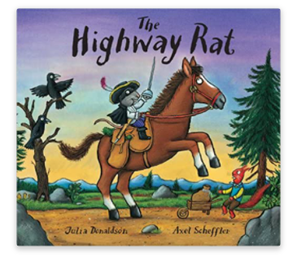
Friday 29th January 2021
English tasks

Slide 2
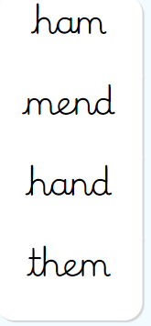
Handwriting
Please practise the following words:
(Easy words- second set)
Look on the letterjoin website to see how to form them correctly.
https://letterjoin.co.uk Username: lj8943
If you are using a laptop the password is: home
If using an ipad or tablet the password is: capital L (Make the shape of a capital L)

Slide 3
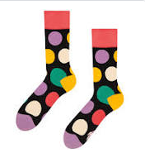
Can you knock our socks off with your neat writing?
Now that you have practised your letters on letterjoin can you practise on a piece of paper?
Can you send a picture of your writing to me?
s.hiley@worthvalleyprimary.co.uk

Slide 4
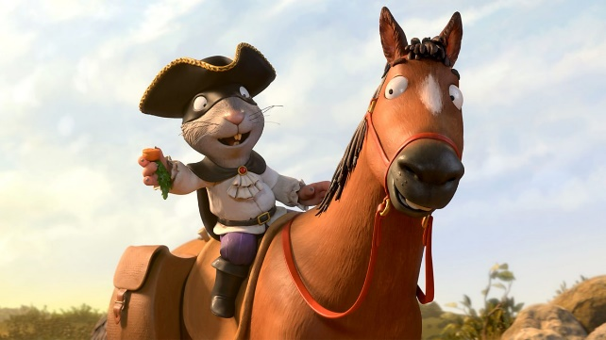
Writing Tasks
This week we are reading
The Highway Rat
by Julia Donaldson.
If you would like to watch the film version of the story again the link is below:
https://www.bbc.co.uk/iplayer/episode/b09kkt1k/the-highway-rat

Slide 5
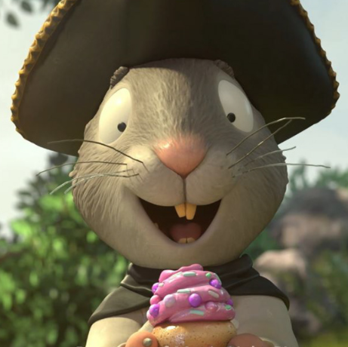
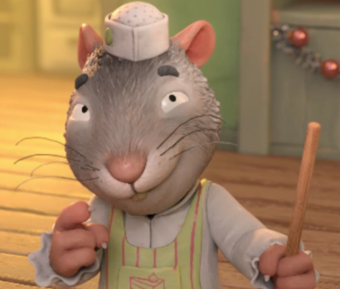
Writing task
Today we need to do a special job to help the Highway Rat.
He has thought very carefully about his behaviour and knows that he wants to put things right. He wants to write a special letter to all of the animals to say sorry but he does not know how to write!
Can we write one for him?

Slide 6
Remember to set your letter out clearly and correctly. We start a letter with Dear….. And end it with From….
What might the Highway Rat want to say to all of the animals?

Slide 7
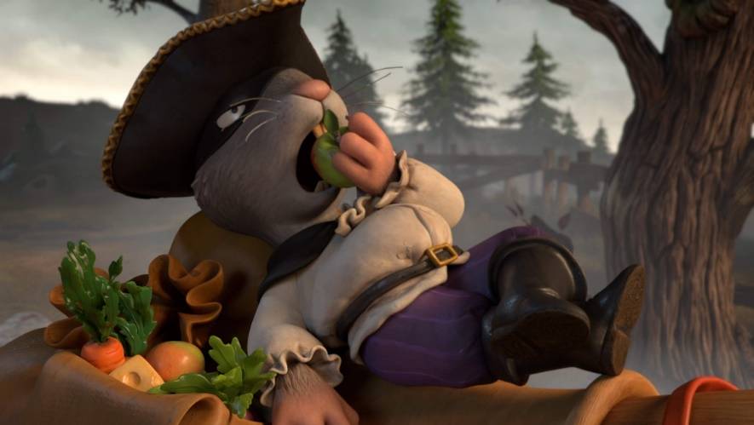
Remember I love to see your work:
You can use Purple Mash to type your work. I have set you a ‘To Do’ for this task.
Or you can write on paper and send a picture to me on my email address:
s.hiley@worthvalleyprimary.co.uk

