Slide 1
History
The Vikings
12/01/2021

Slide 2

Can I understand how some kings in Britain dealt with the Viking invaders?
Resistance by Alfred the Great and Athelstan, first king of England.
Read the powerpoint on these English kings.
Go to the worksheet on Purple Mash and write down how they resisted the Viking invasions on the mind map.
How do you think they felt about the Viking invaders?

Slide 3
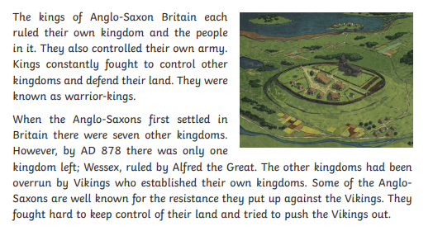

Slide 4
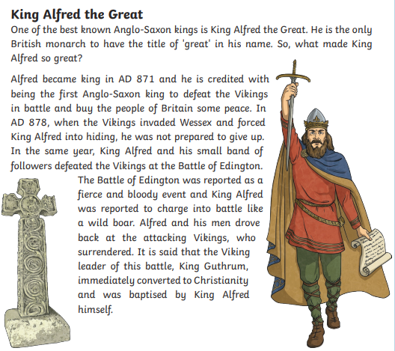

Slide 5
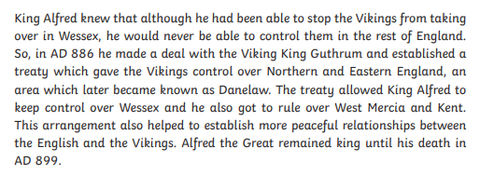

Slide 6
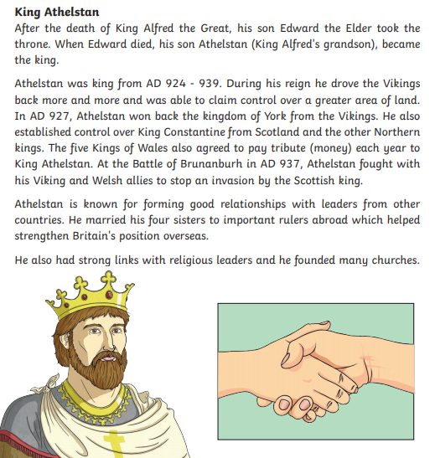

Slide 7
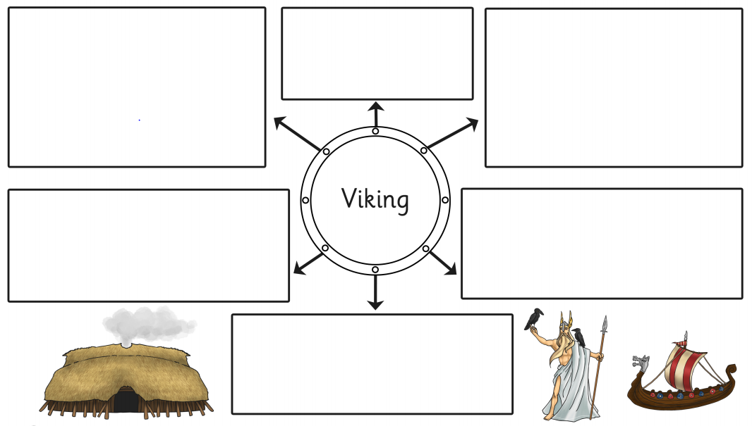
How did the English Kings deal with the Vikings invasions?

