Slide 1
Maths
11/01/21

Slide 2
Times Tables
If you can`t remember which personal times table you are working on, then please contact me.
For the next 2 weeks we will be practising the 6 times table as a whole class.
Use www.timestables.co.uk to have a go at all the times tables, as well as https://ttrockstars.com/
Try the worksheets and games, just like we have done in class, as well as singing or chanting them to your family!
Spend 10 – 15 minutes on this exercise

Slide 3
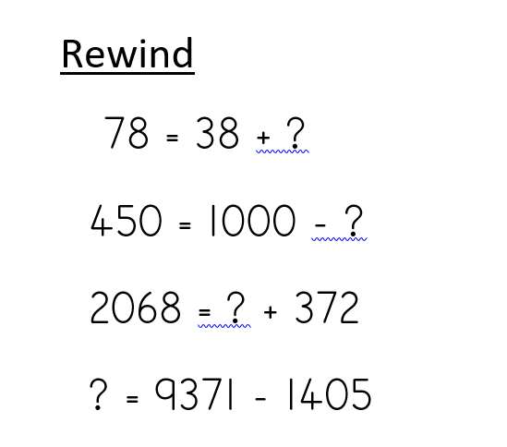
Add and subtract practice

Slide 4
Main teaching
We are continuing with fractions
We will be reminding ourselves what unit fractions are, and then moving onto non-unit fractions
Today we will be watching 2 videos, which contain quizzes and tasks within them. Listen to the instructions on the videos and pause the videos where asked so that you can have a go at the tasks set.

Slide 5
Unit and non-unit fractions
https://classroom.thenational.academy/lessons/to-describe-unit-and-non-unit-fractions-75jkac
https://classroom.thenational.academy/lessons/to-identify-and-describe-non-unit-fractions-6cr32t

