Slide 1
Maths
19/01/21

Slide 2
Times Tables
If you can`t remember which personal times table you are working on, then please contact me.
For this week we will continue practising the 6 times table as a whole class.
Use www.timestables.co.uk to have a go at all the times tables, as well as https://ttrockstars.com/
Try the worksheets and games, just like we have done in class, as well as singing or chanting them to your family!
Spend 10 – 15 minutes on this exercise

Slide 3
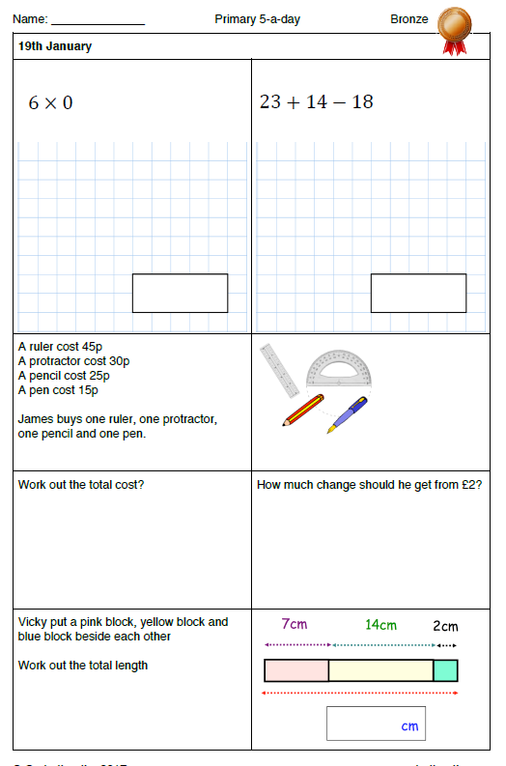
Warm-up

Slide 4
Main teaching
We are continuing with fractions
LC: Can I solve fraction problems?
Watch the enclosed video, including quizzes and tasks https://classroom.thenational.academy/lessons/finding-non-unit-fractions-of-quantities-c5jp4d
Then have a go at today`s 2Do Purple Mash task called Fractions of Quantities 1. Try 5 questions, including at least 2 word questions please!

