Slide 1
Monday 11th January 2021
English tasks.

Slide 2
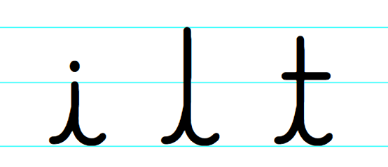
Handwriting
Please practise the first group of easy letters ‘i, l, t’ (lowercase).
https://letterjoin.co.uk
Username: lj8943
Password: capital L (Make the shape of a capital L if you are accessing the site via a tablet or an iPad)

Slide 3
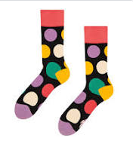
Can you knock my socks off with your neat writing?
Now that you have practised your letters on letterjoin can you practise on a piece of paper?
Can you send a picture of your writing to me?
s.hiley@worthvalleyprimary.co.uk

Slide 4
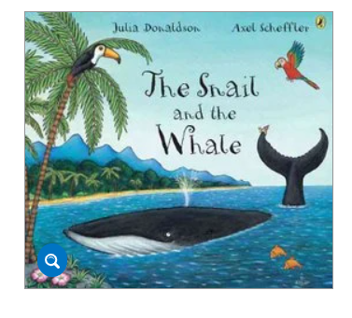
Reading and Writing Task
This week we are reading the Snail and the Whale by Julia Donaldson.
Can you watch the film using the link below?
https://www.bbc.co.uk/iplayer/episode/m000cslw/the-snail-and-the-whale

Slide 5
Reading questions
Can you tell me some of the words the author uses to describe the snail?
What does the whale offer the snail?
Would you go on a trip with the whale? Why or why not?
Where do the snail and whale go? What other animals do they see?

Slide 6
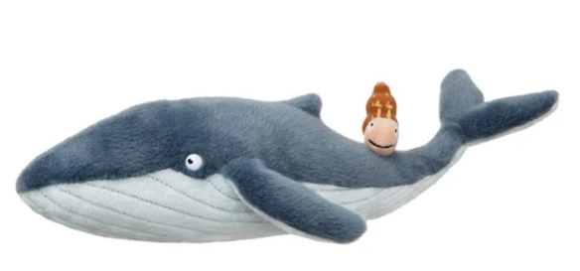
Writing Task
Can you write me some sentences to tell me about your favourite part of the story. Can you use ‘because’ to tell me why this was your favourite part?
Example: My favourite part was when the snail wrote a note to the children and saved the whale. I liked this part because it was amazing that a tiny, little snail could save the life of an enormous, humpback whale.
Was there a part of the story you didn’t enjoy? Could you write this down also?
Example: I did not like it when the whale got stuck on the beach because I was worried that he would never get back to the deep, blue ocean.
Can you draw a picture of your favourite part of the story?
Remember year 2 you need to use; capital letters, finger spaces, full stops and your neatest handwriting.

Slide 7
Remember I love to see your work so please email pictures to me at:
s.hiley@worthvalleyprimary.co.uk

