Slide 1
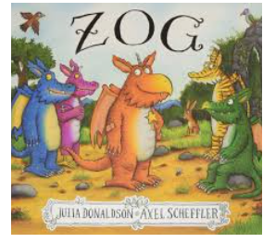
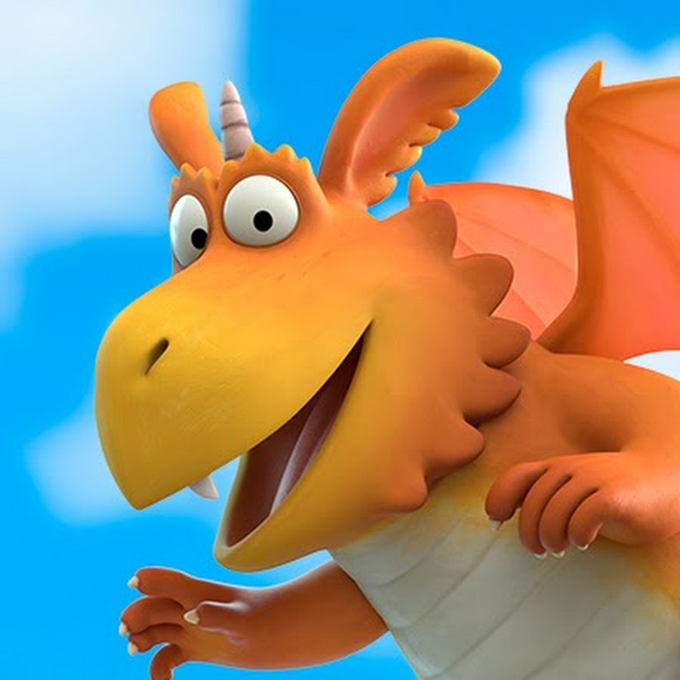
Monday 1st February 2021
English tasks.

Slide 2
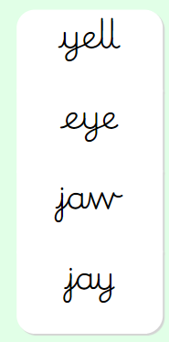
Handwriting
Please practise the following words:
Look on the letterjoin website to see how to form them correctly.
https://letterjoin.co.uk Then click on harder words
Username: lj8943
If you are using a laptop the password is: home
If using an ipad or tablet the password is: capital L (Make the shape of a capital L)

Slide 3
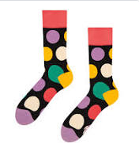
Can you knock our socks off with your neat writing?
Now that you have practised your letters on letterjoin can you practise on a piece of paper?
Can you send a picture of your writing to me?
s.hiley@worthvalleyprimary.co.uk

Slide 4
Reading and Writing Tasks
This week we are reading
Zog
by Julia Donaldson
Can you watch the film version of this story using the link below?
https://www.bbc.co.uk/iplayer/episode/b0bwdw8y/zog

Slide 5
Reading task
Now that you have watched the clip could you answer the questions to show how well you have understood the story?
What was Zog’s teacher’s name?
What did the girl give to Zog when he crashed into the tree?
What did the girl give to Zog when he lost his voice?
What was the girl’s name?
Who came to rescue the girl ?

Slide 6
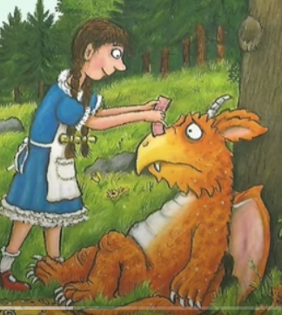
Writing Task:
Can you write about your favourite part of the story? Why was this your favourite part?
Here is an example:
My favourite part of the story is when the Princess helped Zog when he fell and crashed into the tree. I liked this part best because it was when they became friends. Zog would have been very sad without the helpful girl.

Slide 7
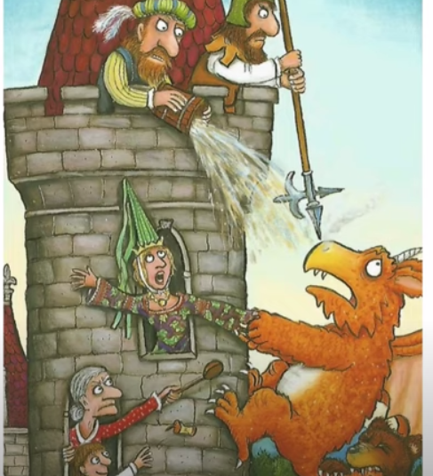
Writing task:
Can you write sentences to tell me about your least favourite part of the story? Why did you not like this part?
Here is an example:
My least favourite part was when Zog tried really hard to capture a princess but couldn’t manage it no matter how hard he tried and cried “I’m no good at this.” I didn’t like this part because I felt upset that Zog was sad.

Slide 8
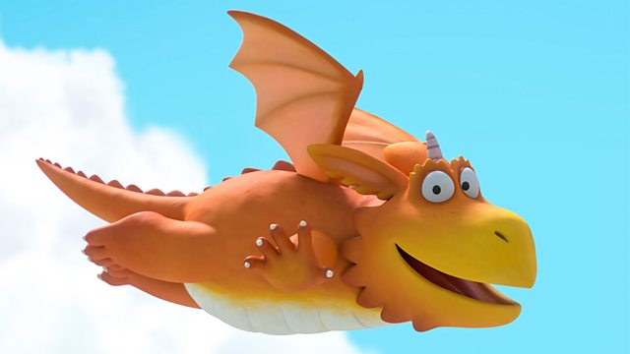
Remember I love to see your work so please email pictures to me at:
s.hiley@worthvalleyprimary.co.uk

