Slide 1
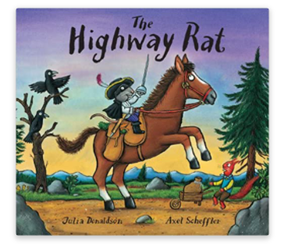
Tuesday 26th January 2021
PSHE Task
https://www.bbc.co.uk/iplayer/episode/b09kkt1k/the-highway-rat

Slide 2
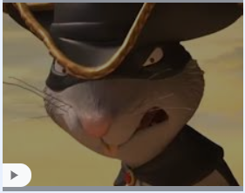
The Highway Rat was a baddie. The Highway Rat was a beast!
Give me your buns and your biscuits! Give me your chocolate éclairs! For I am the Rat of the Highway, and the Rat Thief never shares!

Slide 3
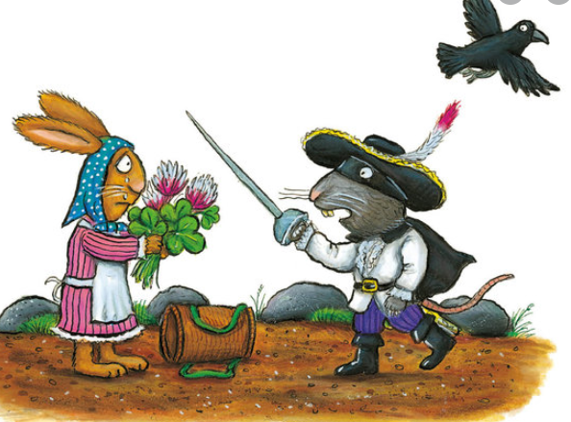
Can you write a little message for The Highway Rat to help turn him into a nice rat?
Can you teach the Highway Rat how to be kind and share?
Can you tell him why it is nice to share our things? Why is it important to be kind?

Slide 4
Remember I love to see your work so please email pictures to me at:
s.hiley@worthvalleyprimary.co.uk

