Slide 1
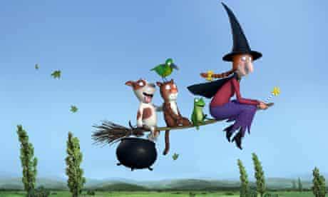
Tuesday 19th January 2021
PSHE Tasks

Slide 2
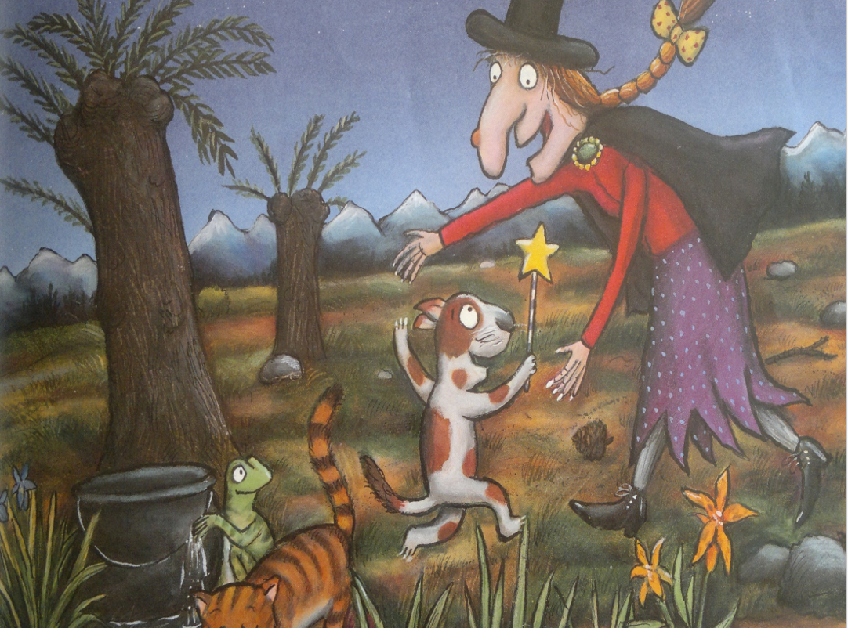
The witch is so grateful to the animals for saving her life. Think of things or people that you are grateful for.
Can you make a thank you card or picture to someone special to say thank you?
(See examples on the next slide)

Slide 3
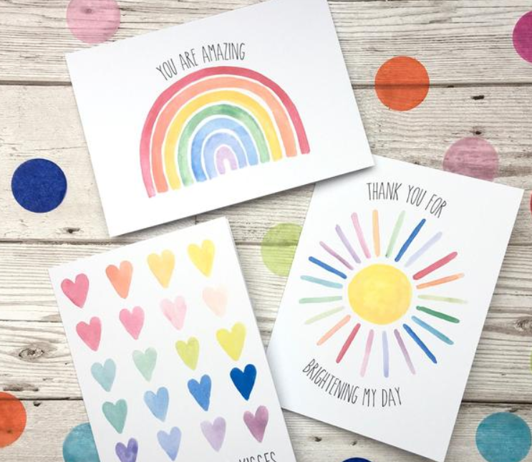
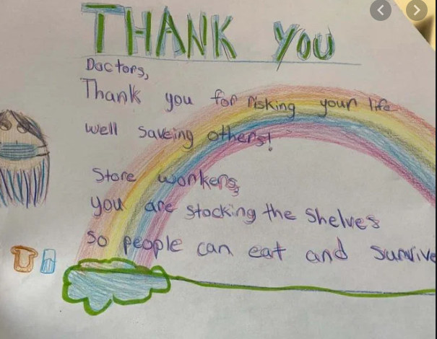
Here are some ideas of people you might like to thank:
I want to say thank you to my grown ups for caring for me.
I want to say thank you to my friends for playing fun games with me.

Slide 4
Remember we love to see your work so please email pictures to us at:
lara.crawford@worthvalleyprimary.co.uk
steph.milner@worthvalleyprimary.co.uk

