Slide 1
PSHE
18.01.21

Slide 2
On Purplemash I have uploaded an activity to reflect what we are good at. I have added text boxes so you can type straight onto the document. Save the document and then upload it back to Purplemash.

Slide 3
Yoga
As part of our mental wellbeing PSHE I would like you to have a go at some of the yoga steps in the next few slides.
If you’d like to take some photos of you doing it then you can always send them to me via email

Slide 4
Mountain Pose
Tadasana
Benefits
Improves posture, strengthens core muscles and legs.
1
Stand tall with your weight balanced evenly on your feet.
Firm your thigh muscles and pull in your tummy.
Press your shoulders back and hang your arms beside your torso.
Breathe deeply and hold as long as needed (at least two breaths).
2
3
4

Slide 5
Chair Pose
Utkataasana
Benefits
Strengthens legs, stretches shoulders and chest.
1
Start in mountain pose. (Standing with your feet shoulder width apart and arms by your side).
Exhale, and bend your knees as if you were sitting in a chair.
Reach your arms towards the ceiling with your palms facing each other.
Hold this pose and breathe.
2
3
4

Slide 6
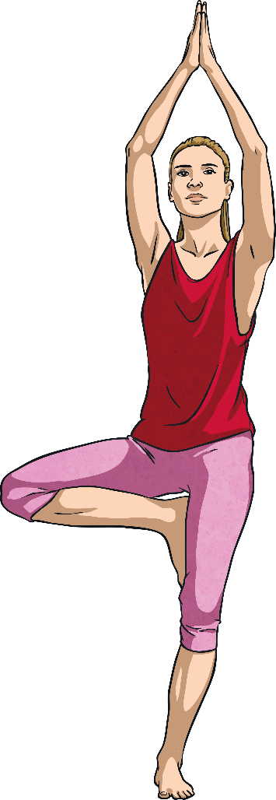
Tree Pose
Vriksasana
Benefits
Improves balance, strengthens thighs, calves and ankles, stretches legs and chest, develops concentration.
1
Begin in mountain pose. (Feet shoulder-width apart, hands at your sides.)
Lift your right foot, turning your knee out; place your foot on your leg wherever feels comfortable.
Press your hands together.
Raise your arms over your head and look up to your hands if possible.
Return hands to your chest and lower your right leg.
Repeat with left leg.
2
3
4
5
6

Slide 7
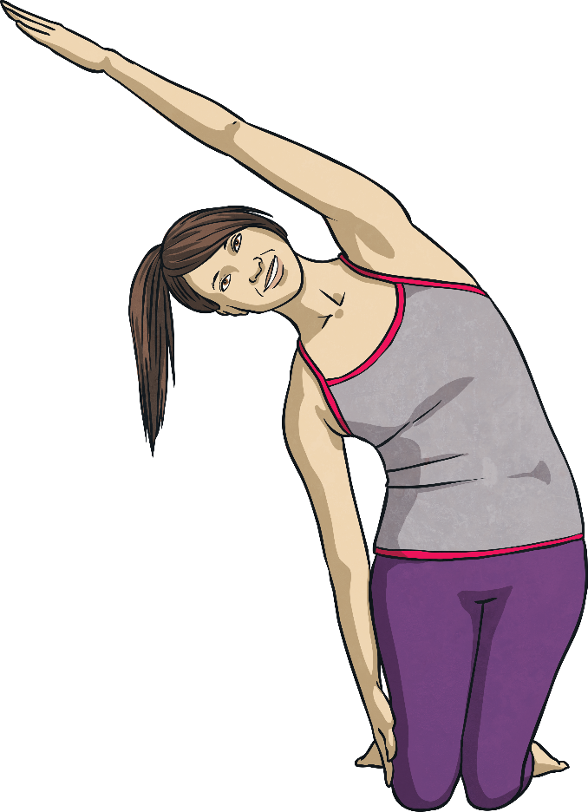
Rainbow Pose
Benefits
Stretches arms, abdominals, spine and chest; calms the mind.
1
Start on your knees. Raise both hands over your head.
Drop one hand by your side, exhale and arch your arm over your body.
Hold this position.
As you bring your dropped arm back over your head, straighten your body.
Repeat on the other side.
2
3
4
5

Slide 8
Elephant Pose
Benefits
Stretches legs and back, relieves stress and calms the mind.
1
Bend at the hips.
Let arms hang low then clasp fingers together.
Swing arms from side to side like a trunk. Swing your whole body from side to side to walk like an elephant.
2
3

Slide 9
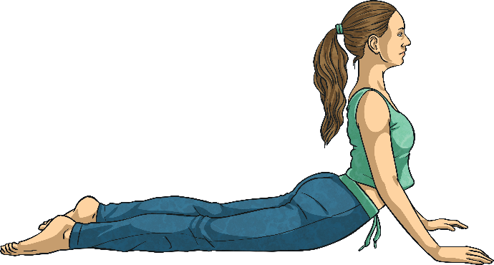
Cobra Pose
Bhujangasana
Benefits
Strengthens spine, backs of arms and legs; stretches shoulders, chest and belly, improves posture, helps relieve stress.
1
Begin by lying on your tummy.
While exhaling, lift your head and upper torso off the floor.
Gaze forward or slightly upward.
Hold this position, then release.
2
3
4

Slide 10
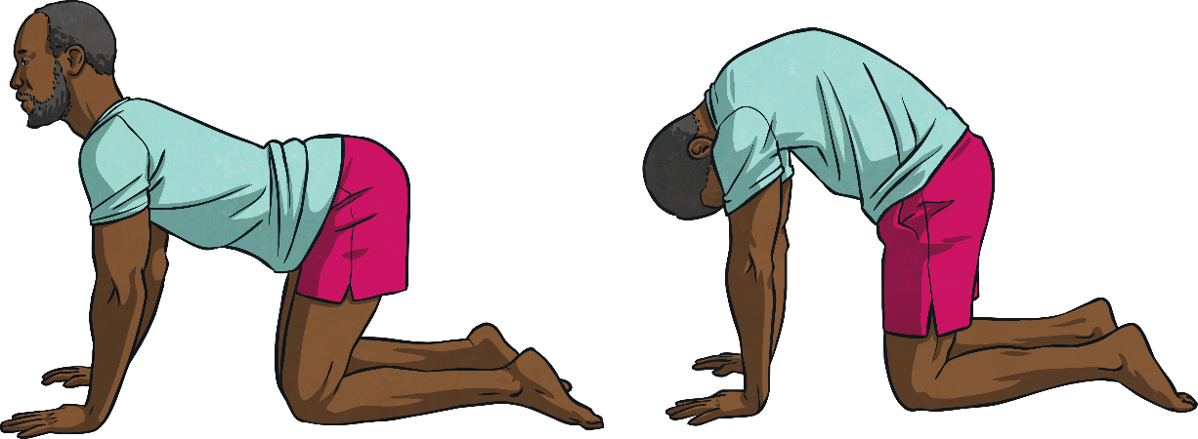
Cat Cow Pose
Marjaryasana Bitilasana
Benefits
Stretches torso and neck, gently massages spine and internal organs.
Start by kneeling on hands and knees. Make sure hands are below your shoulders and your knees below your hips.
Inhale and look up to the ceiling, allow your belly to sink toward the floor.
Exhale and round your back towards the ceiling and look at your belly.
Repeat.
1
2
3
4

Slide 11
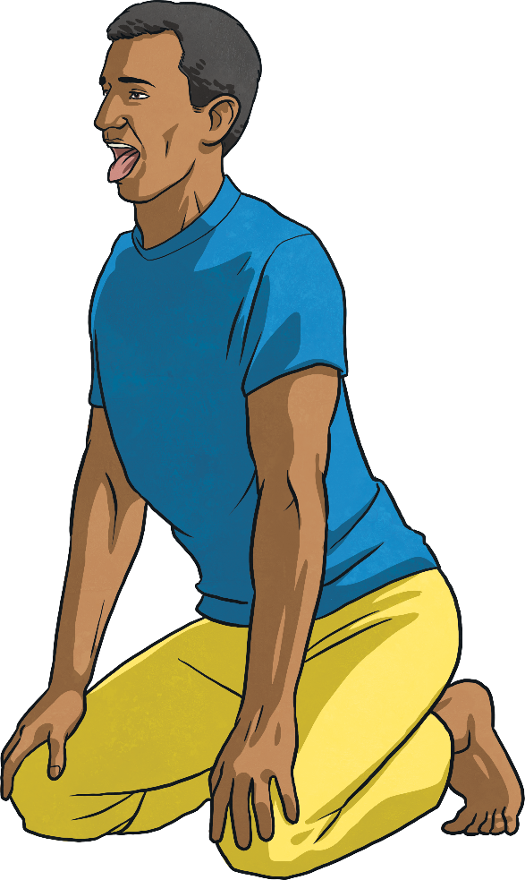
Lion Pose
Simhasana
Benefits
Stretches hips, thighs and ankles; calms the mind, relieves stress and fatigue.
1
Start on your knees, then sit back onto your heels.
Spread your fingers out and press your palms onto your knees.
Take a deep breath in through your nose.
Open your mouth, stretch out your tongue, open your eyes wide and let your breath out through your mouth.
Repeat a few times.
2
3
4
5

Slide 12
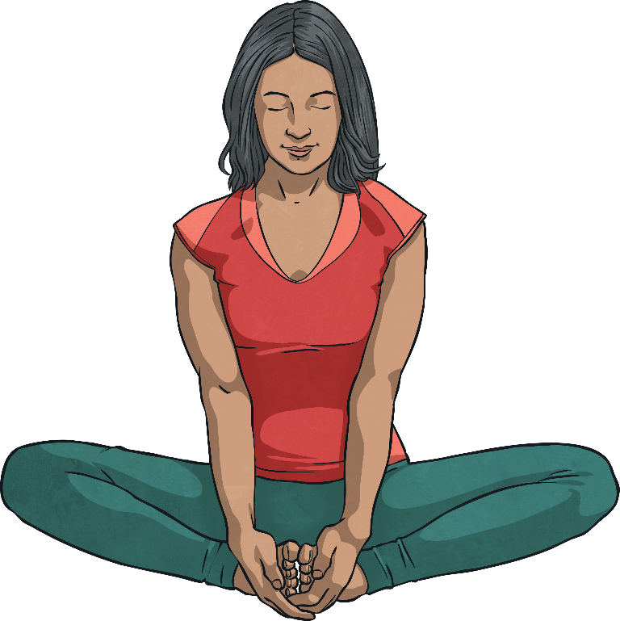
Butterfly Pose
Baddha Konasana
Benefits
Calms the body and mind, helps relieve stress, headaches and fatigue.
1
Begin by sitting with the soles of your feet together.
Wrap your hands around your feet, keep your back straight.
Gently bounce your knees to flap your butterfly wings.
2
3

Slide 13
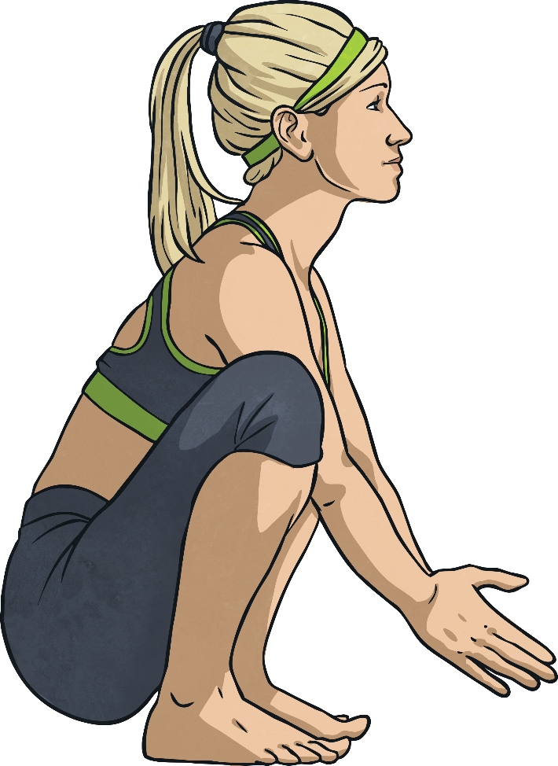
Frog Pose
Ardha Bhekasana
Benefits
Tones legs and increases hamstring flexibility.
Squat on the floor, balancing on your toes, knees spread wide, hands on the floor or out in front of you. Wherever makes you feel most balanced.
Look up and inhale. As you exhale, straighten your legs so you are in a standing position, lower your head towards your knees.
Return to the first position, then repeat.
1
2
3

Slide 14
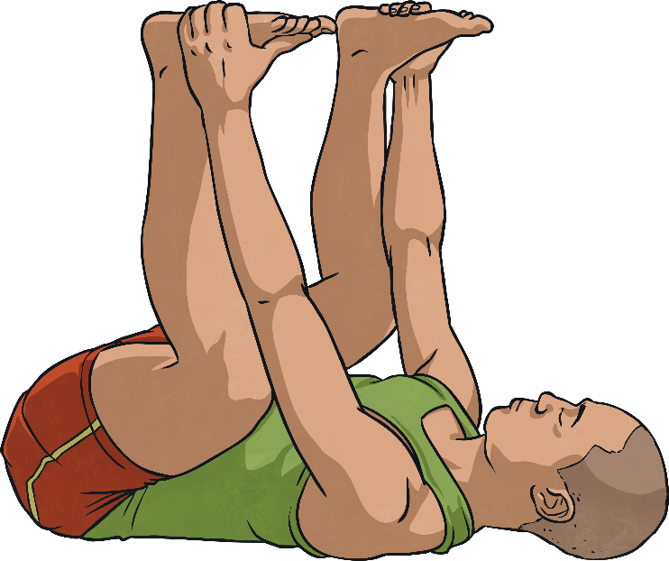
Happy Baby Pose
Ardha Bhekasana
Benefits
Gently stretches inner groin and spine, calms the mind and helps relieve stress and fatigue.
1
Lie down on your back.
Exhale, bend your knees into your belly and hold onto your feet.
Allow your body to gently rock side to side.
2
3

