Slide 1
Monday 1st February 2021
Phonics Group 1
Today we are learning to write some HF (high frequency/ words we see often) and practise writing CVCC words.

Slide 2
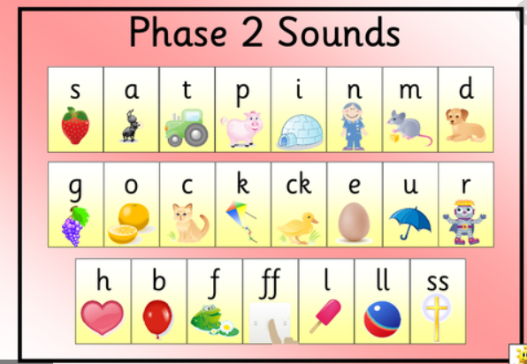
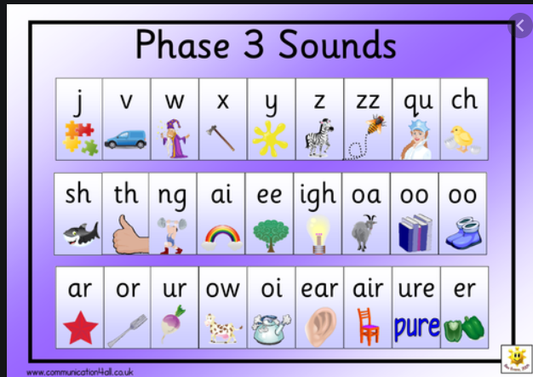
Can you practise your phase 2 and 3 phonemes on the sound mats.
If you would like some extra practise:
Can you practise them on phonics play and play the speed trial game. Remember to do extra practise with any that you find tricky.

Slide 3
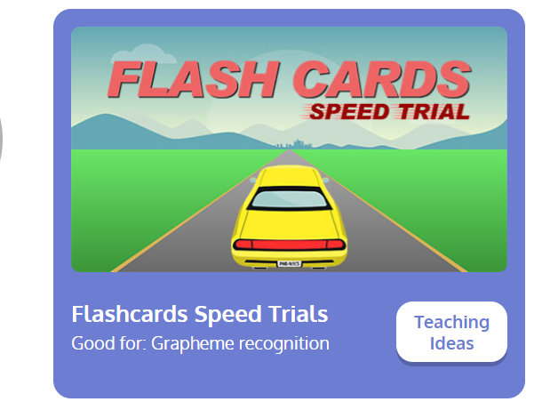

Revisit:
Can you practise the letter sounds we know so far?
https://www.phonicsplay.co.uk/resources/phase/2/flashcards-speed-trials
Phonics play:
Username: jan21
Password: home
Can you play flashcards speed trial and practise all of the phase 2 and 3 phonemes.

Slide 4
Can you ask someone to test you? Can they say the word and you write it quickly? Can you spell each word correctly?
Teach:
Today we are learning to read and write the HFW (High frequency words):
he
she
we
me
be

Slide 5
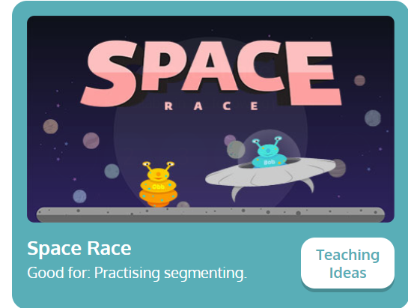
Practise:
Can you practise spelling words by playing ‘Space Race’ on phonicsplay.co.uk
https://www.phonicsplay.co.uk/resources/phase/2/space-race
Username: jan21
Password: home
Space Race then click phase 4. You can practise earlier phases if you would like extra practise.

Slide 6
Apply:
Can you practise reading the sentences below?
If you get stuck remember to sound out each word carefully.
The chimp sings a song as he jumps up and down.
We put the tent next to the pond.
He put the milk in the sink.

