Slide 1
Monday 25th January 2021
Phonics Group 2
Today we are learning to explore the alternative pronunciations of the ‘u’ grapheme.
A grapheme is a way of writing down a letter sound (phoneme).

Slide 2
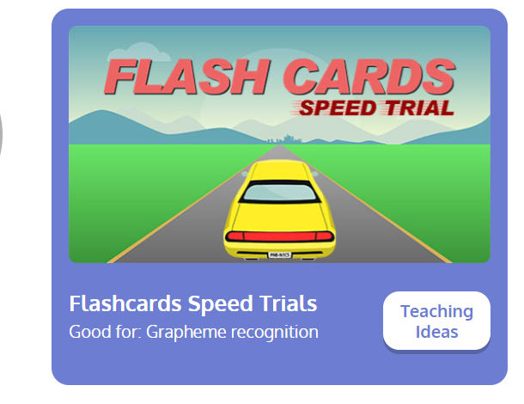
Revisit:
Can you practise the letter sounds we know so far?
https://www.phonicsplay.co.uk/resources/phase/2/flashcards-speed-trials
Phonics play:
Username: jan21
Password: home
Can you play flashcards speed trial and practise all of the phase 3 and 5a phonemes

Slide 3
Teach:
Today we are learning about alternative pronunciations for the u grapheme:
The letter ‘u’ can make two different sounds.
Short u | Long u
plug hump but gust under pull bull pudding full awful | unit unicorn music tuba stupid computer

Slide 4
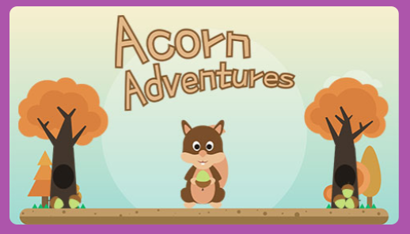
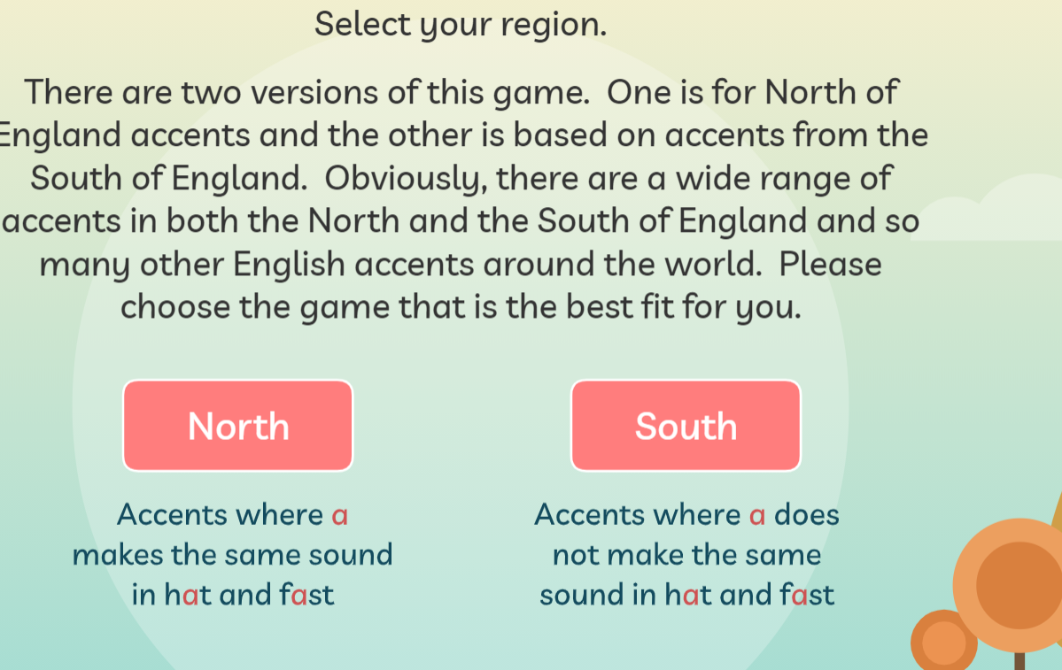
Practise
Practise:
Can you practise reading words with the alternative pronunciation for the u grapheme? Play on the game Acorn Adventures- click on the letter u.
https://www.phonicsplay.co.uk/resources/phase/5/acorn-adventures
Username: jan21
Password: home

Slide 5
Apply:
Can you practise reading the silly sentences below?
Can a unicorn play music on a tuba?
Will a stupid human get stuck in a pudding if they eat it sitting on a muddy cushion?
Will it be fun for a duck to use a computer?

