Slide 1
Tuesday 26th January 2021
Phonics Group 1
Today we are learning to read and spell CVCC words.
(A CVCC word (consonant, vowel, consonant, consonant) examples of CVCC words are: hunt, fast, cart, milk, want.

Slide 2
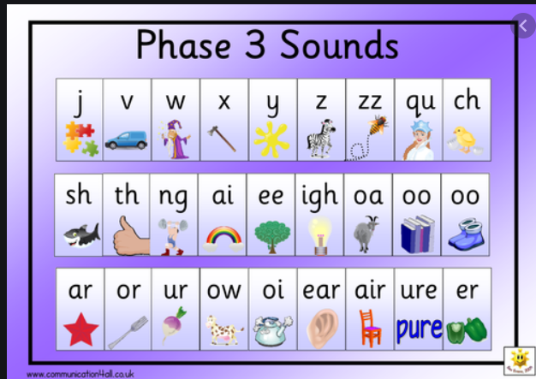
Can you practise your phase 2 and 3 phonemes on the sound mats.
If you would like some extra practise:
Can you practise them on phonics play and play the speed trial game. Remember to do extra practise with any that you find tricky.

Slide 3
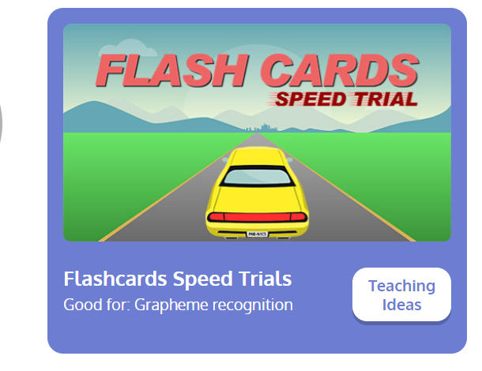
Revisit:
Can you practise the letter sounds we know so far?
https://www.phonicsplay.co.uk/resources/phase/2/flashcards-speed-trials
Phonics play:
Username: jan21
Password: home
Can you play flashcards speed trial and practise all of the phase 2 and 3 phonemes.

Slide 4
Teach:
Can you watch this video to help you learn how to read and write CVCC words.
https://www.youtube.com/watch?v=xG-xKG7I83E&safe=active

Slide 5
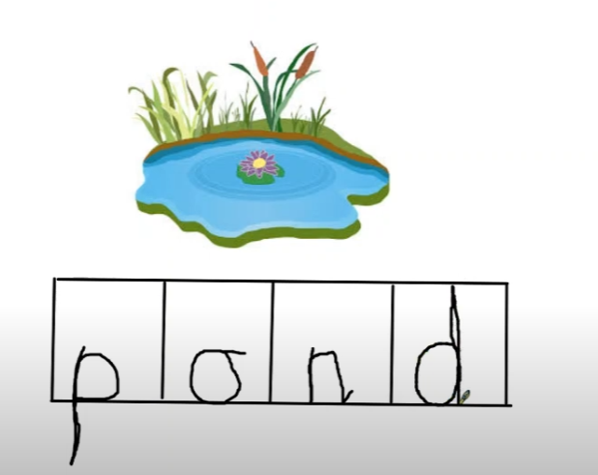
Practise: Can you write the words to match the pictures?
Remember to sound out each word carefully.
Here is an example
of a completed
phoneme frame. One
letter sound
(phoneme) goes in
each box.)

Slide 7
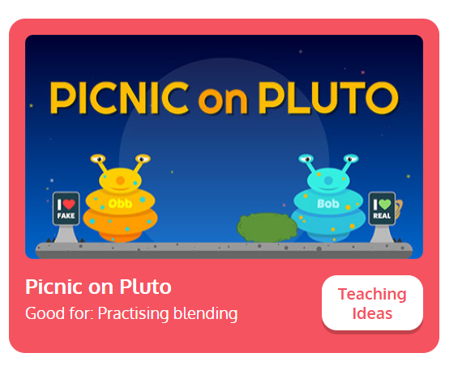
Practise reading:
Can you practise blending CVCC words by playing Buried Treasure on phonicsplay.co.uk
https://www.phonicsplay.co.uk/resources/phase/2/buried-treasure
Username: jan21
Password: home
Picnic on Pluto then click phase 4 CVCC words

Slide 8
Apply:
Can you practise reading the sentences below?
If you get stuck remember to sound out each word carefully.
I can boast that I had toast for my lunch.
I think that pink socks might be the best.
If you feel down in the dumps then jump and sing.

