Slide 1
Tuesday 19th January 2021
Phonics Group 1
Today we are learning to read some tricky words and practise reading CVCC words.

Slide 2
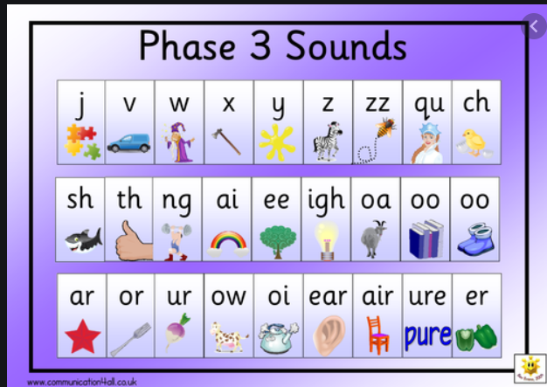
Can you practise your phase 2 and 3 phonemes on the sound mats.
If you would like some extra practise:
Can you practise them on phonics play and play the speed trial game. Remember to do extra practise with any that you find tricky.

Slide 3
Revisit:
Can you practise the letter sounds we know so far?
https://www.phonicsplay.co.uk/resources/phase/2/flashcards-speed-trials
Phonics play:
Username: jan21
Password: home
Can you play flashcards speed trial and practise all of the phase 2 and 3 phonemes.

Slide 4
Teach:
Today we are learning to read and write the tricky words said and so.
These are tricky words because they can not be sounded out. We just have to learn them.
https://www.youtube.com/watch?v=MKlcgUNGK7E

Slide 5
Practise:
Can you practise blending CVCC words by playing Buried Treasure on phonicsplay.co.uk
https://www.phonicsplay.co.uk/resources/phase/2/buried-treasure
Username: jan21
Password: home
Picnic on Pluto then click phase 4 CVCC words

Slide 6
Apply:
Can you practise reading the sentences below?
If you get stuck remember to sound out each word carefully.
Mum said “It is best not to jump on the bed.”
A lost chimp felt so sad when he wept.
This belt is so tight it hurts my waist.

