Slide 1
Tuesday 26th January 2021
Phonics Group 2
Today we are learning to explore the alternative pronunciations of the ‘ow’ grapheme.
A grapheme is a way of writing down a sound (phoneme).

Slide 2
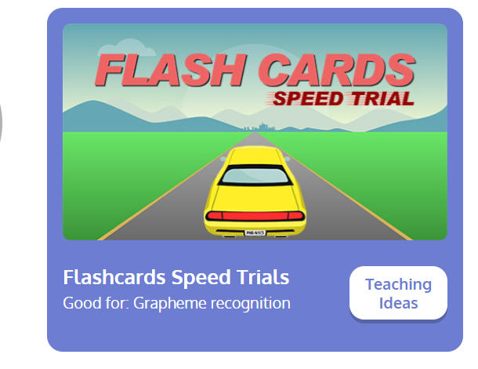
Revisit:
Can you practise the letter sounds we know so far?
https://www.phonicsplay.co.uk/resources/phase/2/flashcards-speed-trials
Phonics play:
Username: jan21
Password: home
Can you play flashcards speed trial and practise all of the phase 3 and 5a phonemes

Slide 3
Teach:
Today we are learning about alternative pronunciations for the ow grapheme:
ow can make two different sounds.
ow | ow
cow owl crown frown | low bowl snow window show

Slide 4
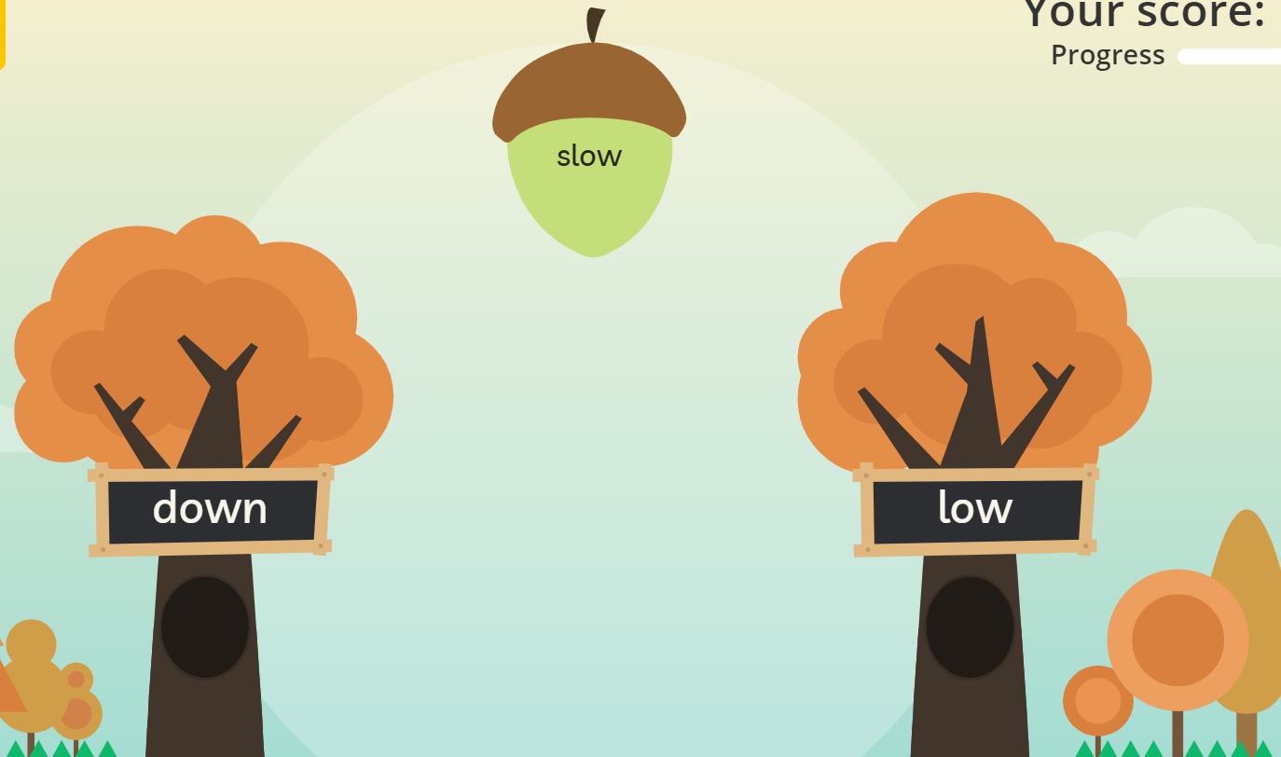
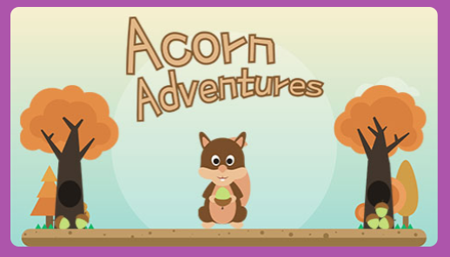
Practise:
Practise:
Can you practise reading words with the alternative pronunciation for the ow grapheme? Play on the game Acorn Adventures- click on ow.
https://www.phonicsplay.co.uk/resources/phase/5/acorn-adventures
Username: jan21
Password: home

Slide 5
Apply:
Can you practise reading the silly sentences below?
Is a brown owl at the window?
Did the cow put his food in a bowl?
Can a shadow be brown?

