Slide 1
PSHE
Monday
11.01.21
carole.nicholson@worthvalleyprimary.co.uk

Slide 2
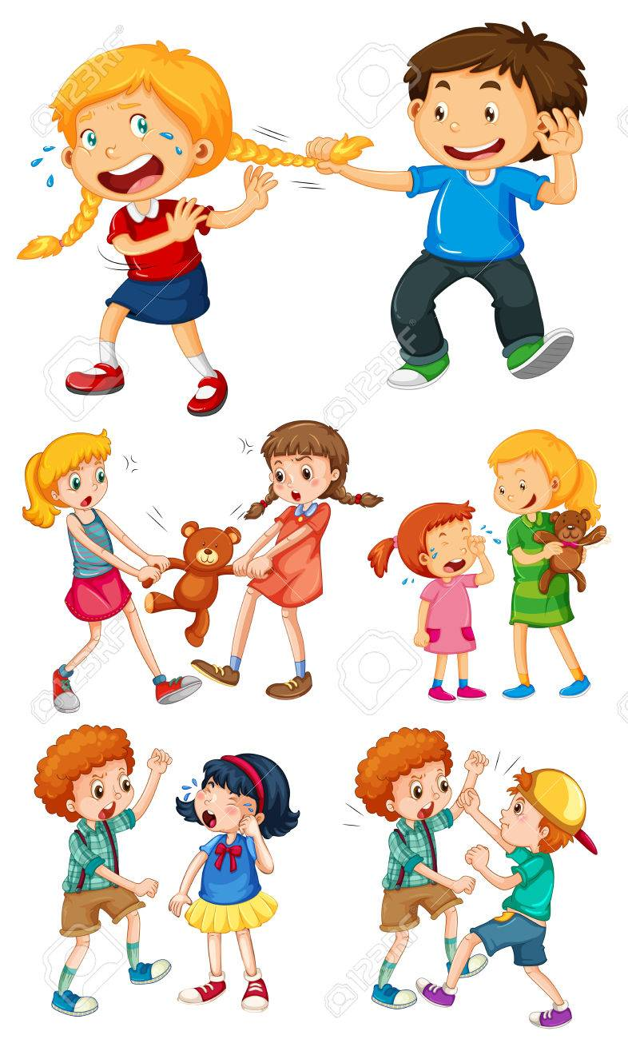
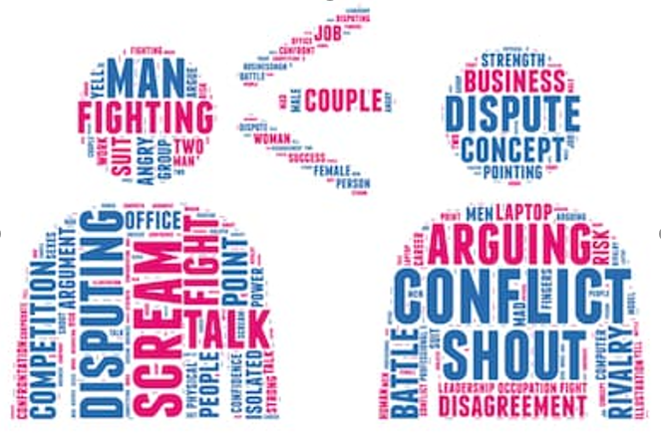
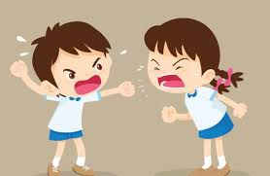
Can I discuss issues respectfully? Can I listen to and respect other points of view? Can I constructively challenge points of view they disagree with?

Slide 3
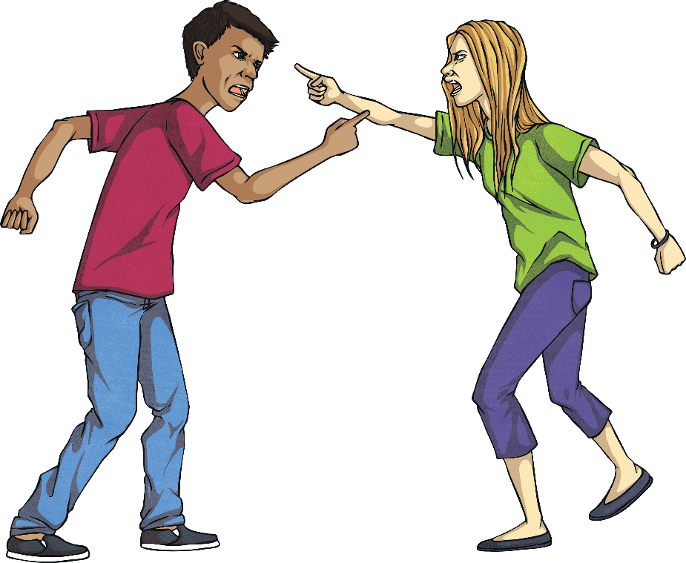
What Is Conflict?
Conflict is when people have a serious disagreement. It can last for a long time and be difficult to solve. Sometimes conflicts can involve physical violence.
At some point in our lives, we all come in to conflict with people. Learning how to resolve (end) conflict is an important life skill.
Think about it!
Have you ever been in conflict with someone?
What happened?
Did you resolve it?

Slide 4
What Causes Conflict?
Think about it!
Why do you think conflict happens?
Conflict can be caused by lots of things. Some of them include:
different beliefs, such as political or religious beliefs;
stubbornness – refusing to see things from someone else’s point of view;
past arguments that haven’t been sorted out.

Slide 5
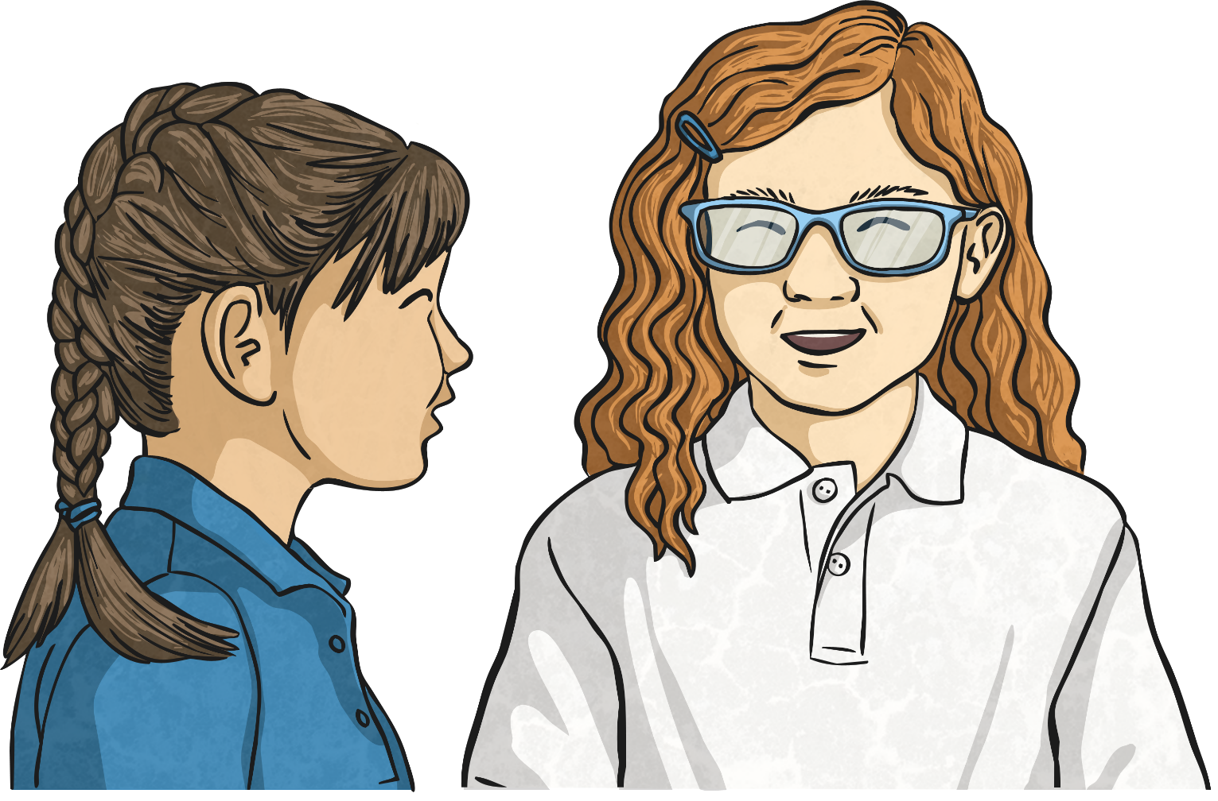
How Can We Resolve Conflict?
Make a list or spider diagram on the different ways you think conflict can be resolved.
Seeing both sides of a story - KS2 PSHE and Citizenship - BBC Bitesize

Slide 6
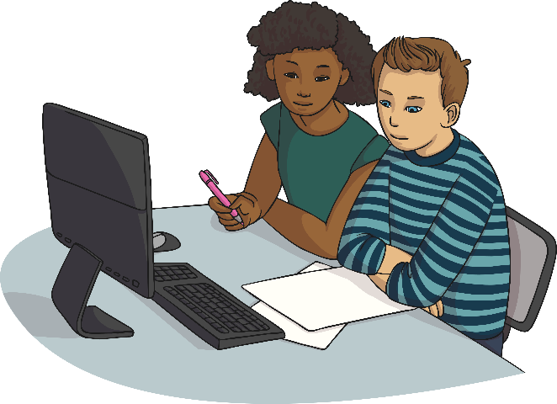
Other Ways to Resolve Conflict
Listening to others is a good way to help resolve conflict. Try to listen carefully to what the other person is saying instead of only talking.
It can be tricky to solve a conflict and sometimes you might need some outside help. Find someone that everyone involved trusts. It could be a sensible class member or an adult from your school. Calmly, explain what has happened and listen to their advice.
Think about it!
Have you tried any of these methods?
What happened?

Slide 7
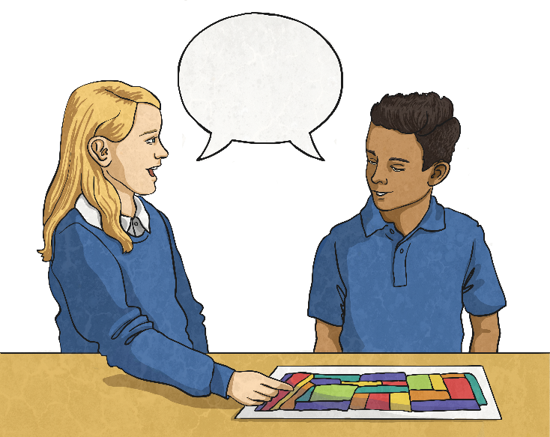
Other Ways to Resolve Conflict
Compromise is when people agree to give up on a bit of something they might want in order to find a fair solution to a problem. If all the people in a conflict compromise a bit, you should be able to find a fair solution.
Empathy is when you try to understand how another person is feeling. Use your imagination to think about how the other person is feeling.
Think about it!
Have you tried any of these methods?
What happened?

Slide 8
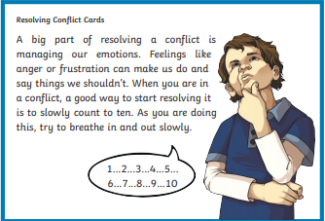
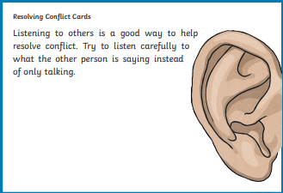
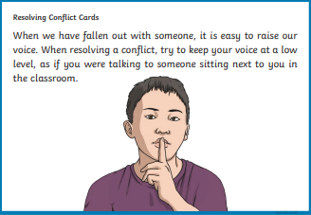
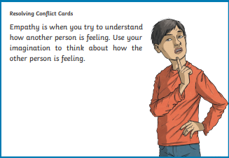
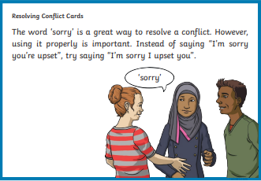

Slide 9
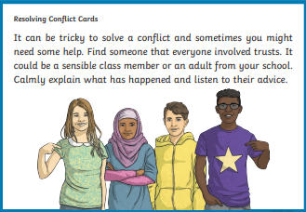
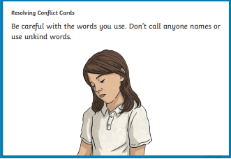
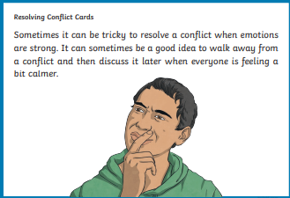
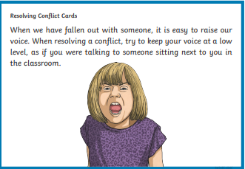
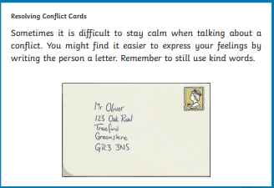
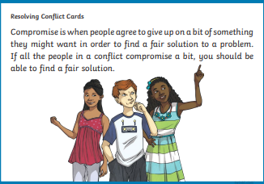

Slide 10
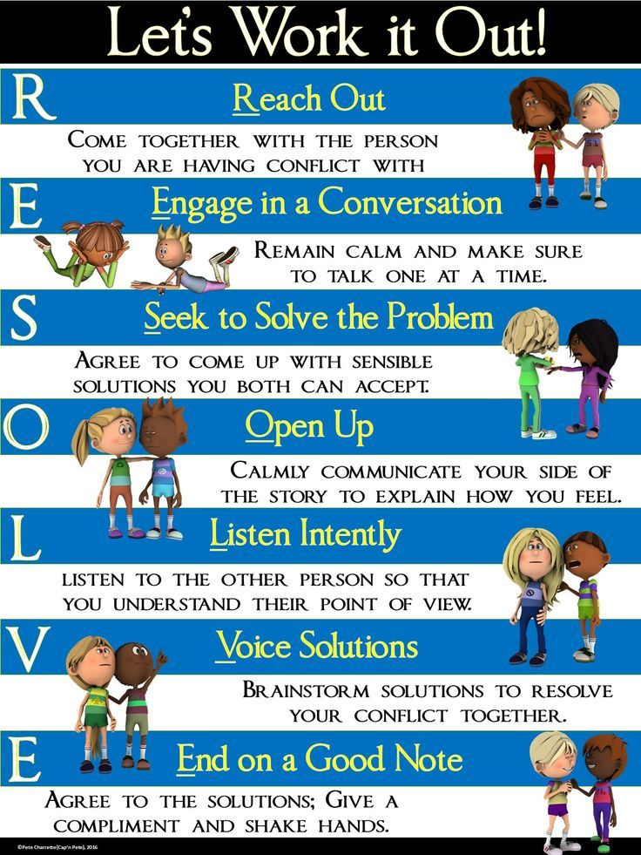
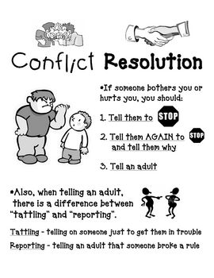
Can you design a poster to help others resolve conflict positively?

Slide 11
