Slide 1
Science
Thursday 14/01/21

Slide 2
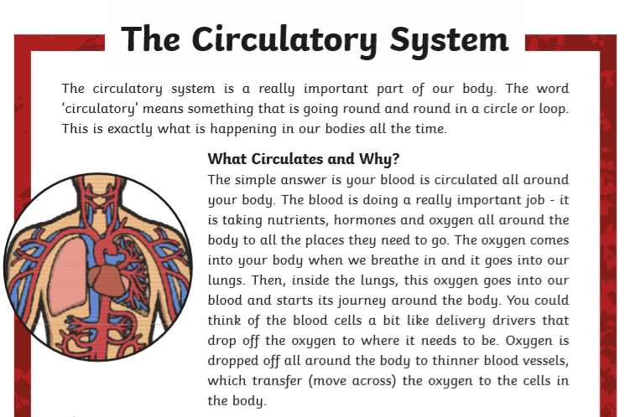
Can I explain how blood moves around the body?

Slide 4
Make notes as you read, or listen to the powerpoint. You can then write your own paragraph on the importance of the heart and the circulatory system.
Click on the link you what a clip on the circulatory system on BBC Bitesize https://www.bbc.co.uk/bitesize/topics/zwdr6yc/articles/zs8f8mn

Slide 5
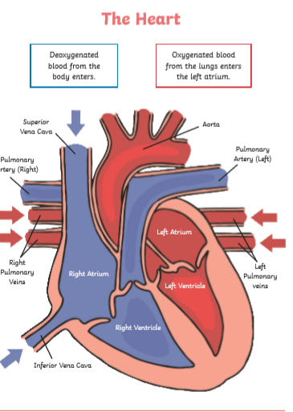
Here is a labelled diagram of the heart. Draw your own diagram and label it.

