Slide 1

Science
Earth and Space
19.01.21

Slide 2
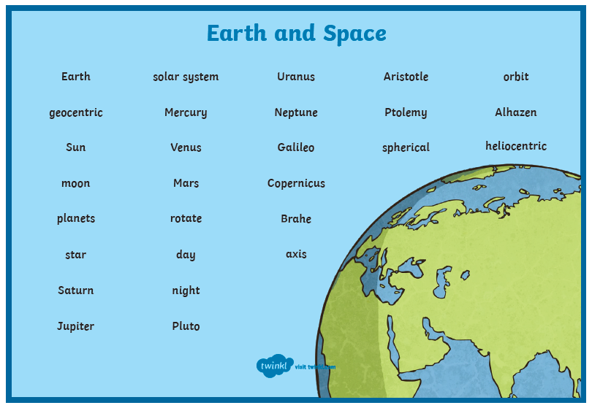
Key vocabulary

Slide 3
Can I explain how the Earth orbits the Sun?
Make sure your sound is turned off.
Watch this video https://www.bbc.co.uk/bitesize/clips/z6vfb9q it explains how the Earth orbits the Sun.
Once you have watched it without the sound, write a script for the video explaining the orbit of the Earth, do this using the 2write tool in PurpleMash. Save your work as: The orbit of Earth
Email me your scripts, then watch the video again with the sound on. How close did your explanation match theirs?

Slide 4
Can I explain day and night?
https://www.bbc.co.uk/bitesize/clips/zrd9wmn
Watch the video on how day and night occur.
Follow these instructions to model it yourself at home:
You will need a torch (you can use the torch app on a phone or tablet if you have access to one), a globe (a spherical object like an orange) and a pen.
What to do:
Using the pen, make a mark on the ‘globe’. This will represent a person
Shine the torch on your location. Then, rotate the globe anticlockwise.
Remember to hold the torch still.
You should see how the mark you made enters day and night
You may need someone to help you be the torch or the ‘globe’.
Please email me any photos of you completing this. It would look fab on our display

Slide 5
Use the 2write tool on PurpleMash
Can you explain how day and night occur?
Remember this should be in your own words using scientific vocabulary.
Remember to give your work a title and think carefully about your punctuation.
Save your work as Day and night

