Slide 1
Spanish Española Friday 14.01.21 Practise the vocabulary on the word mat. Think carefully about your pronunciation.

Slide 3
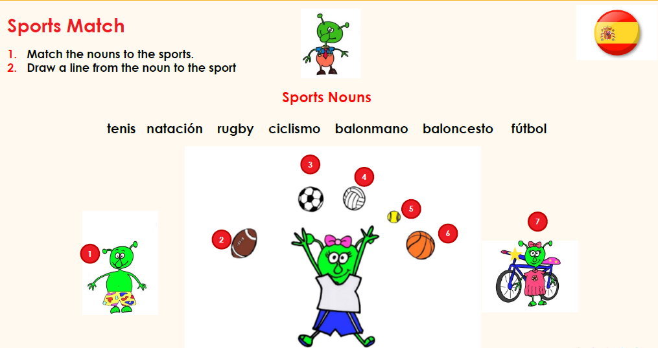
Can you correctly match the nouns to the sports?

