Slide 1
Thursday 28th January 2021
English tasks

Slide 2
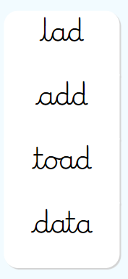
Handwriting
Please practise the following words:
Look on the letterjoin website to see how to form them correctly.
https://letterjoin.co.uk Then click on easy words
Username: lj8943
If you are using a laptop the password is: home
If using an ipad or tablet the password is: capital L (Make the shape of a capital L)

Slide 3
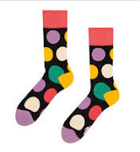
Can you knock our socks off with your neat writing?
Now that you have practised your letters on letterjoin can you practise on a piece of paper?
Can you send a picture of your writing to me?
s.hiley@worthvalleyprimary.co.uk

Slide 4
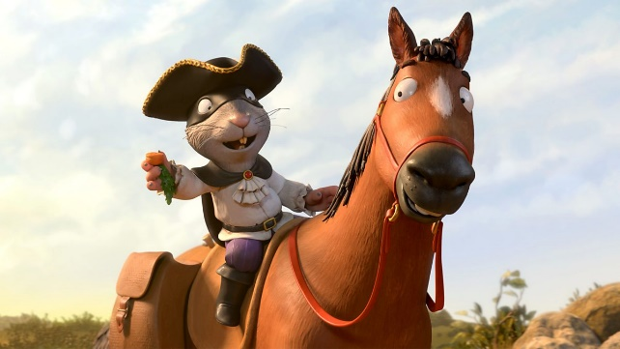
This week we are reading
The highway rat
by Julia Donaldson.
You can re-watch the film using the link below if you have forgotten what happens in the story?
https://www.bbc.co.uk/iplayer/episode/b09kkt1k/the-highway-rat

Slide 5

Writing task
Today we are going to be thinking about speech!
We will be adding speech bubbles to some of the characters from this week’s story the Highway Rat.
Could you choose 3 of your favourite parts of the story and draw the pictures giving the characters a speech bubble and a new speaking part.
There are two examples for you on the next slides.

Slide 6
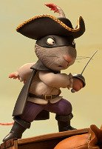
EWW! I don’t like sprouts, give me your cupcakes and chocolate!

Slide 7
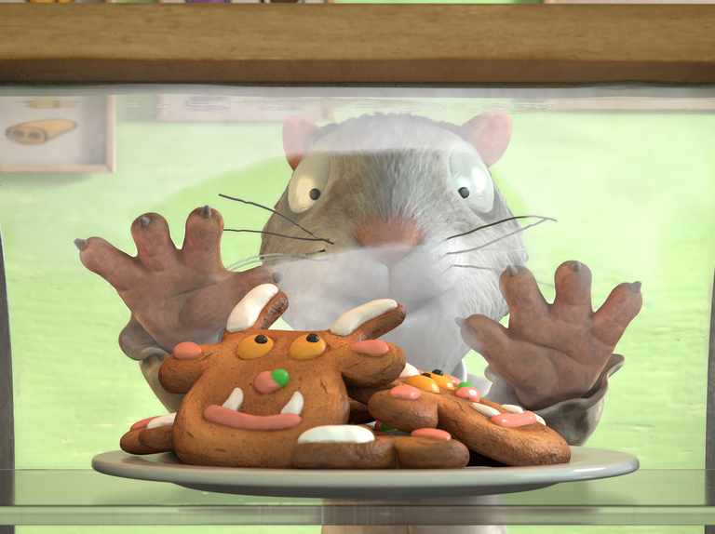
Wow! That Gruffalo biscuit looks so tasty!

Slide 8

Don’t forget your neatest handwriting, finger spaces, and full stops!

Slide 9
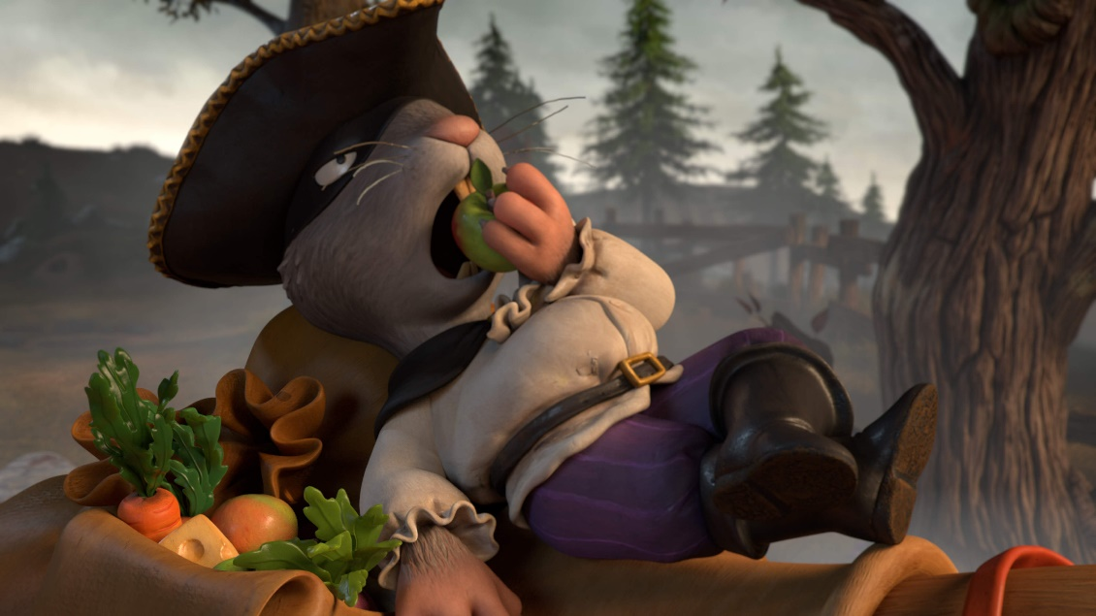
Remember I love to see your work so please email pictures to me at:
s.hiley@worthvalleyprimary.co.uk

