Slide 1
Maths Thursday 14-01-21

Slide 2
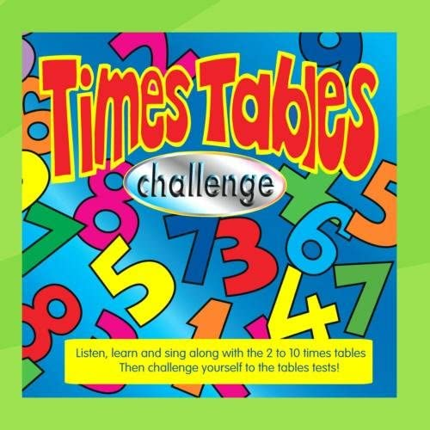
It’s time for a tables work out. Use the 2 x table challenges. Do challenges Step 3 and Step 4.
https://www.timestables.co.uk/2-times-table.html

Slide 3
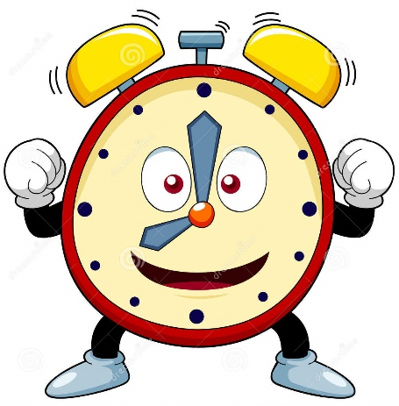
Let's work on our time targets this week.
You will find this clock will help you. You can move the hands to make times. . It will tell you the time as you move the hands. If you press off before you make the time, then press 12 and it will give you the answer so that you can check if you are right. 8 o'clock will show as 8:00.
https://www.visnos.com/demos/clock
Time to the half hour – half past.
We are all telling the time to the half hour today.
https://whiterosemaths.com/homelearning/summer-archive/year-1/
If you were having another go at reading time to the hour yesterday, do this work sheet.
If you tackled the half hour yesterday warm up with this work.
Answers – don’t peek. warm up answers.docx

Slide 4
Now for a bit of a challenge! Here are a mixture of times to the hour and half hour. Look at the big hand. If it points to the 12 it’s an o’clock, if it points to the 6, it’s a half past time.
Try not to look until you have finished.

