Slide 1
Maths Thursday 21-01-21

Slide 2
Let’s start the week with some tables.
Practise your times tables for 15 minutes on Times Tables Rockstars , click on the link and use your login and password. If you have forgotten these email Mrs Grant.
http://play.ttrockstars.com/auth/school/student
Have you been able to upgrade to cool outfits and instruments?
Now go onto the next slide and try Simple or Tricky.
I have put this as a work sheet on Purple Mash so that you can write your answers. Sentences please.

Slide 3
Simple or Tricky
Equipment: Whiteboard and pens
Look at the numbers below.
Which 2 numbers would be easy to add and why?
Which 2 numbers might be tricky? Can you think of ways of making them easier?
How would you go about adding them all together?
10
2
1
11
10
19
17
7
8
50
12
50
90
HOME

Slide 4
Let's continue to work on our time targets this week.
You will find this clock will help you. You can move the hands to make times. . It will tell you the time as you move the hands. If you press off before you make the time, then press 12 and it will give you the answer so that you can check if you are right. 8 o'clock will show as 8:00.
https://www.visnos.com/demos/clock
We have learnt about how to read quarter past the hour. Now we are ready for quarter to the hour.
https://www.youtube.com/watch?v=HKZOGR1pz1I

Slide 5
Now try these questions.
You can use the work on this Power Point and write the answes on paper.
Or open the sheet on the website and type in the boxes.
Login to Squirrel to dos on Purple mash. Write the answers in the text boxes.
https://www.purplemash.com/sch/worth-bd22

Slide 6
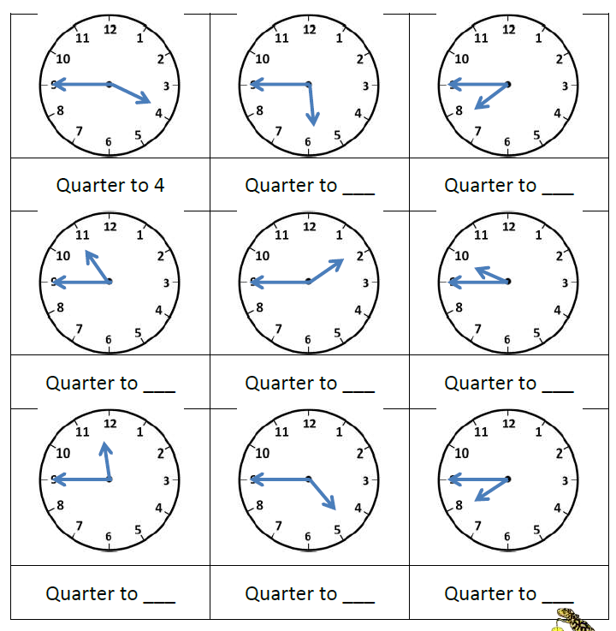

Slide 7
Here are the answers!

Slide 8
