Slide 1
Friday 22nd January 2021
Phonics Group 1 and 2
Today we are learning to spell and read tricky words.

Slide 2
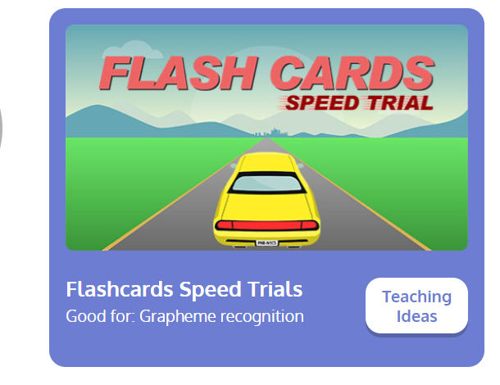
Revisit:
Can you practise the letter sounds we know so far?
https://www.phonicsplay.co.uk/resources/phase/2/flashcards-speed-trials
Phonics play:
Username: jan21
Password: home
Can you play flashcards speed trial and practise all of the phase 3 and 5a phonemes

Slide 3
Can you practise reading and writing these words? Can you ask your grown ups to say them and you write them? Can you spell them correctly?
Teach:
Today we are going to learn tricky words.
Follow the links to on the next slide to sing the tricky word songs.
Can you read and spell each word correctly?
WARNING! The songs are very catchy!

Slide 4
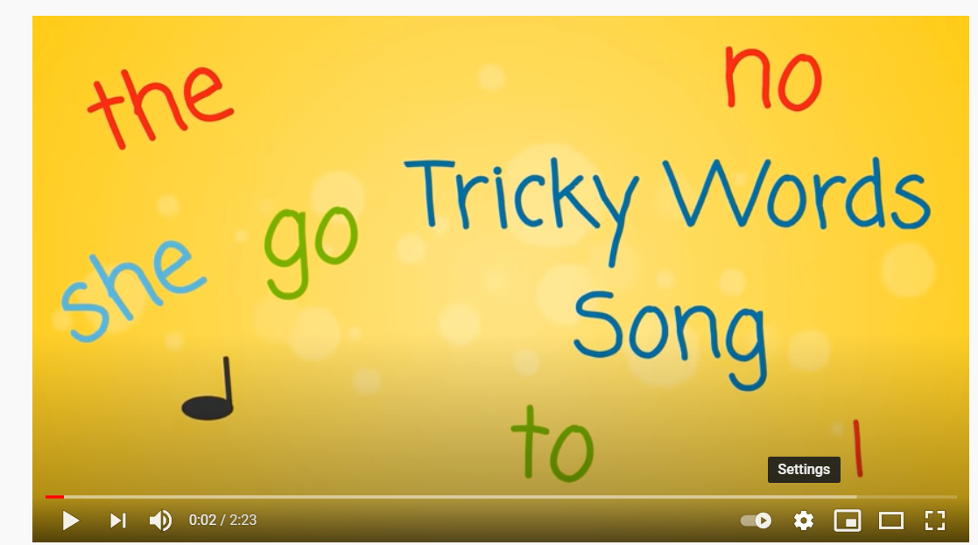
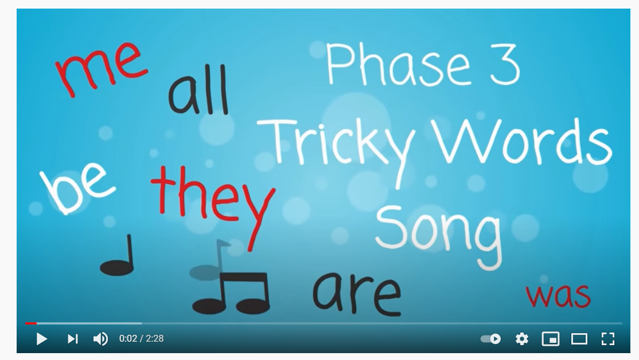
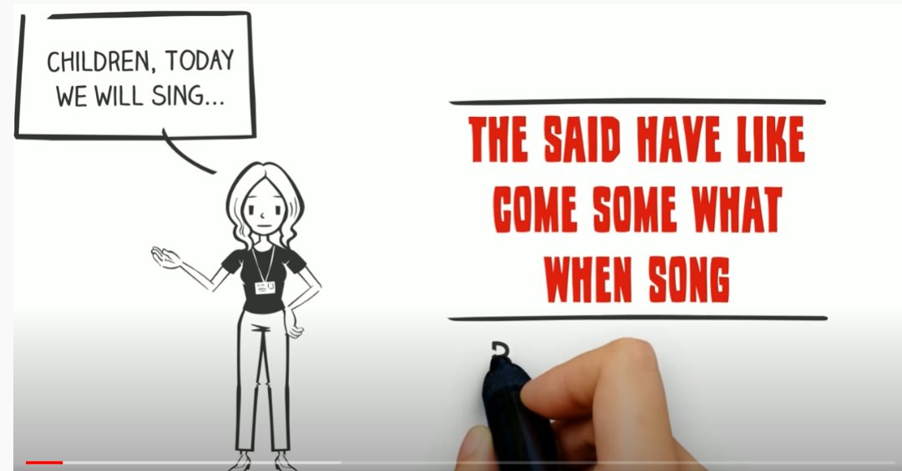
Tricky words
Phase 2:
https://www.youtube.com/watch?v=TvMyssfAUx0
Phase 3:
https://www.youtube.com/watch?v=R087lYrRpgY
Phase 4:
https://www.youtube.com/watch?v=3NOzgR1ANc4

Slide 5
Can you test yourself? How many of these words can you read and spell correctly?

