Slide 1
Maths
Tuesday 19-01-21

Slide 2

Let’s start the week with some tables.
Practise your times tables for 15 minutes on Times Tables Rockstars , click on the link and use your login and password. If you have forgotten these email Mrs Grant.
http://play.ttrockstars.com/auth/school/student
Have you been able to upgrade to cool outfits and instruments?

Slide 3
Some questions to try. Think back to the work we did before Christmas
You will need to write down your answers and working out on a piece of paper.
You could take a picture of your work to show me.

Slide 4
Use the cards to make all of the 2-digit numbers you can that are less than 30.
1
3
5
8
13, 15, 18
answer

Slide 5
Use the cards to make all of the 2-digit numbers you can that are greater than 50.
1
3
5
8
51, 53, 58, 81, 83, 85
answer

Slide 6

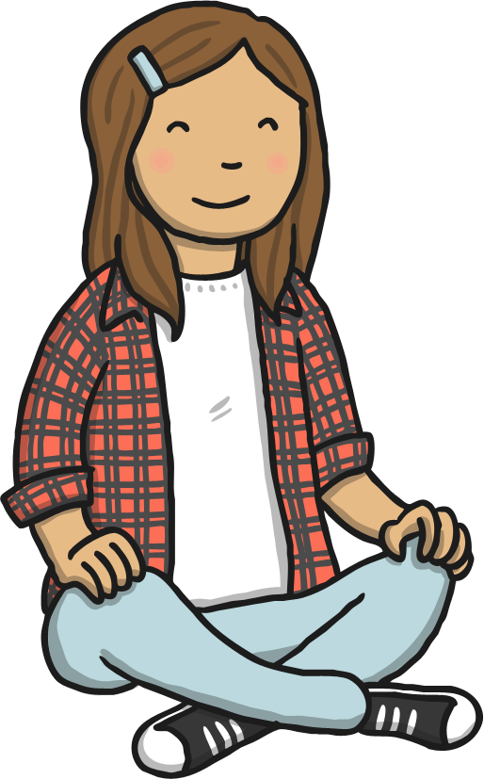
I’m thinking of a number. My number has three tens and five ones. What is my number?
35
answer

Slide 7
Which number is the arrow pointing to?
68
60
70
answer

Slide 8
Our challenge to day is to :-
Add three one-digit numbers (using number bonds to 10)
Steps to success.
Use your number bonds to ten.
Circle the two numbers that make 10 and then add the third.
Use these power point slide to help you.

Slide 9









Slide 10







Slide 11
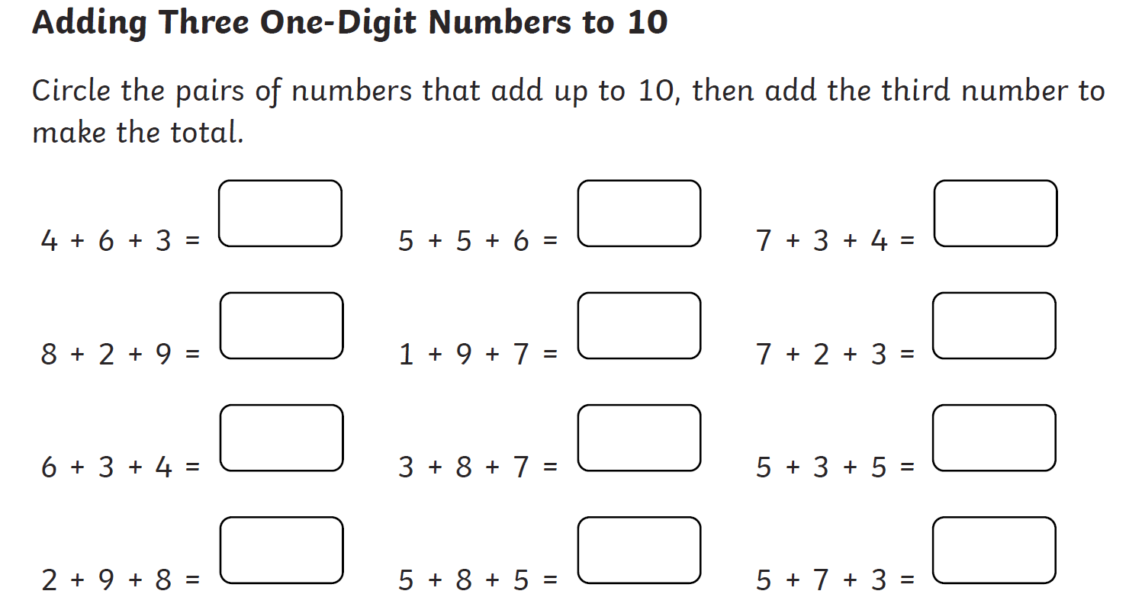

Slide 12
Now try these questions.
You can use the work on this Power Point or
Login to Squirrel to dos on Purple mash. Write the answers underneath on the sheet,
https://www.purplemash.com/sch/worth-bd22
The answers are on this PPP.

Slide 13
