Slide 1
Wednesday 13th January 2021
English tasks.

Slide 2
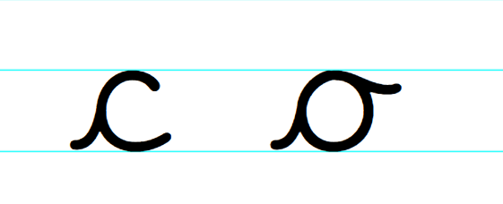
Handwriting
Please practise the first group of easy letters ‘c, o’ (lowercase).
https://letterjoin.co.uk
Username: lj8943
Password: capital L (Make the shape of a capital L if you are accessing the site via a tablet or an iPad)

Slide 3
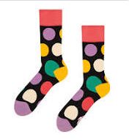
Can you knock my socks off with your neat writing?
Now that you have practised your letters on letterjoin can you practise on a piece of paper?
Can you send a picture of your writing to us?
lara.crawford@worthvalleyprimary.co.uk
steph.milner@worthvalleyprimary.co.uk

Slide 4
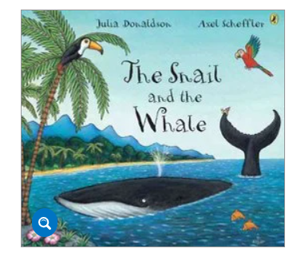
Reading and Writing Task
This week we are reading the Snail and the Whale by Julia Donaldson.

Slide 5
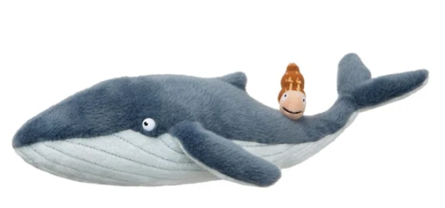
Writing Task
We would like you to send a postcard from the snail to his family and friends in the flock on the rock, telling them about his amazing journey, remember some of the fantastic places the snail and the whale travelled to, use your amazing adjectives to describe the places and draw a fantastic picture to go with your writing.
Don’t forget to use your year 2 writing skills.
Can you ask them a question? Remember how we use question marks.
There is an example on the next slide

Slide 6
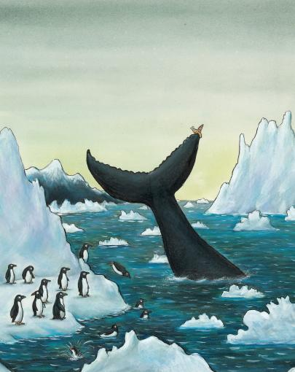
To the flock,
I hope you are ok? I am in the coldest sea, I can see penguins and very tall icebergs. It is so cold, it is not like the smooth, black rock. The waves are wild and the snow is sparkly. What have you all been doing? I miss you, but I am having lots of fun.
From the snail.
xxxx
Can you send a picture of your writing to me?
s.hiley@worthvalleyprimay.co.uk

Slide 7
Here is an extra task if you are wanting an extra challenge for today.
Could you think of a new place the snail and the whale could visit and send a postcard back to the flock?
Can you send a picture of your writing to me?

Slide 8
Thank you for all the lovely work you have sent me so far. I am really proud of your super work and miss you all.
Mrs Hiley

