Slide 1
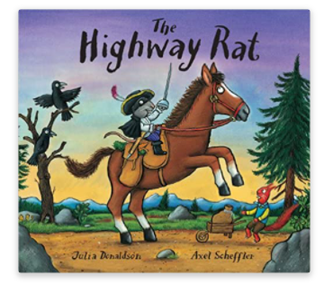
Tuesday 26th January 2021
English tasks

Slide 2
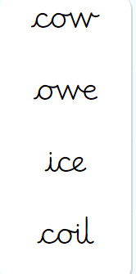
Handwriting
Please practise the following words:
(Easy words- second set)
Look on the letterjoin website to see how to form them correctly.
https://letterjoin.co.uk Username: lj8943
If you are using a laptop the password is: home
If using an ipad or tablet the password is: capital L (Make the shape of a capital L)

Slide 3
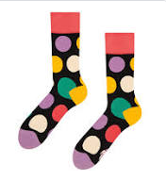
Can you knock our socks off with your neat writing?
Now that you have practised your letters on letterjoin can you practise on a piece of paper?
Can you send a picture of your writing to me?
s.hiley@worthvalleyprimary.co.uk

Slide 4
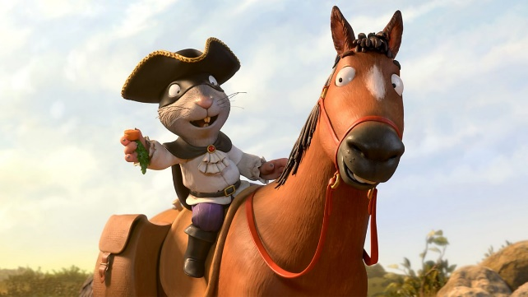
Writing Tasks
This week we are reading
The Highway Rat
by Julia Donaldson.
Can you watch the film version of this story using the link below?
https://www.bbc.co.uk/iplayer/episode/b09kkt1k/the-highway-rat

Slide 5
Writing task
Today I would like you to create a storyboard to re-tell the story of the Highway Rat!
Split the story into six (or more) parts.
Draw a picture for each part of the story.
Write super sentences underneath each picture, describing what is happening!

Slide 6
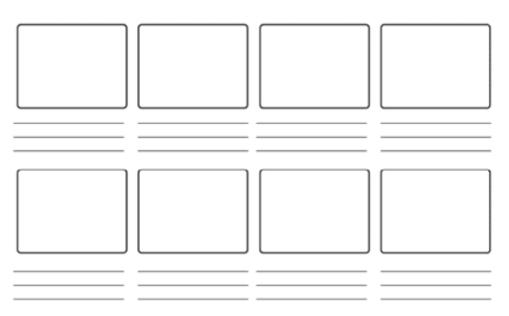
Here is an example of what a story board looks like.
Or you could retell your story to someone at home. Maybe you could film it and send it to me?

Slide 7
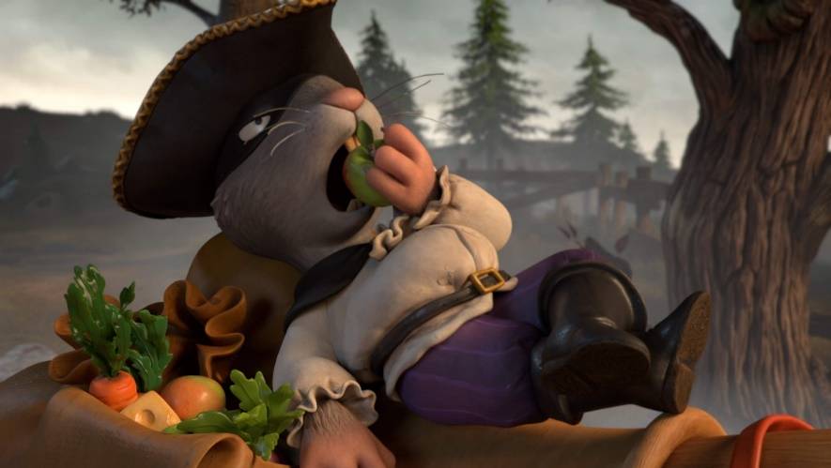
Remember I love to see your work:
You can use Purple Mash to type your work. I have set you a ‘To Do’ for this task.
Or you can write on paper and send a picture to me on my email address:
s.hiley@worthvalleyprimary.co.uk

