Slide 1
Maths Wednesday 27-01-21

Slide 2
Let’s start the week with some tables.
Practise your times tables for 15 minutes on Times Tables Rockstars , click on the link and use your login and password. If you have forgotten these email Mrs Grant.
http://play.ttrockstars.com/auth/school/student

Slide 3
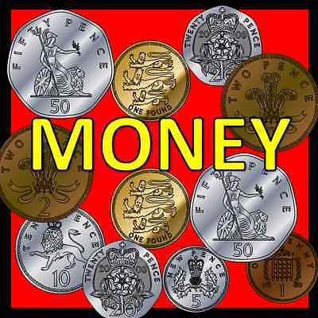
Watch Summer Term Week 10 Lesson 3 Recognizing Notes.
https://whiterosemaths.com/homelearning/summer-archive/year-1/
Then do the work sheets. They are on the website or if you go on Purple Mash 2Dos you should be able to type onto the sheets.
https://www.purplemash.com/sch/worth-bd22

Slide 4
