Slide 1

Maths 26/02/21
Practice on Times Tables Rockstars for 20 mins – click on the link:
ttps://play.ttrockstars.com/auth/school/student

Slide 2
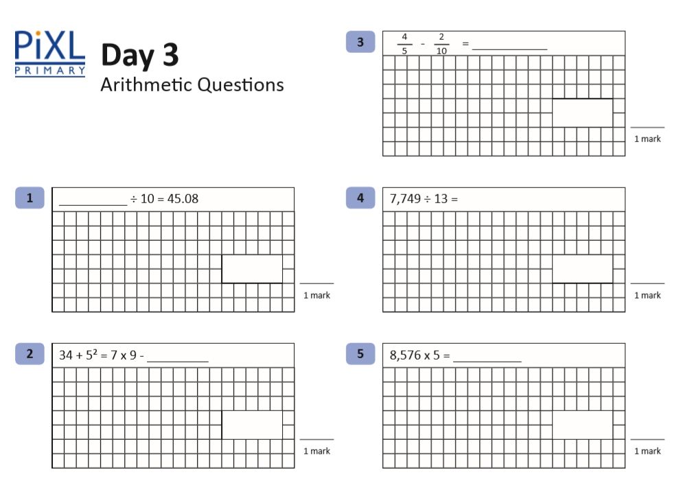
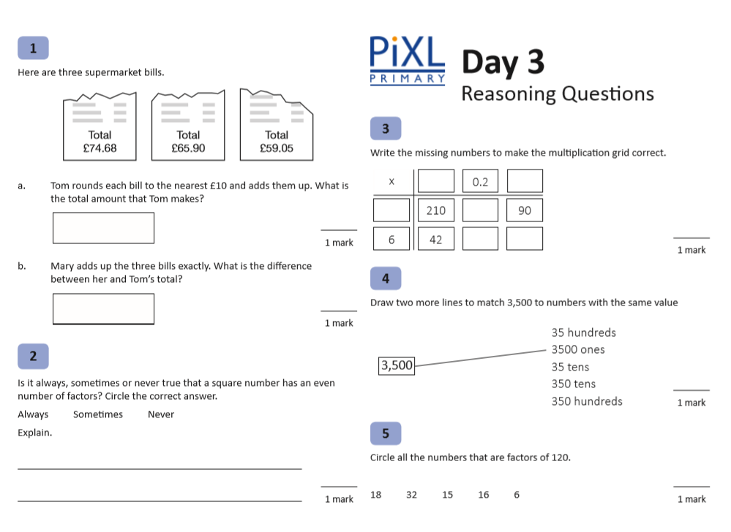
I’m so pleased to be able to welcome you all back into the classroom on the 8th March!
We will return to measurement then.
For the rest of this week I want you to practise the 4 operations to really get your brains raring to go!

