Slide 1
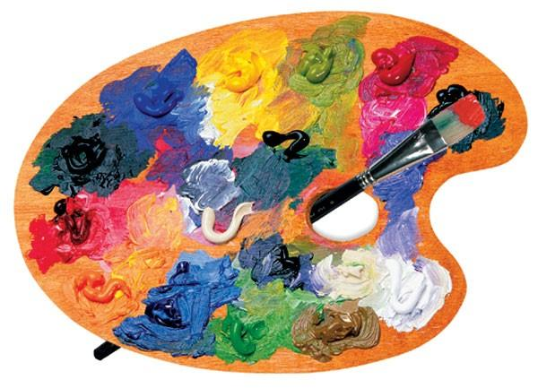
Art
23.02.2021

Slide 2
Painting
This week we are practising our painting skills.
I have been in touch with B&Q in Keighley as they have been having problems with their paint supply. They sent this letter to me…

Slide 3
Dear Year 4, Thank you for agreeing to help us. Due to the current situation, our supplier of colour strips aren’t able to work and we need some samples for our customers. Mr. Tiffany told us you were experimenting with shades of colours, so your challenge is to make us a sample sheet for blue, red and yellow with 8 different shades of each colour. We look forward to seeing your results.

Slide 4
Painting
If you haven`t got access to any paints and/or brushes at home then you can still have a go at this task through
2Do Purple Mash 2paint a picture

Slide 5
Your task:
Click on Purplemash and your 2Dos. Using the 2paint a picture and the ink tool, I’d like you to create different shades of red, yellow and blue.

