Slide 1
English Monday 22.02.21

Slide 2
Handwriting Practice harder words – LETTERJOIN – Students – Password lj8943 (finger swipe is in the shape of a letter L) https://www.letterjoin.co.uk/tablet_login/

Slide 3
Reading
Monday’s reading task is a 3 in 3 activity. All children can complete this reading activity. I have uploaded it to Purple mash under the 2do section.
The work is on a word document so type answers on to it and send it back via Purple mash.
Any problems please email me,
r.metcalf@worthvalleyprimary.co.uk

Slide 4
Spellings todays activity is a say, look, copy and write activity. Your task has been uploaded to Purplemash.
amateur
ancient
marvellous
neighbour
nuisance
occupy
parliament
physical
muscle
restaurant
should
move
plant
water
people
clothes
even
would

Slide 5
Grammar tasks
Today’s grammar task is to add contractions (I’m = I am) to sentences. Everyone can complete this activity.
would have = would’ve I am = I’m
you would = you’d you will = you’ll

Slide 6
Writing task:
Today’s writing task it to continue writing your set of instructions for your flying machine which you created last half term. If you have written your instructions you need to send the back for feedback so you can edit them.
Remember the features you identified last week – use the photo on the next slide to help you.
You must include what you need, sequence the steps in order, draw a diagram to show how it works, use imperatives (put, place).

Slide 7
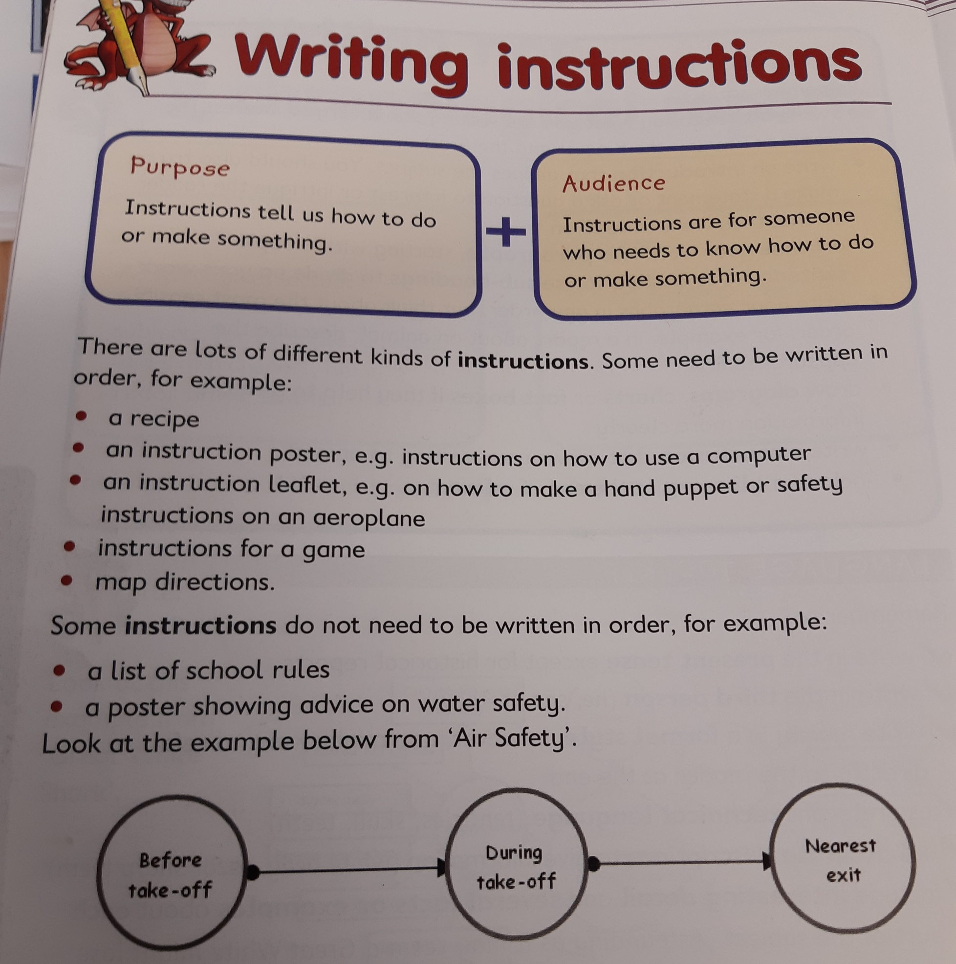
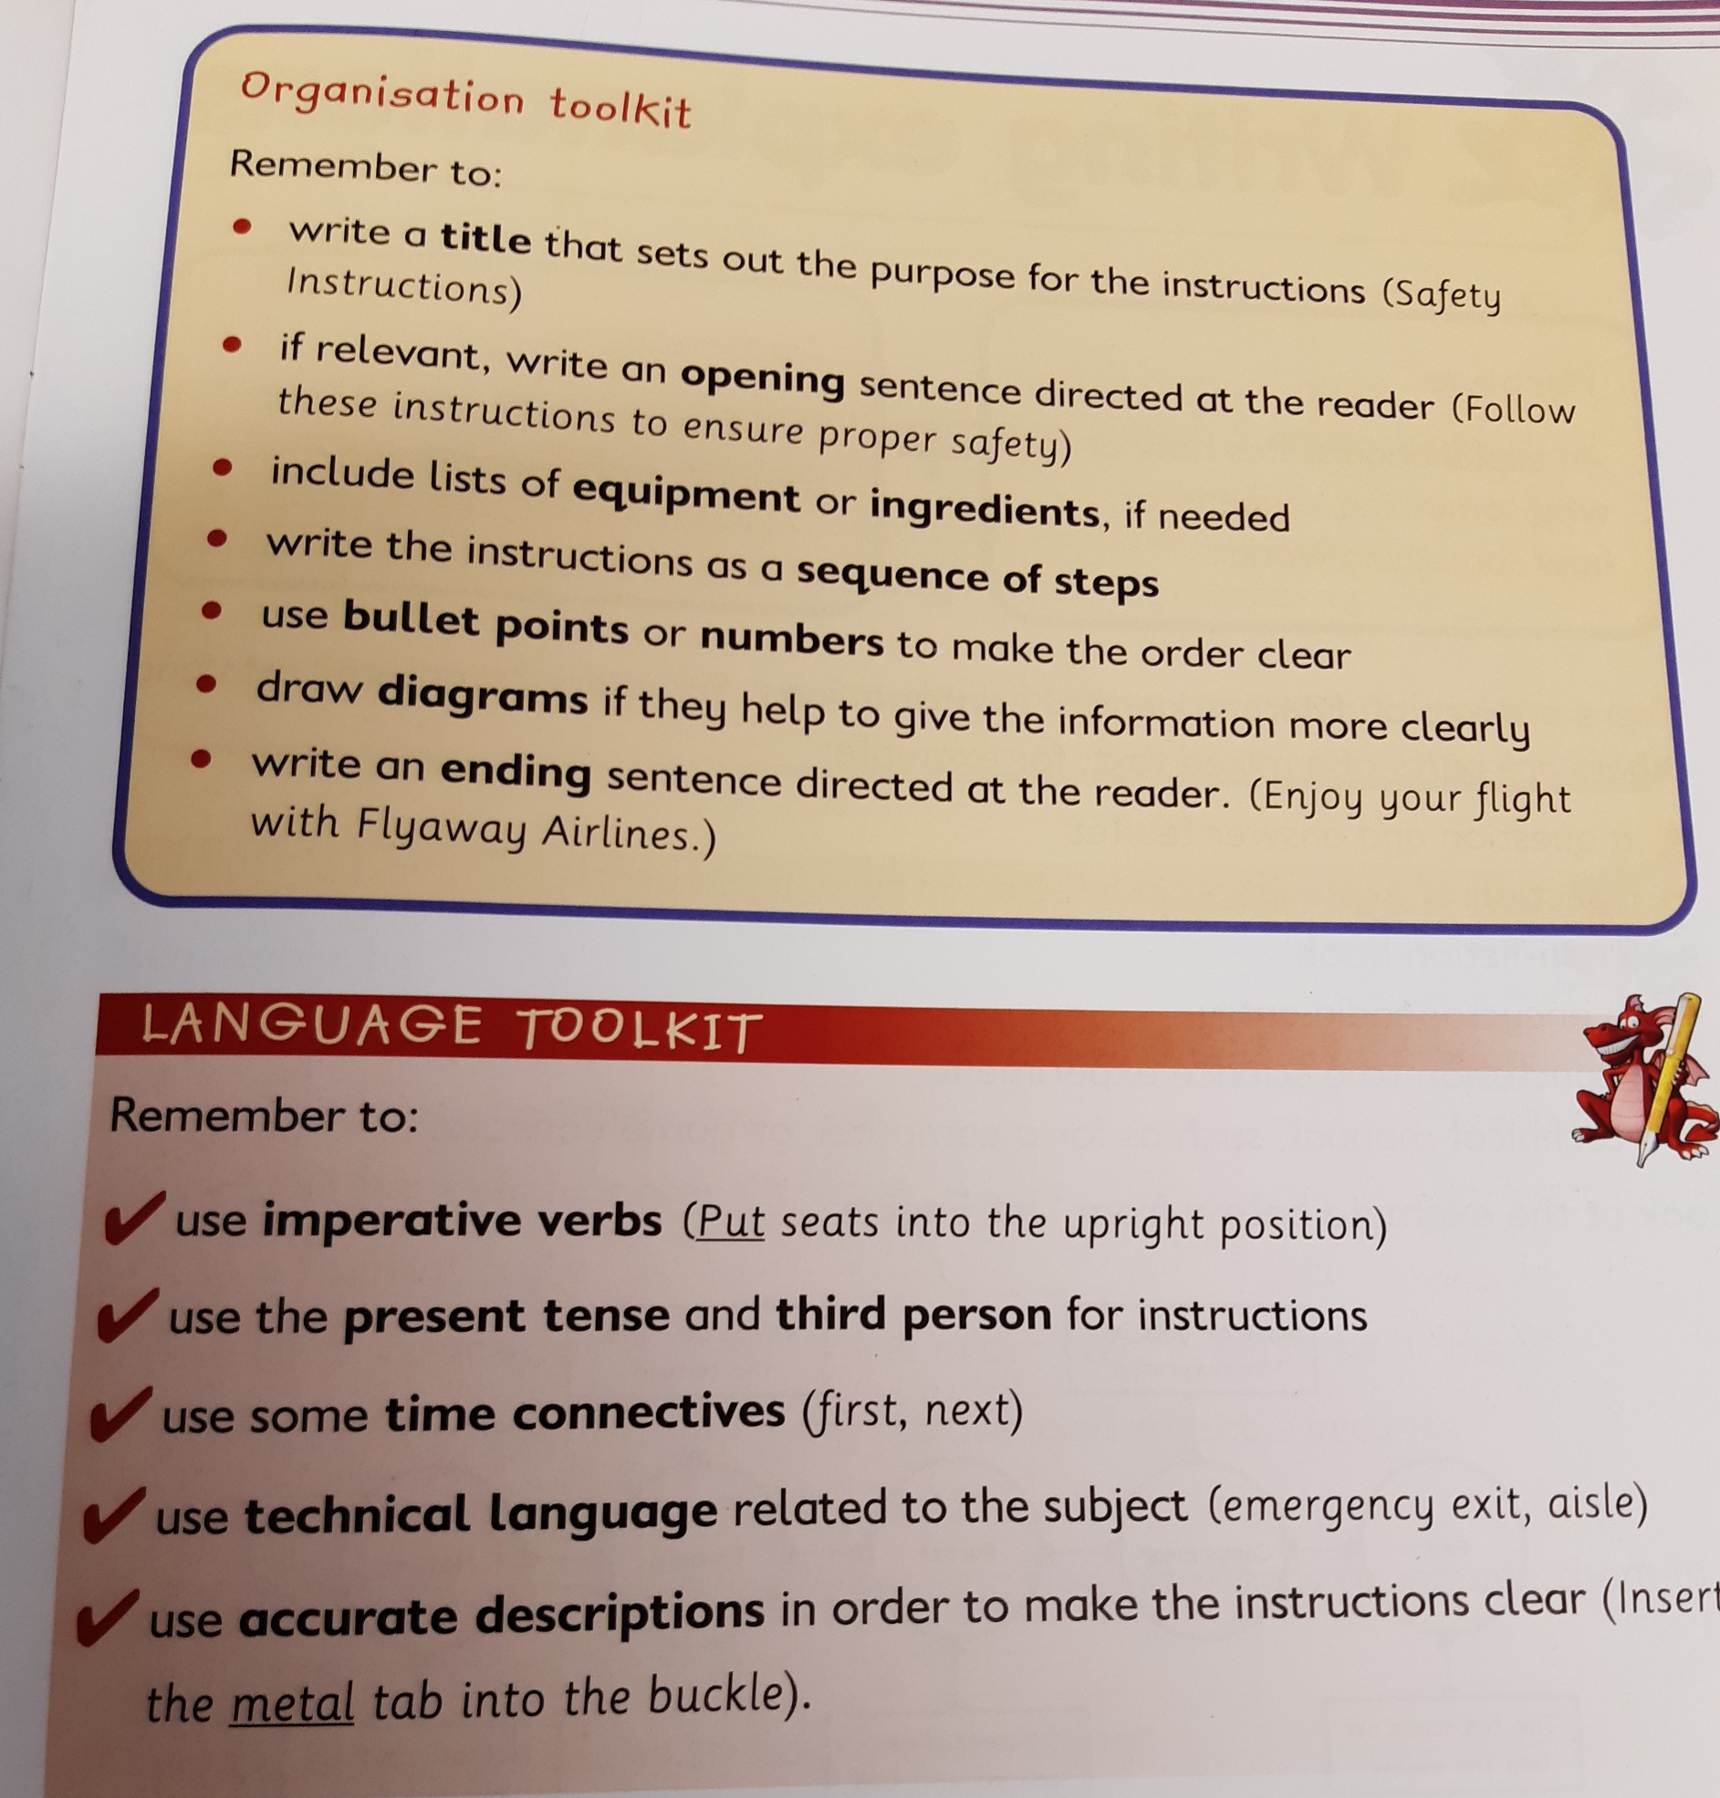
Features of instructions

