Slide 1
English Thursday 25.02.21

Slide 2
Handwriting Practice harder words – LETTERJOIN – Students – Password lj8943 (finger swipe is in the shape of a letter L) https://www.letterjoin.co.uk/tablet_login/

Slide 3
Reading
Today’s reading is a short comprehension – read the text and answer the questions. To open the document go to Purplemash and look in the 2do’s sections.
The work is on a word document so please type your answers on to it and send it back via Purple mash.
https://www.purplemash.com/login/
Any problems please email me,
r.metcalf@worthvalleyprimary.co.uk

Slide 4
Grammar Todays lesson focuses on pronouns, a personal pronoun is a word which can be used instead of a person, place or thing. There are twelve personal pronouns for people: I, you, he, she, it, we, they, me, him, her, us and them. There are three personal pronouns for things: they, them, it. Personal pronouns allow you to avoid repeating a word and to refer to someone already mentioned. If the noun is plural, so is the pronoun which replaces it. Todays activity you need to change the name, place or thing to a pronoun.

Slide 5
Writing task: Today we are going write in the role of the father – you will be writing a short letter from father to his son as he leaves for war (look at the photo on the next slide). You need to use all your knowledge from the book – I have uploaded a video of the story – I’d suggest listening to the story again before writing your letter. Remember to include feelings and write as the father – include I Think about if dad is leaving for war how he will feel, what he might say to his son before he goes.

Slide 6
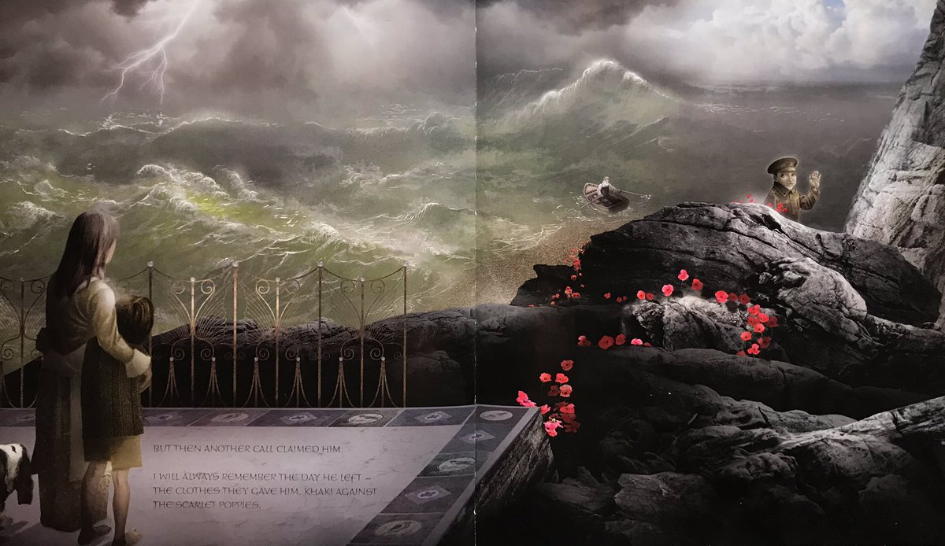
Photo of book

