Slide 1
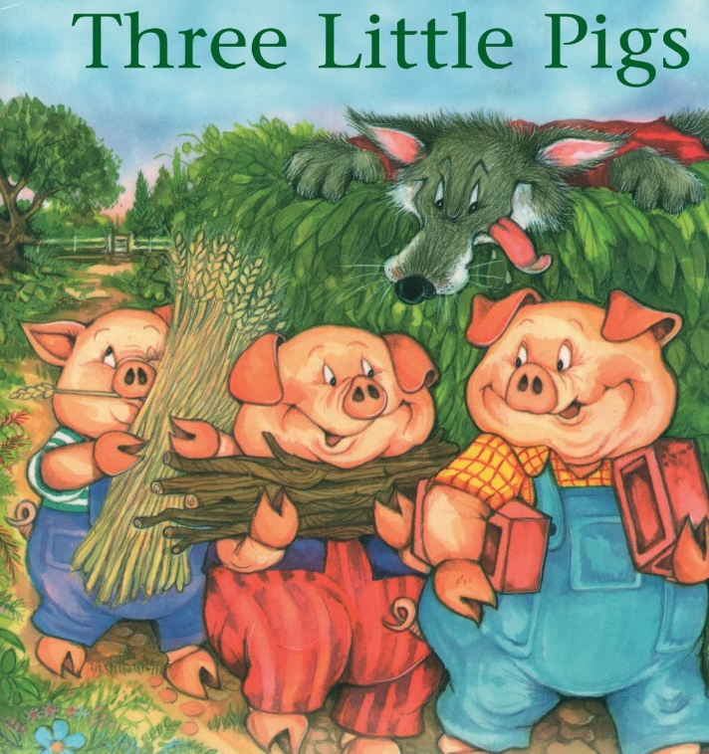
Wednesday 24th February 2021
English tasks.

Slide 2
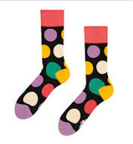
Can you knock our socks off with your neat writing?
Now that you have practised your letters on letterjoin can you practise on a piece of paper?
Can you send a picture of your writing to us?
lara.crawford@worthvalleyprimary.co.uk
steph.milner@worthvalleyprimary.co.uk

Slide 3
Reading and Writing Task
This week we are reading
The three little pigs
You can re-watch the clip using the link below to remind yourself of the story. https://www.youtube.com/watch?v=QLR2pLUsl-Y

Slide 4
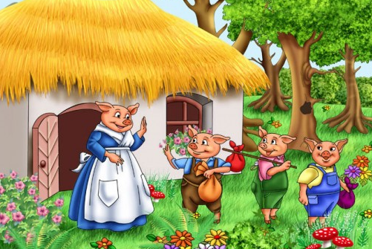
Writing task
For your writing task today we would like you sequence the story of the three little pigs using your best sentences and your most amazing pictures.
Example:
1. Once upon a time there were three little pigs that lived with their mummy pig, but mummy pig said they were getting too big and told the little pigs to go and build a house of their own.

Slide 5
Don’t forget your neatest handwriting, finger spaces, and full stops year one!!
Try and use either six pictures, with six sentences to create your storyboard year one!

Slide 6
Why not try one of these extension activities?
Could you design a house safe enough for all of the pigs? What will you do to keep the wolf out?
Could you make a wanted poster for the wolf?
Could you write a new story where the wolf is really good?

Slide 7
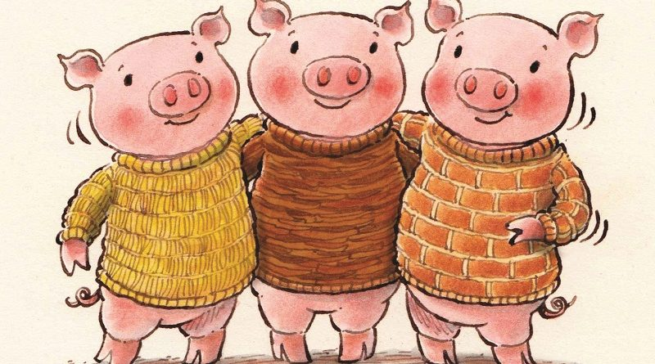
Remember we love to see your work so please email pictures to us at:
lara.crawford@worthvalleyprimary.co.uk
steph.milner@worthvalleyprimary.co.uk

