Slide 1
English
Friday 26th February 2021

Slide 2
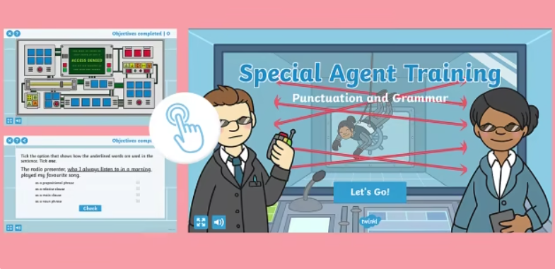
Click on the link to receive your Special Agent Training!
year-6-special-agent-training-exercises
Go to Purple Mash to complete the synonyms and antonyms quiz

Slide 3


Reading Together for Pleasure
Miss Lodge, kindly bought us this lovely book ‘The Book of Hope’ just before the Christmas holiday. We thought it would be nice to share everyday ,some of the words and pictures to provide you with a little bit of comfort, inspiration and entertainment!
Hope you enjoy hearing our voices.

Slide 4
