Slide 1
English
Thursday 25th February 2021

Slide 2
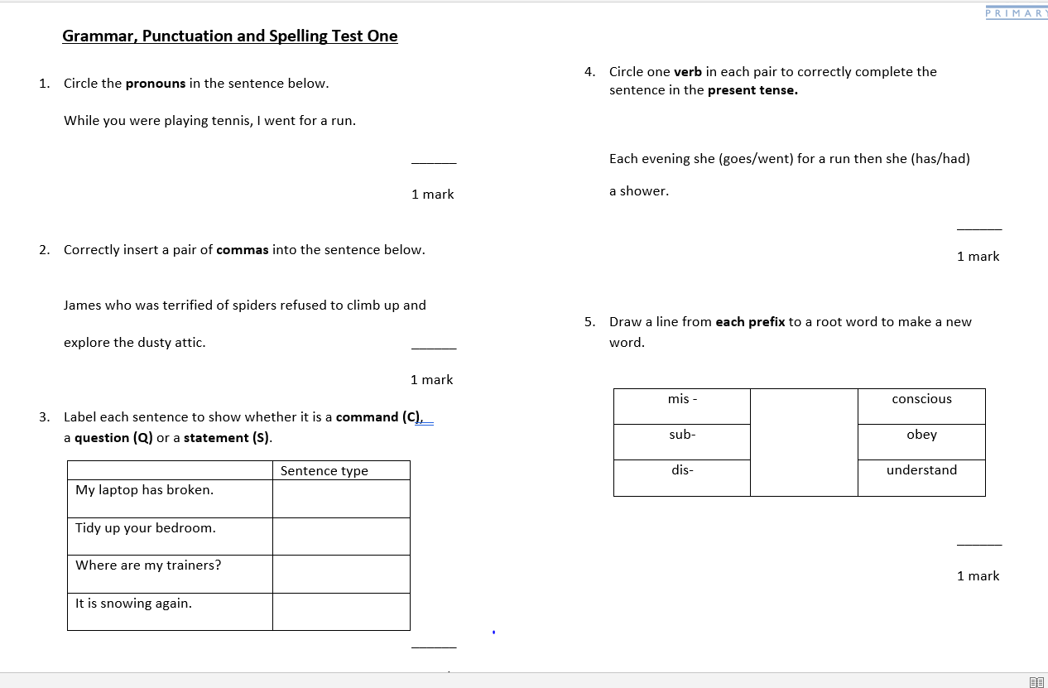

Slide 3
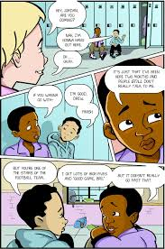
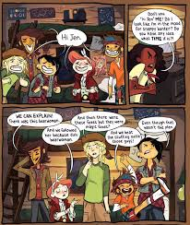
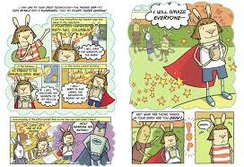
Can I create a mini graphic novel from my suspense story?
This week you are going to change your suspense story into a graphic novel.
As you can see from the examples, each picture represents a scene, with speech bubbles for the dialogue.

Slide 4
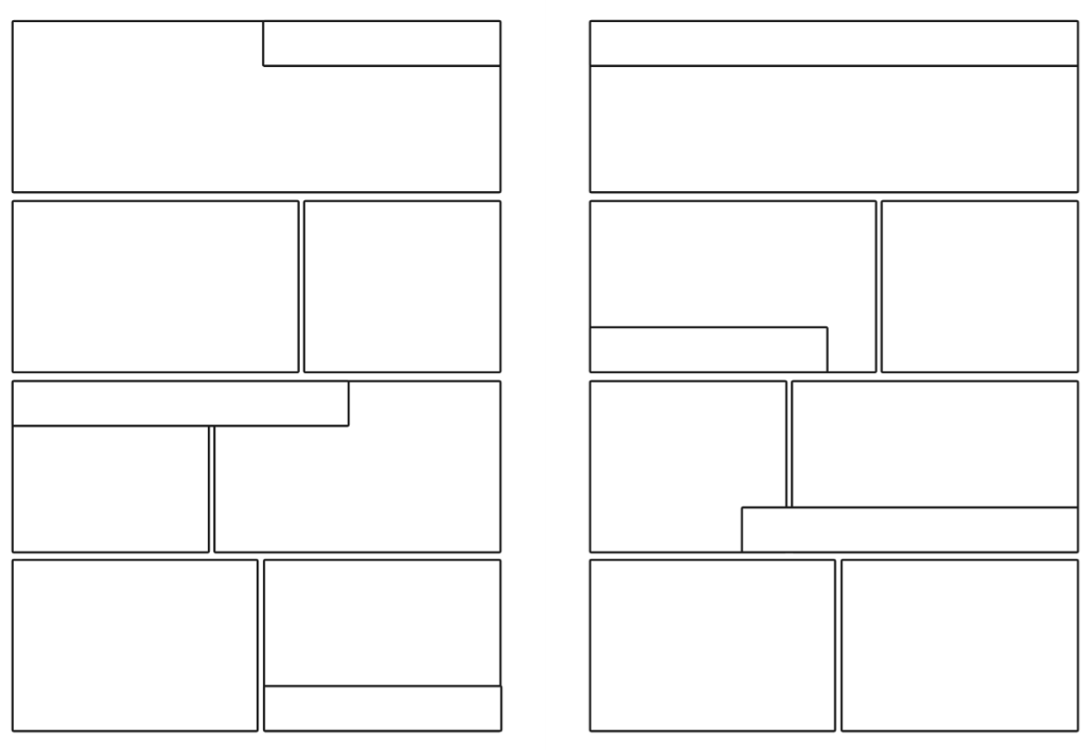
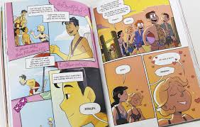

You have now got Tuesday, Wednesday and Thursday to carefully illustrate your suspense story.
Try to add lots of tension, with dark colours- Remember this is a creepy old house!
Give your characters a range of expressions to show their feelings.
Use the larger spaces to draw the illustrations and the smaller rectangles to explain action.
Then, add dialogue between the characters.
Use speech and thought bubbles for this.

Slide 5

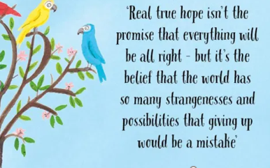
Reading Together for Pleasure
Miss Lodge, kindly bought us this lovely book ‘The Book of Hope’ just before the Christmas holiday. We thought it would be nice to share everyday ,some of the words and pictures to provide you with a little bit of comfort, inspiration and entertainment!
Hope you enjoy hearing our voices.

Slide 6
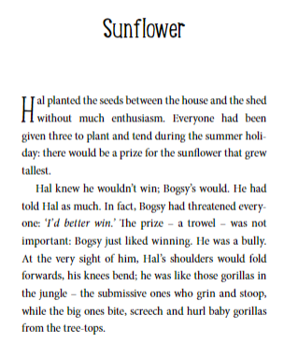
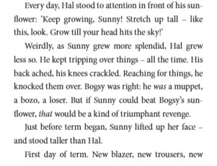
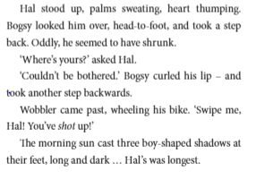
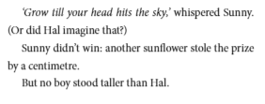
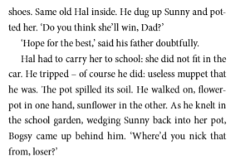

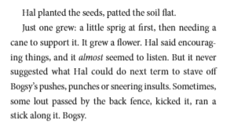
Thursday

