Slide 1
English 26/02/2021

Slide 2
Reading Activity Please see the next slides for your group`s activity
Let me know if you can`t remember which Reading group you are in
You will need a pencil or pen, and paper

Slide 3
Group 4
2Do Purple Mash task
Oliver Twist 2

Slide 4
Group 3
2Do Purple Mash task
Oliver Twist 1

Slide 5
Groups 1 and 2
Read the slides below and then answer Week 5 and 6 questions

Slide 6
Week 5 - text
If you like reading books, then you have much to thank William Caxton for. He didn’t invent printing, but he was the first person to set up a printing press in England in 1472. Before this, people had to copy out books and documents by hand. This was a very skilled and difficult task. It also took a lot of time, which made it expensive. Printing meant that books could be produced more cheaply and in greater numbers. It was a major step forward in getting the country reading. We can only imagine what he would have thought of today’s word processors and printers.

Slide 7
Week 5 - questions
1. According to the article, why might you want to thank William Caxton?
______________________________________________
2. When did he set up the first printing press in England?
______________________________________________
3. How did people make books and documents before printing?
______________________________________________

Slide 8
Week 6 - text
If you like reading books, then you have much to thank William Caxton for. He didn’t invent printing, but he was the first person to set up a printing press in England in 1472. Before this, people had to copy out books and documents by hand. This was a very skilled and difficult task. It also took a lot of time, which made it expensive. Printing meant that books could be produced more cheaply and in greater numbers. It was a major step forward in getting the country reading. We can only imagine what he would have thought of today’s word processors and printers.

Slide 9
Week 6 - questions
1. There were problems with writing books and documents by hand. Name two of these problems.
a) __________________________________ b) __________________________________
2. Name one of the advantages of printing books.
___________________________________________________________________
3. Which word is closest in meaning to produce? Tick one.
print make
date expensive

Slide 10
Spellings – Group 3
This week`s spellings are all about converting nouns to adjectives by adding suffixes (endings)
Your word list below contains both the noun and adjective
For example danger becomes dangerous by adding -ous
Other nouns remove the vowel first and then add the –ous, such as nerve and nervous

Slide 11
Handwriting and Spellings Group 3

Slide 12
Spelling group 3
Then have a go at Phase 5 and 6 games on
https://www.phonicsplay.co.uk/resources
Or practise, play games and test yourself on Spelling Frame https://spellingframe.co.uk/spelling-rule/16/11-The-suffix-ous-1-of-2

Slide 13
Handwriting + Spellings Group 2
Prefixes are groups of letters that can be added to the beginning of root words. They usually change the meaning of the root word. The focus prefixes for this unit are anti- and sub-.
The prefix anti- means against. The prefix sub- means under or below.

Slide 14
Handwriting and Spellings Group 2

Slide 15
Group 2 Spellings
Then have a play around with the different games and tests on
https://spellingframe.co.uk/
And
https://www.phonicsplay.co.uk/resources

Slide 16
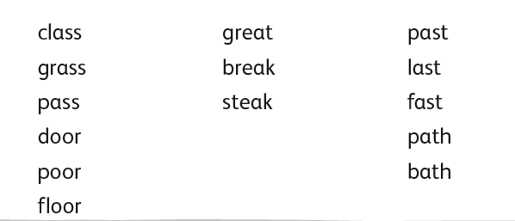
Handwriting + Spellings Group 1

Slide 17
Handwriting + Spellings Group 1
Try the Spelling Frame practise, games and tests on https://spellingframe.co.uk/
Try any of the year groups 1 to 4 including the exception words
Or the Phonics Play website https://www.phonicsplay.co.uk/resources

Slide 18
Handwriting
Use the spelling sheets to practise your handwriting. You will not be able to trace the word, unless you can print the sheets off, but you will be able to copy it.
Practise 3 words per day on lined paper and then have a go at writing sentences with those words in
Remember, it is quality joined writing that we are looking for, with your proper tripod grip
You can also practise other letters and words via https://www.letterjoin.co.uk using the username lj8493 and the password L (capital l)

Slide 19
Grammar
Subordinating conjunctions and phrases
Who can remember what I SAW A WABUB stands for?
Have a go at the 2Do Purple Mash task called
Creating sentences sub clauses

Slide 20
Writing
LC: Can I organise paragraphs around a theme?
Each new section of your explanation text should start a new paragraph. You might also give it a sub-heading, but you don`t have to use sub-headings if you prefer not to.
Using your research from yesterday, can you split your information into different paragraphs?
For example, you might say
Paragraph 1: Romulus kills Remus
Paragraph 4: Hadrian builds his wall

