Slide 1
English
Monday 22nd Febuary 2021

Slide 2
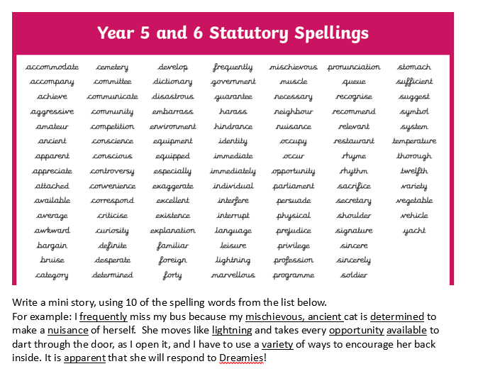


Slide 3
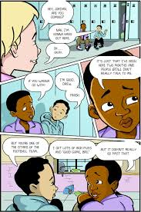
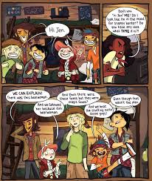
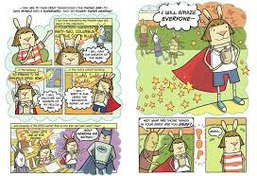
Can I create a mini graphic novel from my suspense story?
This week you are going to change your suspense story into a graphic novel.
As you can see from the examples, each picture represents a scene, with speech bubbles for the dialogue.

Slide 4
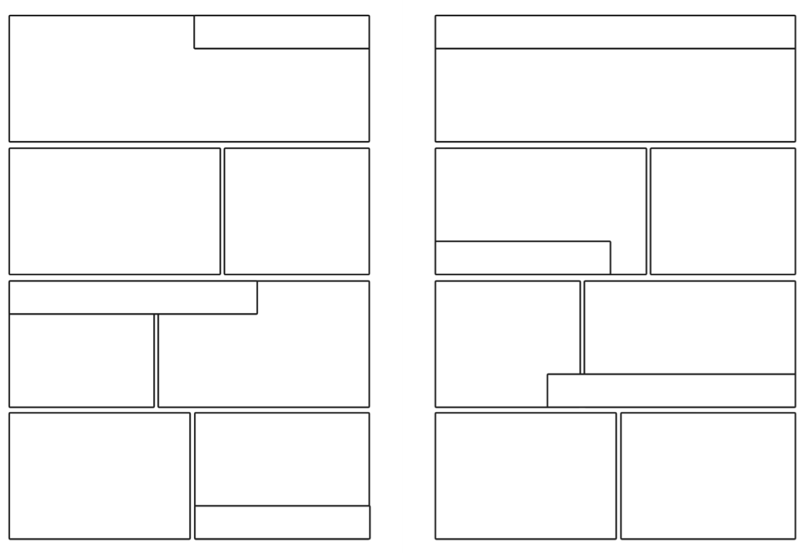
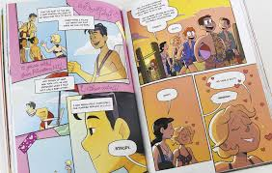
Use the larger spaces to draw the illustrations and the smaller rectangles to explain action.
Then, add dialogue between the characters.
Use speech and thought bubbles for this.
Today’s task is to plan which sections of your story will fit into which space.
Use the template above to make notes in so you have a plan ready for drawing tomorrow.

Slide 5
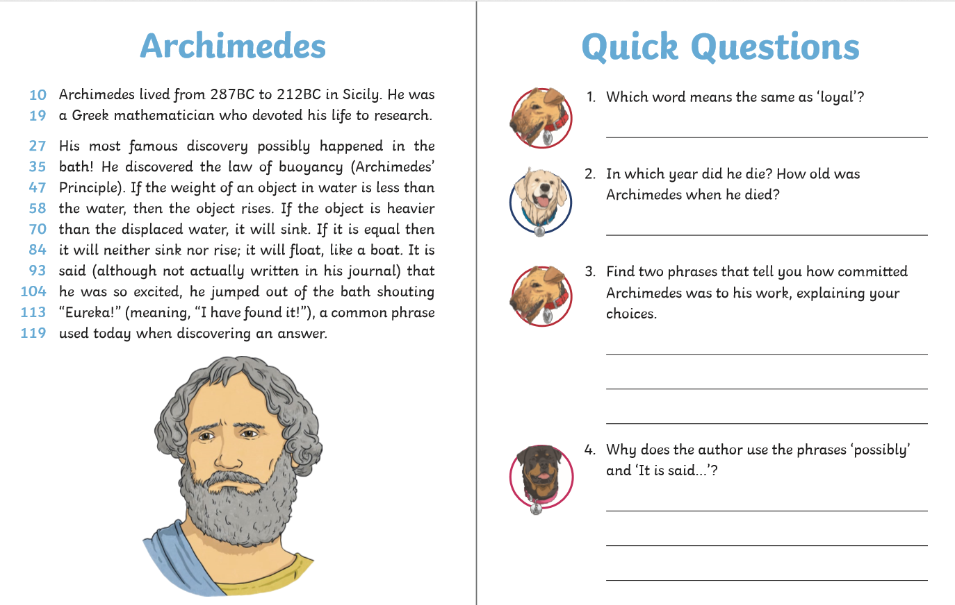
60 Second Read
Go to Purple mash to find the worksheet

Slide 6

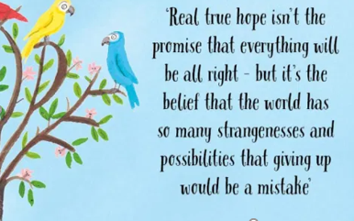
Reading Together for Pleasure
Miss Lodge, kindly bought us this lovely book ‘The Book of Hope’ just before the Christmas holiday. We thought it would be nice to share everyday ,some of the words and pictures to provide you with a little bit of comfort, inspiration and entertainment!
Hope you enjoy hearing our voices.

Slide 7
