Slide 1
English 25/02/2021

Slide 2
Reading Activity Please see the next slides for your group`s activity
Let me know if you can`t remember which Reading group you are in
You will need a pencil or pen, and paper

Slide 3
Groups 1 and 2
2Do Purple Mash task
Left and Right
Answer Set B questions

Slide 4
Groups 3 + 4
Read the slides below and then answer Week 9 and 10 questions

Slide 5
Week 9 - text
If you glance at a map of Britain, with a bit of imagination you might think that it looks like someone sitting down. Scotland is the head; the arms are folded over a very full tummy to make Wales; Devon and Cornwall are the outstretched legs and feet; and East Anglia is, well, what we use to sit on. If that is the case, then the backbone of this craggy figure must be the Pennines – a range of hills, moors and mountains that divides northern England. Large sections of the Pennines are protected as an area of outstanding natural beauty.

Slide 6
Week 9 - questions
1. … If you glance at a map …
In this context, which word is closest in meaning to glance? Tick one.
open look
fold colour
2. What does the text suggest that a map of Britain looks like (with a bit of imagination)?
______________________________________________
3. What are the arms folded over the top of?
_________________________________________________________________

Slide 7
Week 10 - text
If you glance at a map of Britain, with a bit of imagination you might think that it looks like someone sitting down. Scotland is the head; the arms are folded over a very full tummy to make Wales; Devon and Cornwall are the outstretched legs and feet; and East Anglia is, well, what we use to sit on. If that is the case, then the backbone of this craggy figure must be the Pennines – a range of hills, moors and mountains that divides northern England. Large sections of the Pennines are protected as an area of outstanding natural beauty.

Slide 8
Week 10 - questions
1. According to the text, what are Devon and Cornwall?
_________________________________________________________________
2. Find and copy the name of the place that is described as a range of hills, moors and mountains.
______________________________________________
3. Find and copy the word in the last sentence that is closest in meaning to looked after.
_____________________________

Slide 9
Week 5 - text
If you like reading books, then you have much to thank William Caxton for. He didn’t invent printing, but he was the first person to set up a printing press in England in 1472. Before this, people had to copy out books and documents by hand. This was a very skilled and difficult task. It also took a lot of time, which made it expensive. Printing meant that books could be produced more cheaply and in greater numbers. It was a major step forward in getting the country reading. We can only imagine what he would have thought of today’s word processors and printers.

Slide 10
Week 5 - questions
1. According to the article, why might you want to thank William Caxton?
______________________________________________
2. When did he set up the first printing press in England?
______________________________________________
3. How did people make books and documents before printing?
______________________________________________

Slide 11
Week 6 - text
If you like reading books, then you have much to thank William Caxton for. He didn’t invent printing, but he was the first person to set up a printing press in England in 1472. Before this, people had to copy out books and documents by hand. This was a very skilled and difficult task. It also took a lot of time, which made it expensive. Printing meant that books could be produced more cheaply and in greater numbers. It was a major step forward in getting the country reading. We can only imagine what he would have thought of today’s word processors and printers.

Slide 12
Week 6 - questions
1. There were problems with writing books and documents by hand. Name two of these problems.
a) __________________________________ b) __________________________________
2. Name one of the advantages of printing books.
___________________________________________________________________
3. Which word is closest in meaning to produce? Tick one.
print make
date expensive

Slide 13
Spellings – Group 3
This week`s spellings are all about converting nouns to adjectives by adding suffixes (endings)
Your word list below contains both the noun and adjective
For example danger becomes dangerous by adding -ous
Other nouns remove the vowel first and then add the –ous, such as nerve and nervous

Slide 14
Handwriting and Spellings Group 3

Slide 15
Spelling group 3
Then have a go at Phase 5 and 6 games on
https://www.phonicsplay.co.uk/resources
Or practise, play games and test yourself on Spelling Frame https://spellingframe.co.uk/spelling-rule/16/11-The-suffix-ous-1-of-2

Slide 16
Handwriting + Spellings Group 2
Prefixes are groups of letters that can be added to the beginning of root words. They usually change the meaning of the root word. The focus prefixes for this unit are anti- and sub-.
The prefix anti- means against. The prefix sub- means under or below.

Slide 17
Handwriting and Spellings Group 2

Slide 18
Group 2 Spellings
Then have a play around with the different games and tests on
https://spellingframe.co.uk/
And
https://www.phonicsplay.co.uk/resources

Slide 19
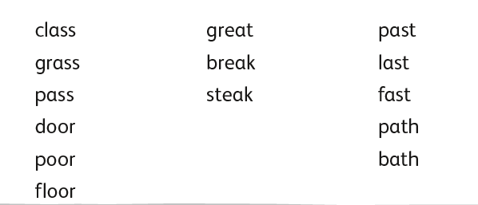
Handwriting + Spellings Group 1

Slide 20
Handwriting + Spellings Group 1
Try the Spelling Frame practise, games and tests on https://spellingframe.co.uk/
Try any of the year groups 1 to 4 including the exception words
Or the Phonics Play website https://www.phonicsplay.co.uk/resources

Slide 21
Handwriting
Use the spelling sheets to practise your handwriting. You will not be able to trace the word, unless you can print the sheets off, but you will be able to copy it.
Practise 3 words per day on lined paper and then have a go at writing sentences with those words in
Remember, it is quality joined writing that we are looking for, with your proper tripod grip
You can also practise other letters and words via https://www.letterjoin.co.uk using the username lj8493 and the password L (capital l)

Slide 22
Grammar
Subordinating conjunctions and phrases
Read the following slides
Have a go at the tasks and questions included

Slide 24
Getting Started
What is a conjunction?
A conjunction links two or more words, phrases or clauses together.
There are two main types of conjunctions we use within sentences.
Do you know what they both are?
co-ordinating conjunctions (e.g. and) link two main clauses together as an equal pair to create a compound sentence. We usually remember these words using the acronym ‘FANBOYS’.
subordinating conjunctions (e.g. when) introduce a subordinate clause. You can remember some of the most useful subordinating conjunctions by...

Slide 25
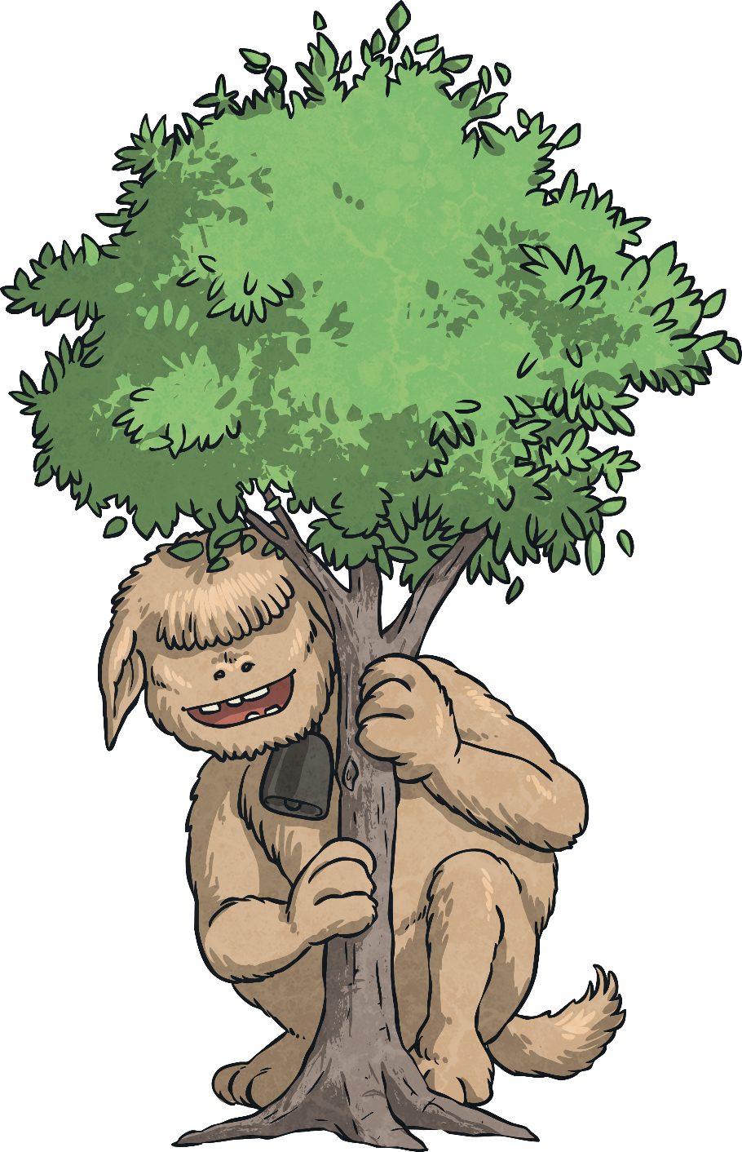
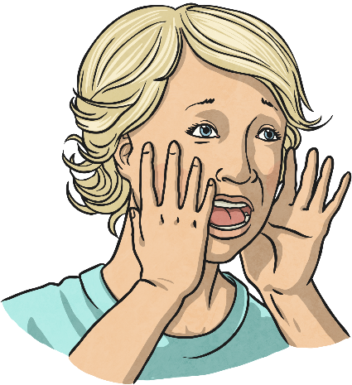
…spotting one of the rarest monsters on the planet, a wabub, and shouting...
I SAW A WABUB!

Slide 26
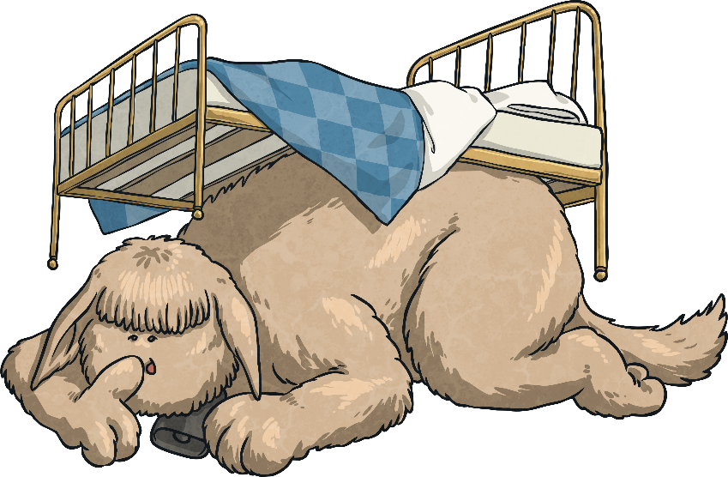
…is an acronym to help you remember the first letters of some of the most important subordinating conjunctions.
I Saw a Wabub…
If
Since
As
When
Although
While
After
Before
Until
Because
I
S
A
W
A
W
A
B
U
B!

Slide 27
So, how do we use subordinating conjunctions?
Next Steps
Subordinating conjunctions are the first words within a subordinate clause. Subordinate clauses do not make sense on their own but, when they are used with a main clause, they create a complex (multi-clause) sentence.
Subordinate clauses will always have a subject and verb within them, e.g.
after she smiled
after Christmas
subordinating conjunction
subject
verb
Here ‘after’ is being used as a preposition.
is a subordinate clause
is not a subordinate clause

Slide 28
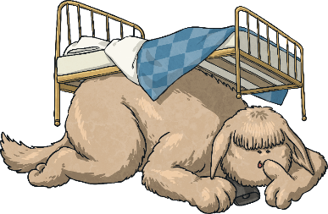
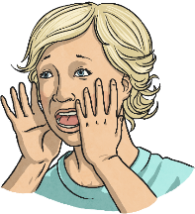
Can you spot the subordinate clause and the subordinating conjunction in this sentence?
Next Steps
I SAW A WABUB!
The eager pupils sped into school when the bell rang.
The eager pupils sped into school when the bell rang.

Slide 29
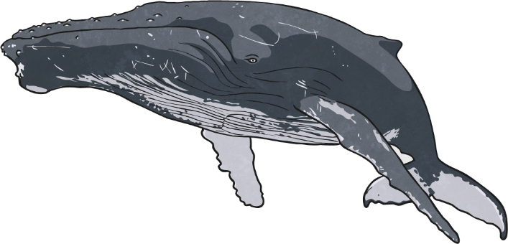
Can you spot the subordinate clause and the subordinating conjunction in this sentence?
Next Steps
I SAW A WABUB!
Whales give birth to live young as they are mammals.
Whales give birth to live young as they are mammals.

Slide 30
Can you spot the subordinate clause and the subordinating conjunction in this sentence?
Next Steps
I SAW A WABUB!
The hopeless rugby team lost the game because they hadn’t trained.
The hopeless rugby team lost the game because they hadn’t trained.

Slide 31
In the sentences we have looked at so far, the subordinate clause has always come after the main clause but watch...
Next Steps
I SAW A WABUB!
When the bell rang, the eager pupils sped into school.
The eager pupils sped into school when the bell rang.

Slide 32
Subordinating conjunctions can also be used as the first word in a sentence. When the subordinate clause comes before the main clause, make sure you remember to use a comma to mark where the subordinate clause ends.
Next Steps
I SAW A WABUB!
When the bell rang, the eager pupils sped into school.

Slide 33
Next Steps
I SAW A WABUB!
Can you swap these sentences around so that the subordinate clause comes before the main clause? Don’t forget your commas!
Whales give birth to live young as they are mammals.
Because they hadn’t trained, the hopeless rugby team lost the game.

Slide 34
Can you spot the subordinating conjunctions in this piece of text? Where have they been used in these sentences?
I SAW A WABUB!
Subordinating Conjunction Hunt
As he walked closer, Cleo could see the crocodilius in the cave entrance. The beast was hurriedly eating the remains of its last unlucky victim because it was ravenous. Cleo examined its bright red eyes, huge smoking nostrils and razor-sharp teeth while the beast was occupied. Although Cleo was standing quite a distance away, the terrible stench of the gruesome beast was still making him feel nauseous. Cleo took a deep breath before he tiptoed bravely forward. It was time for battle.
As he walked closer, Cleo could see the crocodilius in the cave entrance. The beast was hurriedly eating the remains of its last unlucky victim because it was ravenous. Cleo examined its bright red eyes, huge smoking nostrils and razor-sharp teeth while the beast was occupied. Although Cleo was standing quite a distance away, the terrible stench of the gruesome beast was still making him feel nauseous. Cleo took a deep breath before he tiptoed bravely forward. It was time for battle.

Slide 35
Now, it’s your turn. Which subordinating conjunction would fit best at the start of this subordinate clause? Is there more than one possibility?
I SAW A WABUB!
Practise Your Skills
I am sending you a letter
I am your biggest fan.

Slide 36
Now, it’s your turn. Which subordinating conjunction would fit best at the start of this subordinate clause? Is there more than one possibility?
I SAW A WABUB!
Practise Your Skills
I eat lunch, I am going
to an important meeting.

Slide 37
Now, it’s your turn. Which subordinating conjunction would fit best at the start of this subordinate clause? Is there more than one possibility?
I SAW A WABUB!
Practise Your Skills
he was thrown from his saddle,
Henry was wary of riding his horse.

Slide 38
Now, it’s your turn. Which subordinating conjunction would fit best at the start of this subordinate clause? Is there more than one possibility?
I SAW A WABUB!
Practise Your Skills
The two chemicals should cause a reaction you have used them in the right quantities.

Slide 39
Complete the sentences below by writing the subordinating conjunctions from the box in the correct places to form complex sentences. Use each conjunction only once.
I SAW A WABUB!
Quick Quiz:
Question 2
a)
b)
c)
The greenhouse got smashed the boys were playing football.
they were in trouble, they had to go inside the house.
they were well-behaved, they could have their ball back next week.

Slide 40
Can you remember all of the subordinating conjunctions using the ‘I SAW A WABUB’ acronym?
I SAW A WABUB!
Quick Quiz:
Question 3
If
Since
As
When
Although
While
After
Before
Until
Because

Slide 41
Writing
LC: Can I write an introduction to an explanation text?
An introduction gives the reader some background information about a subject.
Your subject today is How Rome was formed?
You will need to research your answers using books and/or the internet – sites such as https://www.ducksters.com/history/ancient_rome.php, https://www.historyforkids.net/roman-history-facts-for-kids.html and https://www.natgeokids.com/uk/discover/history/romans/10-facts-about-the-ancient-romans/

Slide 42
Writing task
Now you have found out some background facts as to how Rome was formed, see if you can write your own introduction about How Rome was formed?
Can you use some conjunctions in your writing? Use the conjunction word bank on Purple Mash to help you.
Remember that an introduction is generally quite short, maybe just a few sentences long, as you will be writing in more detail later.

