Slide 1
English 23/02/2021

Slide 2
Reading Activity Please see the next slides for your group`s activity
Let me know if you can`t remember which Reading group you are in
You will need a pencil or pen, and paper

Slide 3
Groups 1 and 2
2Do Purple Mash task
Female Pirates

Slide 4
Groups 3 and 4
Please read the following text on Anglo Saxons
Then answer the questions called week 7 and week 8

Slide 5
Week 7 - text
You might believe that the Anglo Saxons are long gone and, to a certain extent, you’d be right. As far as Britain is concerned, their time was really between the eighth and eleventh centuries. But there are still traces where they live on, if you know where to look – including your own address. Many of the place names that are so familiar to us today actually come from Anglo Saxon roots. If your home town’s name ends in bury, borough, ton or ley, then the Anglo Saxons started a settlement there. Your next question is, what do these roots mean?

Slide 6
Week 7 - questions
… to a certain extent, you’d be right.
In this context, which words are closest in meaning to a certain extent? Circle one.
totally sure extreme amount without question in some ways
_________________________________________________________________
2. … As far as Britain is concerned …
In this context, which word is closest in meaning to concerned? Circle one.
involved worried extinct invaded
3. According to the text, when did the Anglo Saxons have their time?
_________________________________________________________________

Slide 7
Week 8 - questions
1. According to the text, which endings to place names come from Anglo Saxon roots?
Find and copy two examples.
a) _______________________________ b) __________________________________
2. How does the author try to make this text feel relevant to you?
_________________________________________________________________________
Your next question is, what do these roots mean?
Why do you think the author doesn’t explain what the roots mean?
________________________________________________________________________

Slide 8
Spellings – Group 3
This week`s spellings are all about converting nouns to adjectives by adding suffixes (endings)
Your word list below contains both the noun and adjective
For example danger becomes dangerous by adding -ous
Other nouns remove the vowel first and then add the –ous, such as nerve and nervous

Slide 9
Handwriting and Spellings Group 3

Slide 10
Spelling group 3
Then have a go at Phase 5 and 6 games on
https://www.phonicsplay.co.uk/resources
Or practise, play games and test yourself on Spelling Frame https://spellingframe.co.uk/spelling-rule/16/11-The-suffix-ous-1-of-2

Slide 11
Handwriting + Spellings Group 2
Prefixes are groups of letters that can be added to the beginning of root words. They usually change the meaning of the root word. The focus prefixes for this unit are anti- and sub-.
The prefix anti- means against. The prefix sub- means under or below.

Slide 12
Handwriting and Spellings Group 2

Slide 13
Group 2 Spellings
Then have a play around with the different games and tests on
https://spellingframe.co.uk/
And
https://www.phonicsplay.co.uk/resources

Slide 14
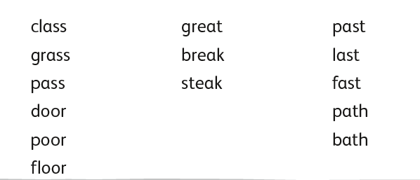
Handwriting + Spellings Group 1

Slide 15
Handwriting + Spellings Group 1
Try the Spelling Frame practise, games and tests on https://spellingframe.co.uk/
Try any of the year groups 1 to 4 including the exception words
Or the Phonics Play website https://www.phonicsplay.co.uk/resources

Slide 16
Handwriting
Use the spelling sheets to practise your handwriting. You will not be able to trace the word, unless you can print the sheets off, but you will be able to copy it.
Practise 3 words per day on lined paper and then have a go at writing sentences with those words in
Remember, it is quality joined writing that we are looking for, with your proper tripod grip
You can also practise other letters and words via https://www.letterjoin.co.uk using the username lj8493 and the password L (capital l)

Slide 17
Grammar
Recap on co-ordinating conjunctions
These are joining words, they join 2 phrases or sentences together
Who can remember what FANBOYS stands for?

Slide 18
FANBOYS
For And Nor But Or Yet So
Have a go at the 2Do Purple Mash task called Co-Ord Conjunctions 3

Slide 19
Writing
This week we are learning about Explanation texts and how to write one
Below is the Ignite for Write toolkit and checklist to help us

Slide 21
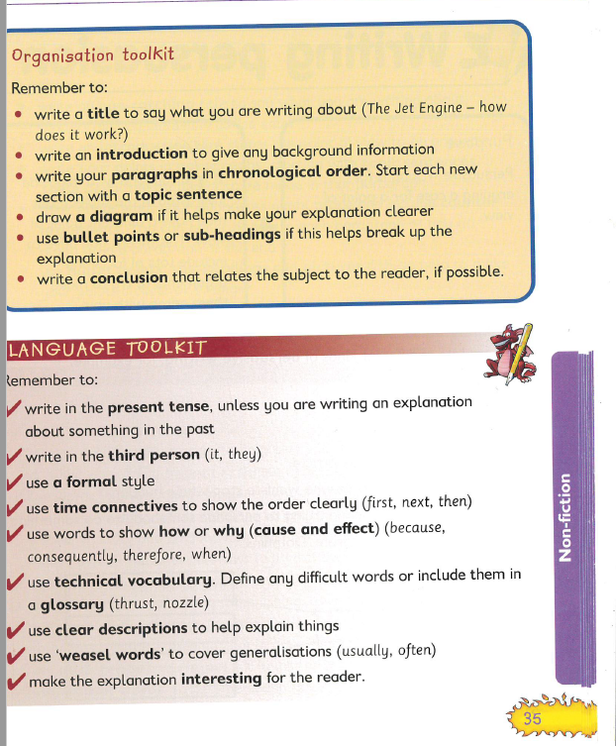

Slide 22
Writing
We are going to write our own Explanation text about Rome later next week
First, let`s watch a video clip about some Roam history
https://www.youtube.com/watch?v=tClxdOsC_JY

Slide 23
Writing
From the video…
Can you work out what is the key information? What are the important bits?
Make a bullet point list of the main facts
You might want to include:
Important dates
Names of important people or places
Famous events, battles, buildings

Slide 24
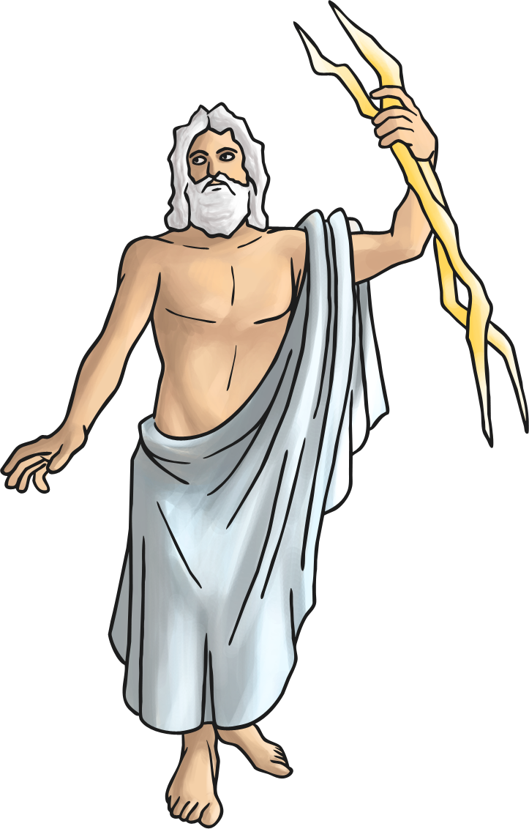
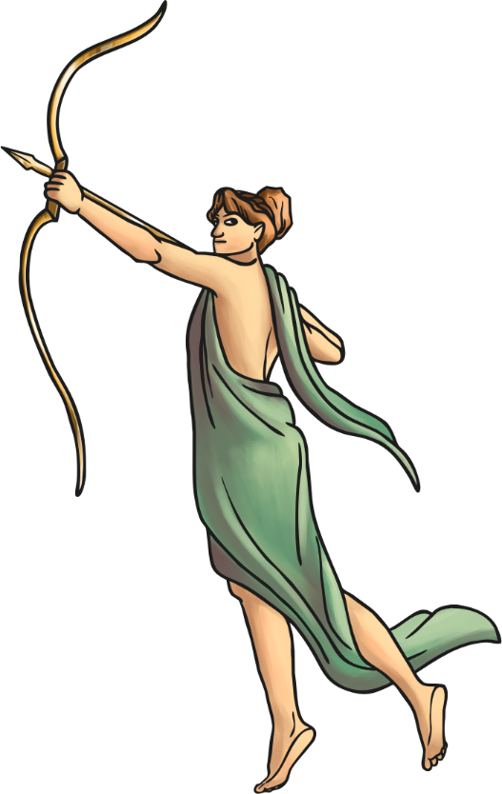
Roman Facts
The modern calendar, 12 months and 365 days,
was created by the Romans.
Romans believed in Gods and Goddesses who ruled over different areas of life. They built temples for them and took them offerings.

Slide 25
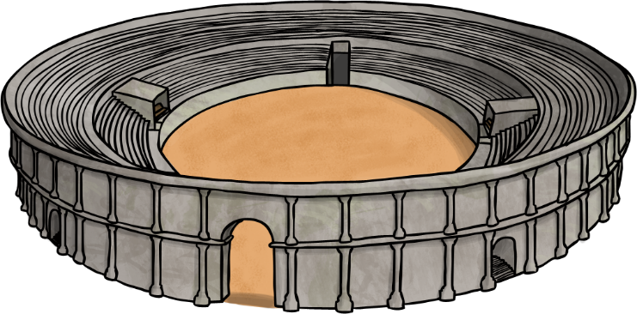
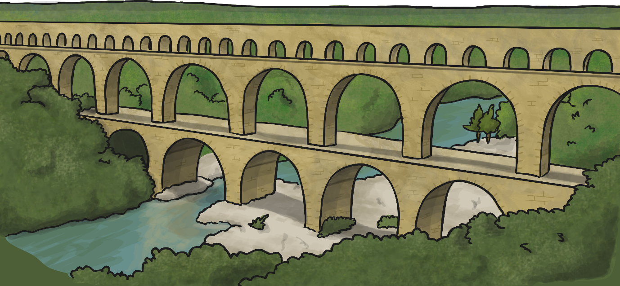
Roman Facts
Rome was founded in 753BC and quickly became a rich and powerful city.
The Romans were amazing architects and engineers. They built roads and walls.

Slide 26
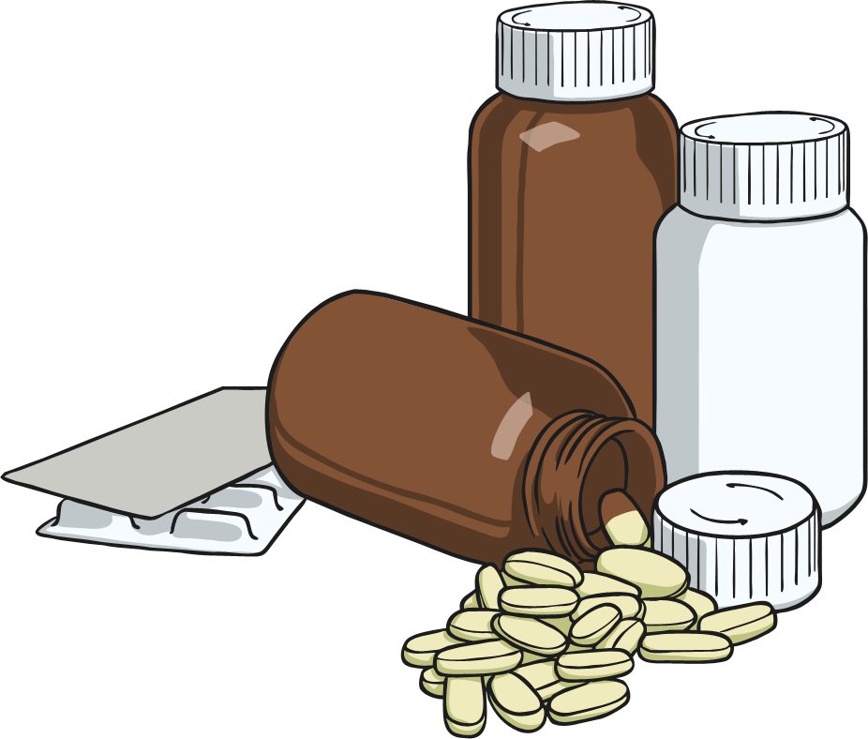
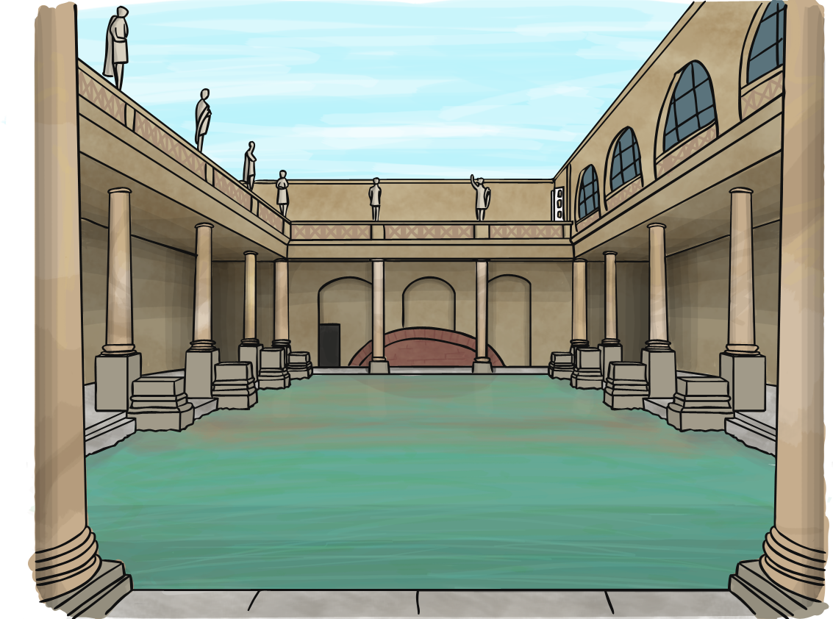
Roman Facts
Urine was collected from the bathhouses to be used for laundry and medicine.
Instead of toilet paper, the Romans used a wet sponge on the end of a stick.

Slide 27
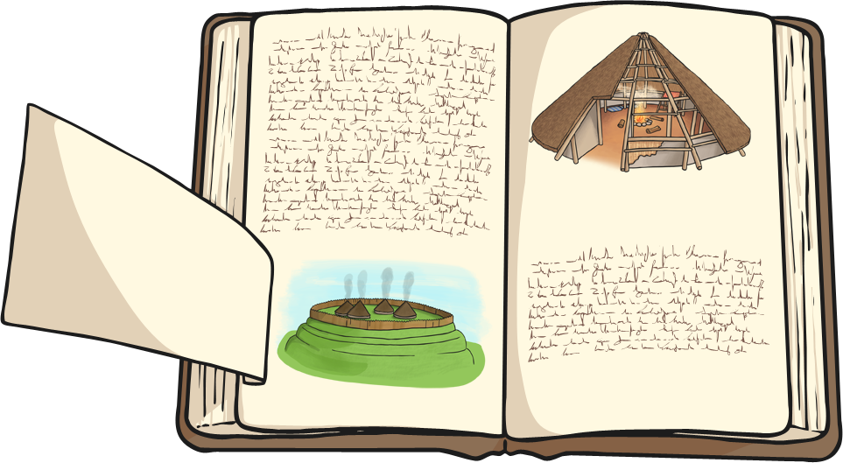
Roman Facts
Education was very important and all children were taught to read and write. Children were taught through fear of being beaten if they got something wrong.

Slide 28
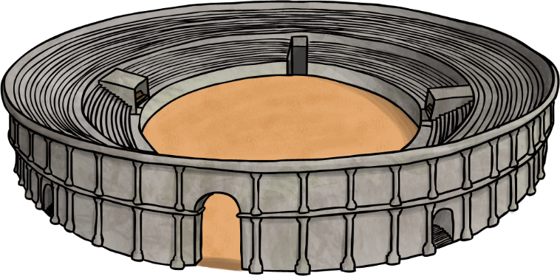
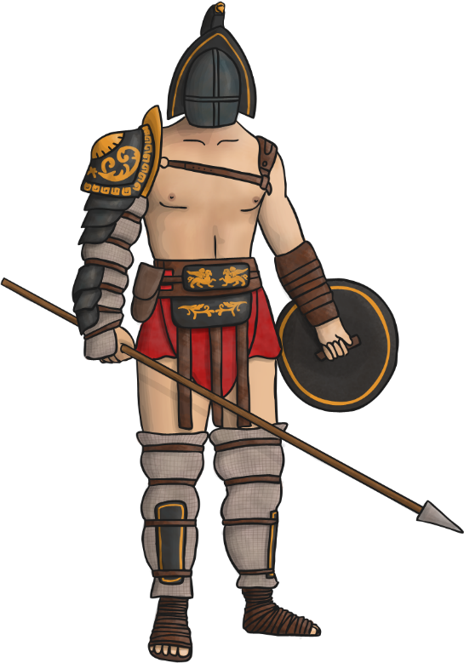
Roman Facts
Gladiators were both professional and amateur fighters. They fought to entertain Roman citizens.
Gladiators would fight each other as well as wild animals, such as lions and bears.

