Slide 1
English 24/02/2021

Slide 2
Reading Activity Please see the next slides for your group`s activity
Let me know if you can`t remember which Reading group you are in
You will need a pencil or pen, and paper

Slide 3
Groups 1 and 2
2Do Purple Mash task
Left and Right
Read the poem and answer Set A questions today
Answer Set B questions on the same poem tomorrow

Slide 4
Group 3
2Do Purple Mash task
Eid 2

Slide 5
Group 4
2Do Purple Mash
Eid 3

Slide 6
Spellings – Group 3
This week`s spellings are all about converting nouns to adjectives by adding suffixes (endings)
Your word list below contains both the noun and adjective
For example danger becomes dangerous by adding -ous
Other nouns remove the vowel first and then add the –ous, such as nerve and nervous

Slide 7
Handwriting and Spellings Group 3

Slide 8
Spelling group 3
Then have a go at Phase 5 and 6 games on
https://www.phonicsplay.co.uk/resources
Or practise, play games and test yourself on Spelling Frame https://spellingframe.co.uk/spelling-rule/16/11-The-suffix-ous-1-of-2

Slide 9
Handwriting + Spellings Group 2
Prefixes are groups of letters that can be added to the beginning of root words. They usually change the meaning of the root word. The focus prefixes for this unit are anti- and sub-.
The prefix anti- means against. The prefix sub- means under or below.

Slide 10
Handwriting and Spellings Group 2

Slide 11
Group 2 Spellings
Then have a play around with the different games and tests on
https://spellingframe.co.uk/
And
https://www.phonicsplay.co.uk/resources

Slide 12
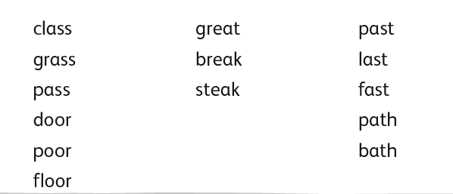
Handwriting + Spellings Group 1

Slide 13
Handwriting + Spellings Group 1
Try the Spelling Frame practise, games and tests on https://spellingframe.co.uk/
Try any of the year groups 1 to 4 including the exception words
Or the Phonics Play website https://www.phonicsplay.co.uk/resources

Slide 14
Handwriting
Use the spelling sheets to practise your handwriting. You will not be able to trace the word, unless you can print the sheets off, but you will be able to copy it.
Practise 3 words per day on lined paper and then have a go at writing sentences with those words in
Remember, it is quality joined writing that we are looking for, with your proper tripod grip
You can also practise other letters and words via https://www.letterjoin.co.uk using the username lj8493 and the password L (capital l)

Slide 15
Grammar
Subordinating conjunctions
Watch the BBC bitesize clip below https://www.bbc.co.uk/bitesize/topics/zwwp8mn/articles/zqk37p3#:~:text=A%20conjunction%20is%20a%20word,because'%20or%20'when'%20.&text=A%20subordinating%20conjunction%20is%20simply,to%20another

Slide 16
Grammar – subordinate conjunctions
Have a go at the 2Do Purple Mash task called
Matching Subordinate Clauses

Slide 17
Writing
LC: Can I note the structure of an explanation text?
Read the following 3 texts on 2Do Purple Mash
How was the Indus Valley discovered?
The Super Solar System!
Ancient Rome
What is the same about all these texts? What are their features?

