Slide 1
English 01/03/2021

Slide 2
Spellings
This week we are focusing on common exception words. These are words that aren`t necessarily spelt how you would think they should be.
Each spelling group have been given their own list of words, but feel free to learn other groups` spellings too!

Slide 3
Handwriting and Spellings Group 3

Slide 4
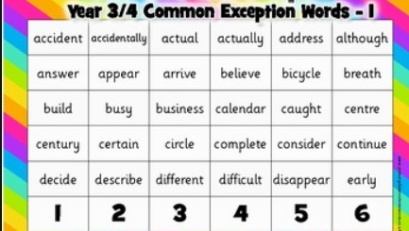
Handwriting and Spellings Group 2

Slide 5
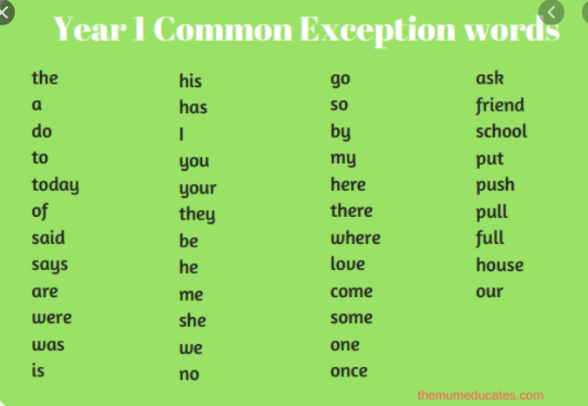
Handwriting + Spellings Group 1

Slide 6
Handwriting
Use the spelling sheets to practise your handwriting. You will not be able to trace the word, unless you can print the sheets off, but you will be able to copy it.
Practise at least 8 words per day on lined paper and then have a go at writing sentences with those words in
Remember, it is quality joined writing that we are looking for, with your proper tripod grip
You can also practise other letters and words via https://www.letterjoin.co.uk using the username lj8493 and the password L (capital l)

Slide 7
Creative Writing
YOUR CHOICE
Write a story of your choice using accurate grammar and punctuation. Can you remember how to write speech properly?
If you need help with an idea, then you can use the next slide`s image

Slide 8
Writing help

