Slide 1
English
Thursday 4th March 2021

Slide 3

Six Reasons to Celebrate World Book Day!
Books make you smarter!
Books are magical and you can visit other worlds and times.
New authors that spark your imagination.
Books are relaxing to read after a long day at school.
You can raise money for charity!
Find a special book and have a “friend” for life.
In the U.K. and Ireland, World Book Day is always held on the first Thursday in March.

Slide 4
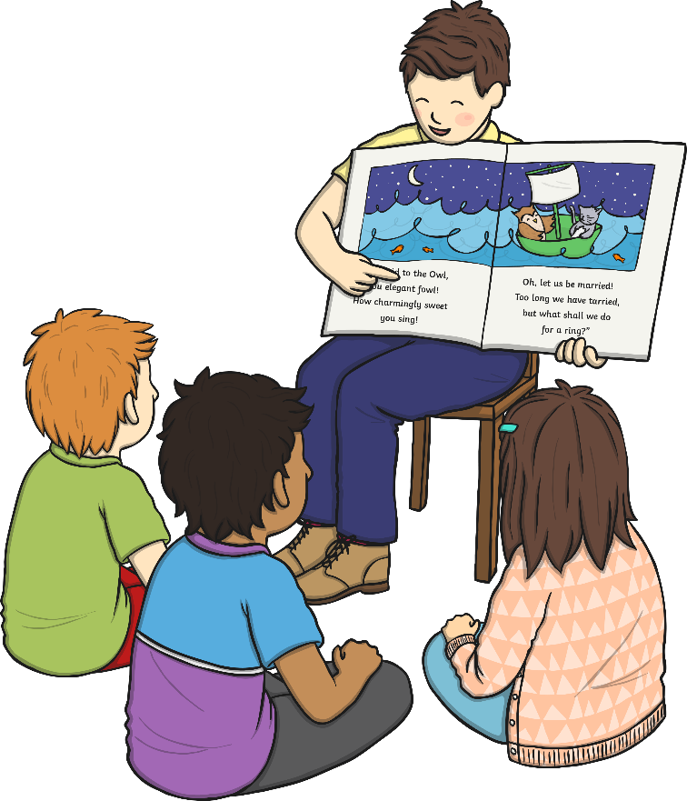
Where to Find Your Next Favorite Book!
There are lots of different ways to find an exciting book:
Ask your teacher about their favorite books.
Ask your parents!
Ask your friends!
Make your own book!
With your parent’s permission, visit websites for more ideas.
Make sure you make time to read today!

Slide 5
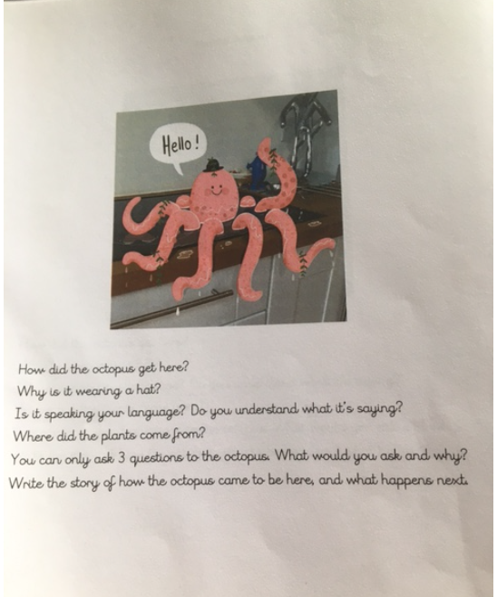
Complete the inference questions on Purple Mash

Slide 6

Go to Purple mash to find the worksheet

Slide 7
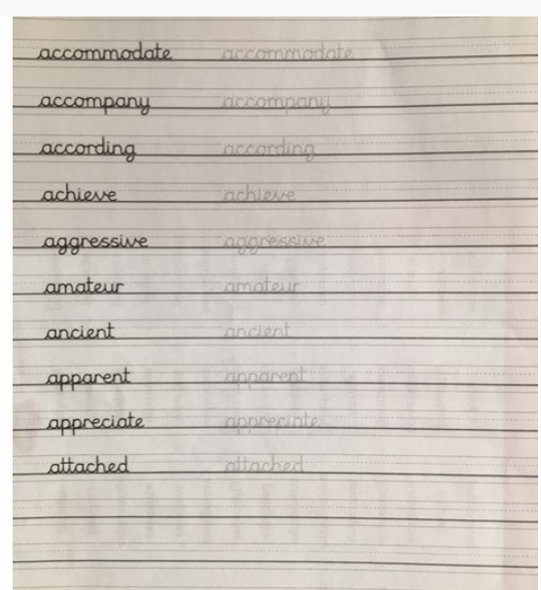
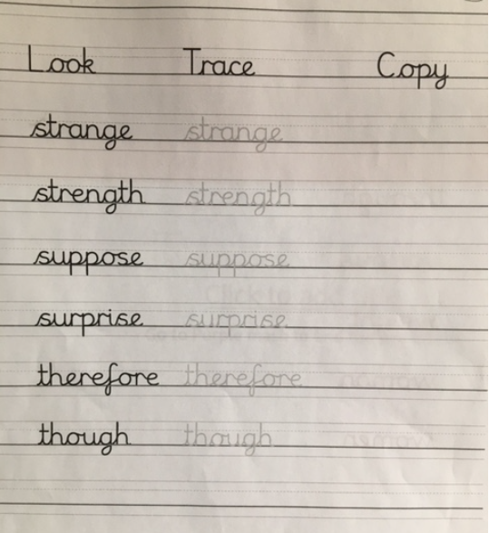
Practise your spellings

