Slide 1
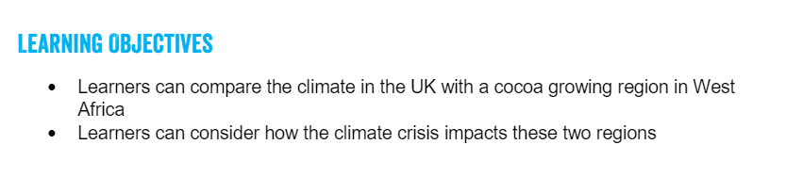
Tuesday 23rd February 2021
You can choose the world you want
Lesson 2
FAIRTRADE FORTNIGHT
22 FEBRUARY – 8 MARCH 2021

Slide 2
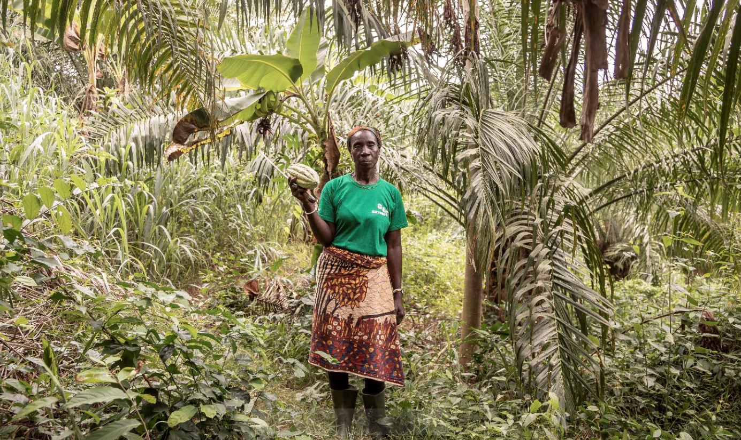
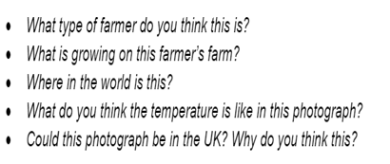
This is a farmer on her farm.

Slide 3
This is Madame Bazoua, a cocoa farmer who lives in the Cote d’Ivoire in West Africa.

Slide 4
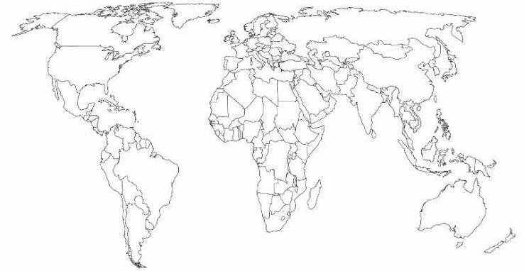
Where does it come from?
We are here!
Tropic of Cancer
Panama
Tropic of Capricorn
Kenya
Côte d'Ivoire
On the next slides you will see products that we eat from around the world. Think about where they come from. They all need to grow in places without cold winters, and more sunshine all year round. They mostly grow in tropical regions.

Slide 5
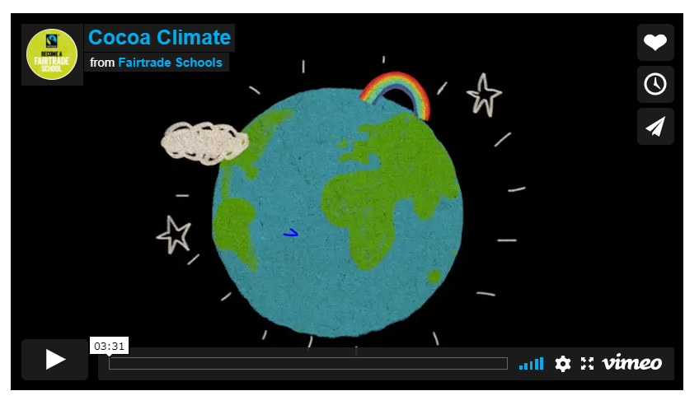
Can I understand different climates in temperate and topical rainforest climates?
Watch the film Cocoa Climate.
What are the similarities and differences between the two climates?
cocoa-climate
Remember to record the types of agriculture in these 2 climates.

Slide 6
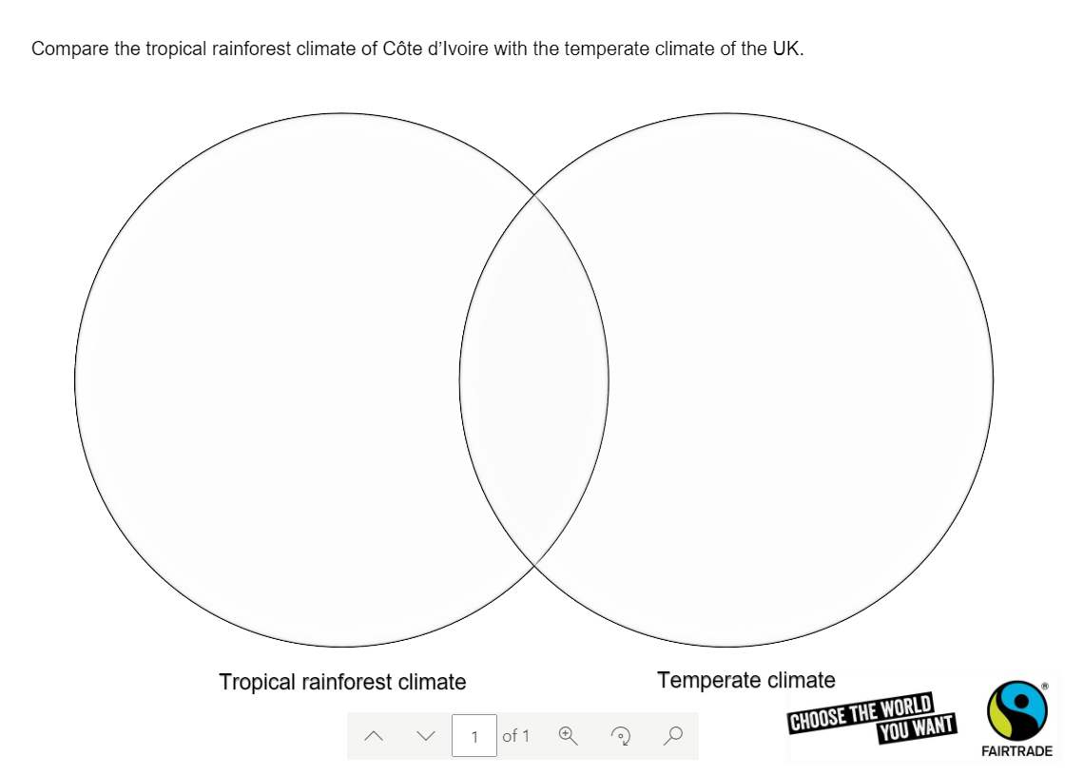
Can I understand different climates in temperate and topical rainforest climates?
What are the similarities and differences between the two climates?
Record your answers on the sheet on Purple Mash
Remember to record the types of agriculture in these 2 climates.

Slide 7

Can I understand different climates in temperate and topical rainforest climates?
Now use a different colour to record the effects of the

