Slide 1
Tuesday 23rd February 2021
You can choose the world you want
Lesson 1
FAIRTRADE FORTNIGHT
22 FEBRUARY – 8 MARCH 2021

Slide 2
You can choose the world you want
Our choices are powerful. Every day we make many choices that touch the lives of other people all over the world. They can help us shape the world we want.

Slide 3
It is Fairtrade Fortnight. This Fairtrade Fortnight we are thinking about what we want the world to be and the ways in which we can make choices to shape the world.
What is ‘a choice’?
Having a choice means the right or possibility of choosing between different things. In your choices, you get to weigh up the good things and bad things about the options. What choices have you made today? Maybe you chose what to have for breakfast. Toast, fruit or cereal, or maybe pancakes? Did you get a choice between your bike and your scooter to travel to school, if you are in school? Maybe you chose an extra ten minutes in bed rather than having a shower! To make good choices we need information about what our choices will mean for us, and what effect they will have on others.

Slide 4
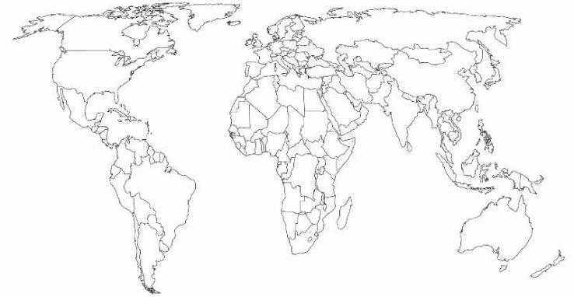
Where does it come from?
We are here!
Tropic of Cancer
Panama
Tropic of Capricorn
Kenya
Côte d'Ivoire
On the next slides you will see products that we eat from around the world. Think about where they come from. They all need to grow in places without cold winters, and more sunshine all year round. They mostly grow in tropical regions.

Slide 5
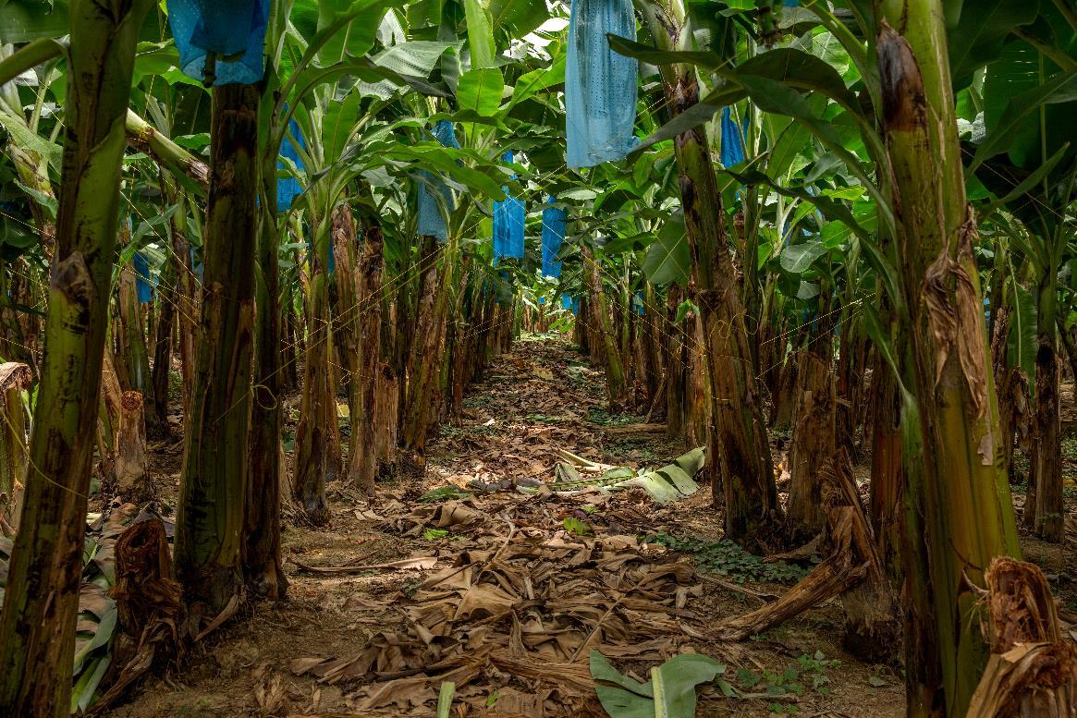
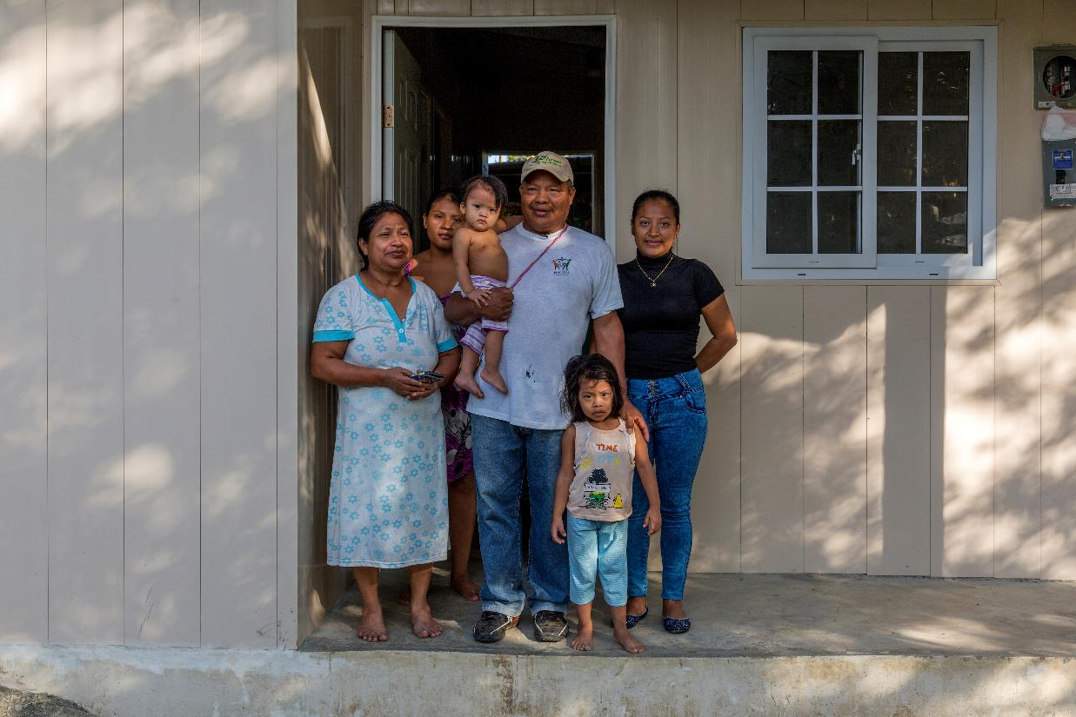
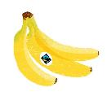
Where does it come from?
Bananas grow in tropical countries. Many bananas we buy come from Central America and the Caribbean. For example, from countries like Panama, where Marcial is a banana farmer. He grows his bananas, with the help of his family on a small plot of land, and relies on the money he makes selling his bananas to support his family. Sometimes this is very difficult.

Slide 6
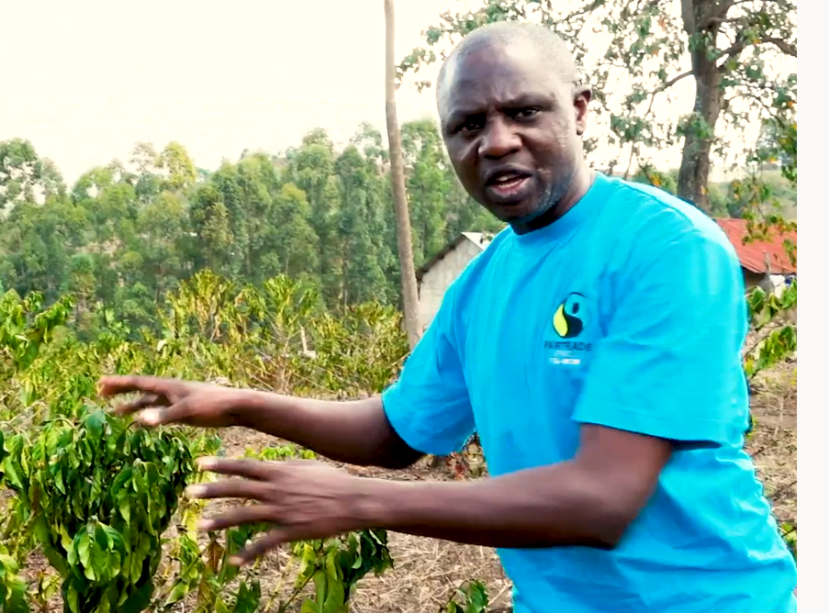
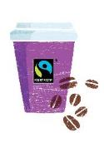
Where does it come from?
Coffee
Coffee needs good warm temperatures to grow, and good rainfall to flower and grow the coffee cherries. If the rain comes at the wrong time, the coffee plants can become too dry and die. Farmers depend on making a good income from their coffee and rely on the weather being right. In Kenya, Bernard is a coffee farmer. He helps train other farms to find ways to protect their crops.

Slide 7
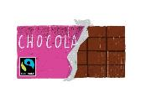
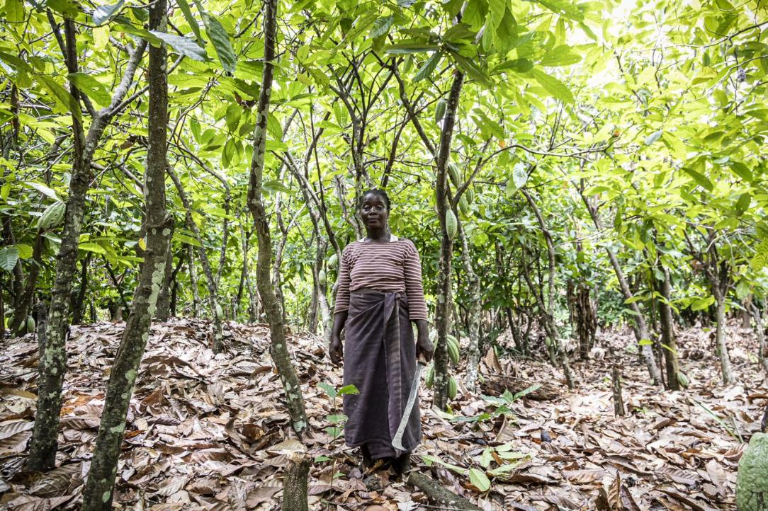
Where does it come from?
Cocoa
Cocoa only grows in tropical forests, where it is very warm and humid, and there is some protection from other types of trees. These cocoa farms are often remote, a long way from towns and cities, and farmers struggle to earn enough money to meet their needs. Farmers like Thérèse. Her village does not even have a road. You can only get to it by foot, motorbike or 4- wheel drive vehicle through the fields.

Slide 8
Your choices make a difference
We buy products grown by farmers like Marcial, Bernard and Thérèse every day. What we choose to by can make a big difference. These 3 farmers are all Fairtrade farmers. This means that if we choose their products, with the Fairtrade Mark, they receive a better deal for their products.

