Slide 1
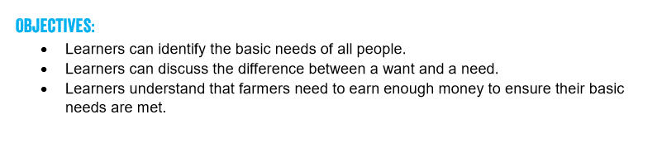
Thursday 4th March 2021
Can I understand the difference between a want and a need?
Lesson 5
FAIRTRADE FORTNIGHT
22 FEBRUARY – 8 MARCH 2021

Slide 2


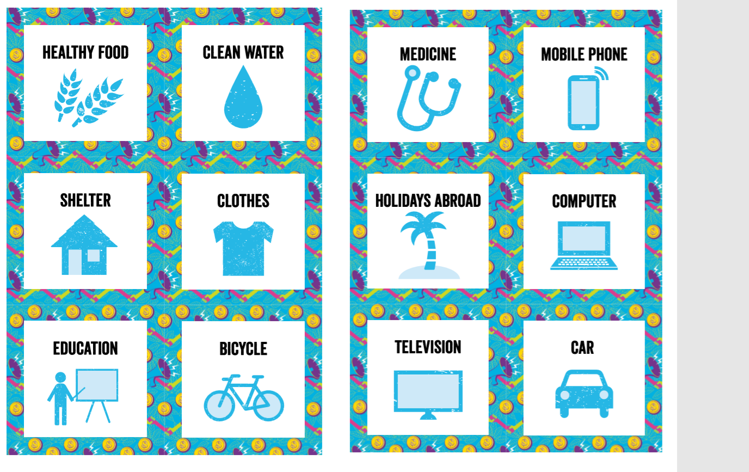
There is a difference between things that a human needs and things that a human wants.
A need is something a person needs to survive and a want is something nice to have.
Divide the cards into wants and needs.
Now make a list of all the things a human needs to live a healthy life.

Slide 3
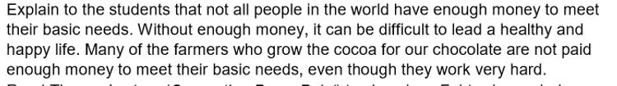
Now think about the importance of earning money.
Which of the cards do you think you would need to pay for?
N

Slide 4
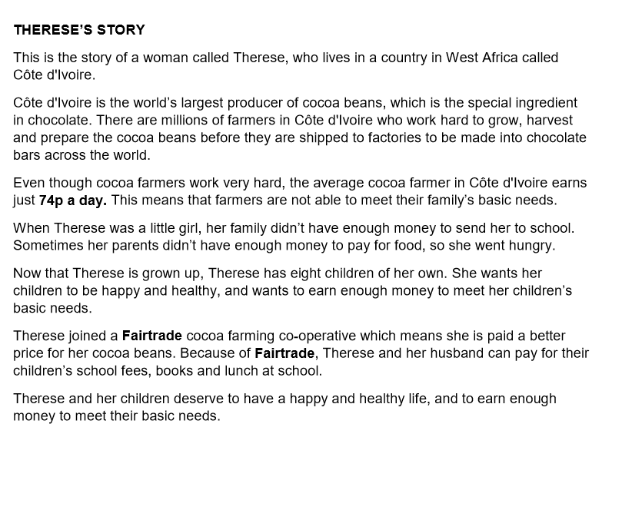
Here is Therese’s story. It shows how Fairtrade can help farmers and workers to meet their basic needs.
Write a paragraph about how important it is to have your basic needs met.
What else can you discover about Fairtrade?

Slide 5
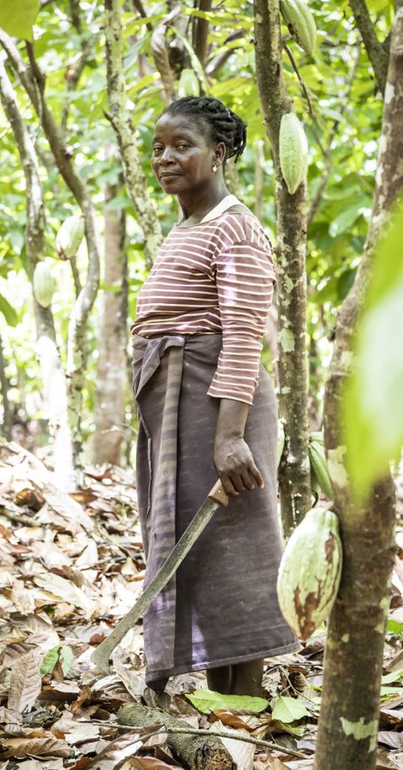
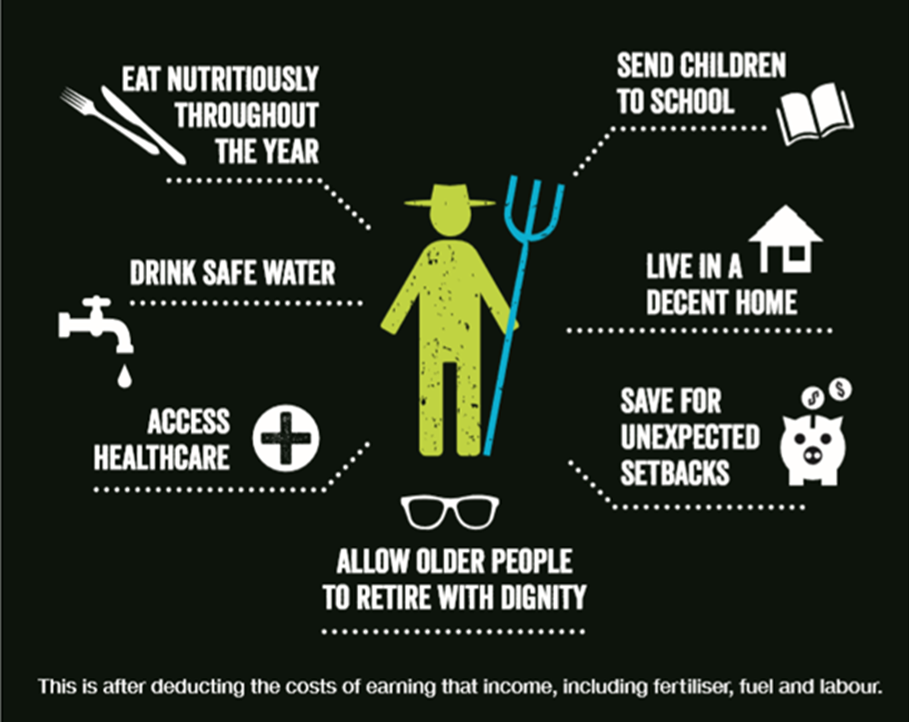
Notes:
These are some of the basic needs that farmers need to pay for. Do you think that it is possible to pay for all of these things with 74p?

